Slide 1
Let’s go to school.
第2课时
WWW.PPT818.COM

Slide 2
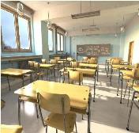
新学期回到学校，再次见到老师和同学，我们可以说：
Nice / Glad to see you again.
你提出建议跟好朋友一块去上学，你可以这样表达：
Let’s go to school.
school
Let’s go to the classroom.
classroom
Revision 复习

Slide 3
你有一辆新自行车，你会跟朋友这样说：
Look! I have a new bike.
你想看一看同学的新自行车，你会说：
Can I see it?
当你递东西给别人时，你应该说：
Here you are.

Slide 4
textbook

Slide 5
storybook

Slide 6
炫
Come on. 来吧，向同学
一下你的新课本或新故事书吧！
Look! I have a new…

Slide 7
Let’s chant.
I have a storybook.
Me too!
I have a textbook.
Me too!
I have a ruler.
Me too!
I have a bag.
Me too!

Slide 9
Thank You.

