Slide 1
Unit 6
I’m watching TV.
Section B 第1课时
WWW.PPT818.COM

Slide 2
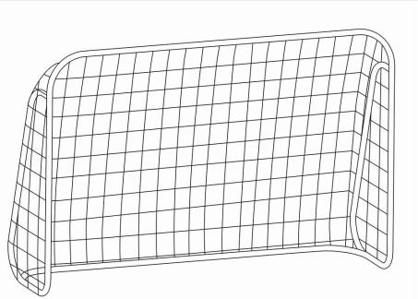
pool
shop
supermarket
man
1
2
3
4

Slide 3
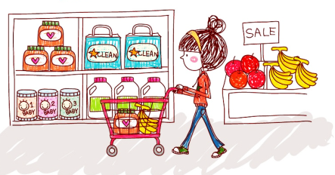
Look and say
What’s she doing?
She’s shopping.
Where is she shopping?
She’s shopping at the supermarket.

Slide 4
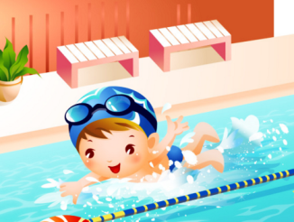
What’s he doing?
________________.
_______is he swimming?
________________________.
He’s swimming
Where
He’s swimming in the pool

Slide 5
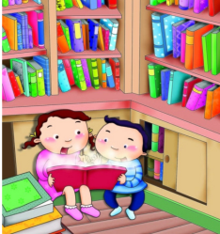
What are they doing?
_______________.
______ ____ they ________?
__________________________.
They are reading
Where
are
reading
They are reading at the library

Slide 6
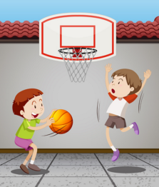
What____ they_______?
They ____________________.
________________________?
________________________________.
are
doing
are playing basketball
Where are they playing
They’re playing basketball at school

Slide 7
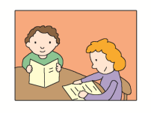
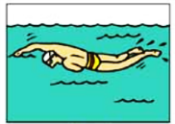
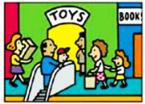
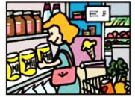
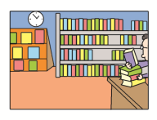
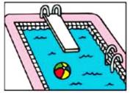
1a
Look at the pictures. Complete the chart.
swimming shopping reading
supermarket library pool

Slide 8
Places | Activities
pool
swimming
supermarket
shopping
library
reading

Slide 9
Look at the pictures in 1a. Then ask and answer questions.
1b
Is the man swimming in a river?
No, he isn’t. He’s swimming in a pool.

Slide 10
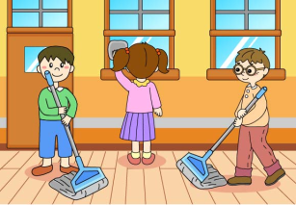
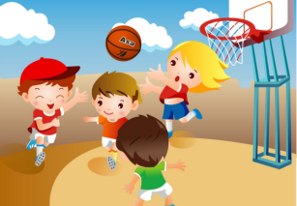
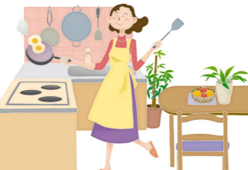
What’s he/she doing?
He / She is…
Where is he/she …?
He/ She’s...

Slide 11
1c
Listen and complete the chart.
Names | Places | Activities
Alice | supermarket
Mike
Lisa

Slide 12
1d
Listen again. Check your answers in 1c.
Names | Places | Activities
Alice | supermarket
Mike
Lisa
shopping (buying milk and bread)
school
playing basketball
library
reading

Slide 13
Tapescripts
Conversation 1
A: Hello. Is Alice there?
B: No, she isn’t. She’s at the supermarket.
A: Oh, is she shopping?
B: Yes, she is. She’s buying milk and bread.

Slide 14
Conversation 2
A: Hello. Is Mike there?
B: Sorry, he’s still at school.
A: Oh. Umm, is he doing his homework?
B: No, he isn’t. He’s playing basketball.

Slide 15
Conversation 3
A: Lisa?
B: No, this is her sister, Julie.
A: Oh. Is Lisa there?
B: No, she isn’t. She’s at the library.
A: Oh. Is she reading?
B: Yes, she is.

Slide 16
Use the information in the chart to make a conversation.
1e
Is Alice playing
basketball?
No, she isn’t. She is shopping in the supermarket.

Slide 17
Names | Places | Activities
Alice | supermarket
Mike
Lisa
shopping (buying milk and bread)
school
playing basketball
library
reading
Is __________________?
Yes, he/she is.
No, he/she isn’t. He/ She is_______.

Slide 18
Exercise
单项选择。
1.Look! The children are swimming in the _____．
A. pool B. restaurant C. zoo D. library
2. —Who's in the room?
—Mr. Smith. He _____ a story.
A. is writing B. Writes C. writing D. writed
3.Some boys are playing _____ basketball.
A. a B. the C. / D. an
A
A
C

Slide 19
4. —Is Paul playing baseball now?
—____. He's playing basketball.
A. Yes, he is B. No, he isn't
C. Yes, he does D. No, he doesn't
5.Three ____ are in the shop.
A. man B. mans C. men D. mens
6. —____you watching TV?
—Yes, I _____．
A. Do, do B. Can, can C. Are, do D. Are, am
B
C
D

Slide 20
汉译英。
1. 你在干什么？ 我在家看电视。
2. 你弟弟在干什么？他在做作业。
3. 汤姆的妈妈在清扫房间。
— What are you doing?
— I’m watching TV at home.
— What is your brother doing?
— He’s doing homework.
Tom’s mother is cleaning room.

