Slide 1
Unit3 Lesson 3
What do you do on Saturday?
WWW.PPT818.COM

Slide 2
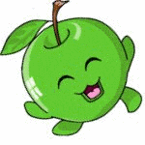
Which one is missing?
Wednesday
Tuesday
Monday
Thursday
Friday

Slide 3
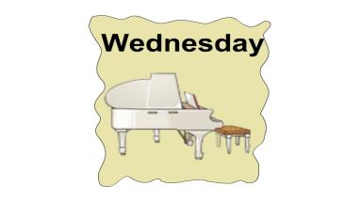
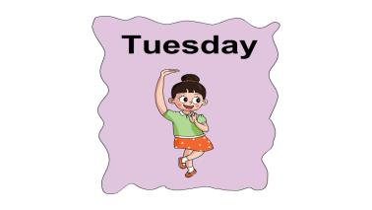
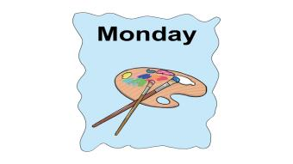
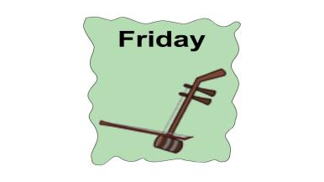
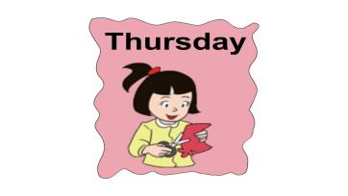
look and say
I like…
I can…on…

Slide 4
come to the text

Slide 5
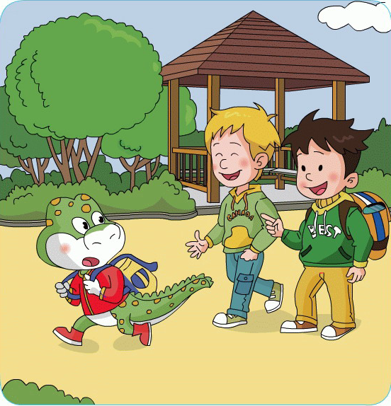
It’s time for school！
Hurry up!
No, it’s ________today.
Saturday

Slide 6
Hurry up ! Run , run !

Slide 7
星期六
Saturday

Slide 8
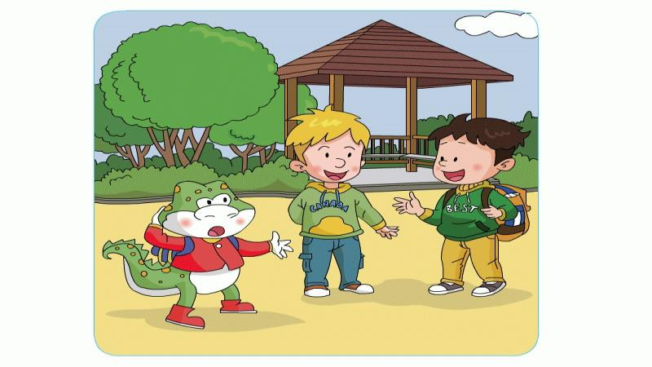
What do you do on Saturday?
play football
We often

Slide 9
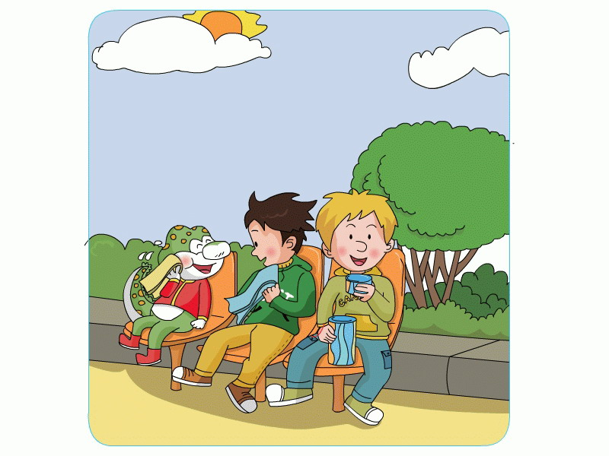
What do you do on Sunday?
I often play the piano.

Slide 10
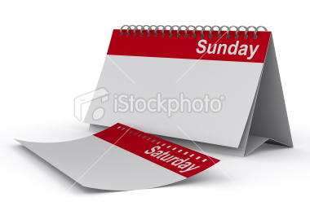
星期日
Sunday

Slide 11
Thursday
Sunday
Friday
Tuesday
Monday
Wednesday
Saturday

Slide 12
Let's read in groups
（小组互相读课文）

Slide 13
Hurry up!
It’s time for school.
Saturday
No! It’s today.
Saturday ?
What do you do on
play football .
We often
Let’s go and play!
OK!
Sunday?
What do you do on
I often play the piano.

Slide 14
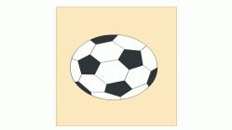
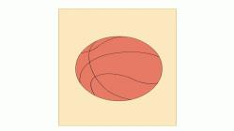
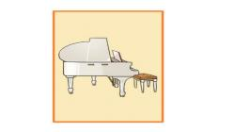
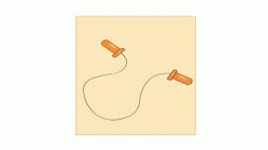
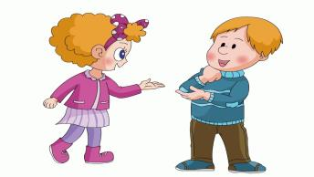
What do you do on Saturday?
I often play football.

Slide 15
Summary
本节课学到的单词有：
hurry up Saturday Sunday
本节课学会运用的句子是：
What do you do on Saturday/Sunday?
I / We often…

Slide 16
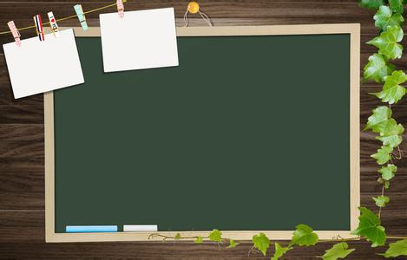
write
Let’s
hurry up
Saturday
Sunday

Slide 17
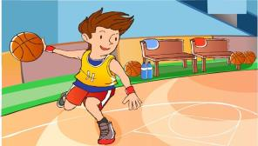
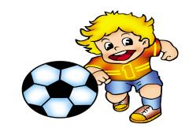
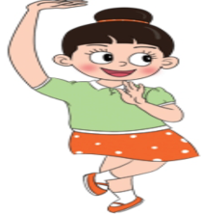
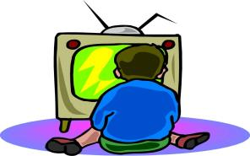
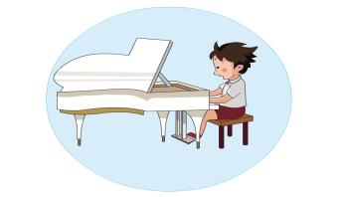
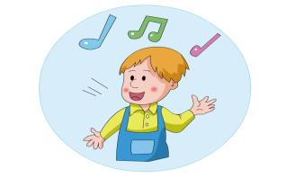
play basketball
play football
dance
watch TV
sing
play the piano

