Slide 1
Unit 7
Intemational charities
Integrated skills
WWW.PPT818.COM

Slide 2
Check the preview
重点词组
为… 提供…
做些义工
联合国
成立于1946年
因为战争
欧洲战争之后
为了…
代替工作
provide … for …
do some voluntary work
(义务的，
志愿的）
the United Nations
be set up in 1946
because of the war
after the war in Europe
so that …
instead of working

Slide 3
World Wide Fund for Nature
Oxfam
World Vision
ORBIS
UNICEF

Slide 4
Let's play a guessing game.

Slide 5
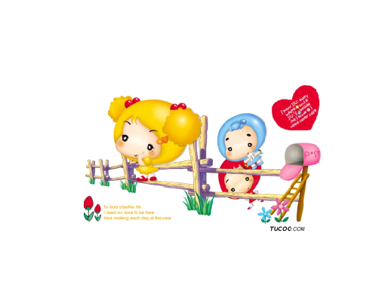
Mrs Black was blind at the age of sixty. Now ten years past, she still can't see anything because she is very poor and has no enough money to go to hospital.

Slide 6
ORBIS
It works to help people who are unable to see.

Slide 7
Some restaurants sell dishes made in rare animals. The animals are protected by laws(法律).

Slide 8
World Wide Fund for Nature
It can protect the wildlife, nature and environment。

Slide 9
Mr Jone is out of work now. The factory he has worked in bankrupted(破产) last month. He and his workmates lost their jobs and they have less and less money to support their families.

Slide 10
It can make our world become fair.

Slide 11
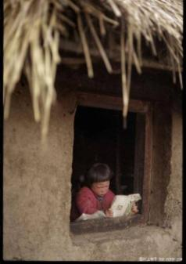
Children in poor areas in Africa don't have enough food or enough houses to live in. They are ill, but they can't go to hospital;they are old enough , but they can't go to school.

Slide 12
UNICEF
It works to provide children with f_______, house, m_______ and education.
ood
edicine

Slide 13
How much do you know about UNICEF?

Slide 14
1. What is UNICEF?
2. When and where was it set?
3. Why was it set up?
4. How many countries and areas does UNICEF work in?
It is part of the United Nations.
It was set up in Europe in 1946.
Because it wanted to help the children whose lives were changed because of the war.
Over190.

Slide 15
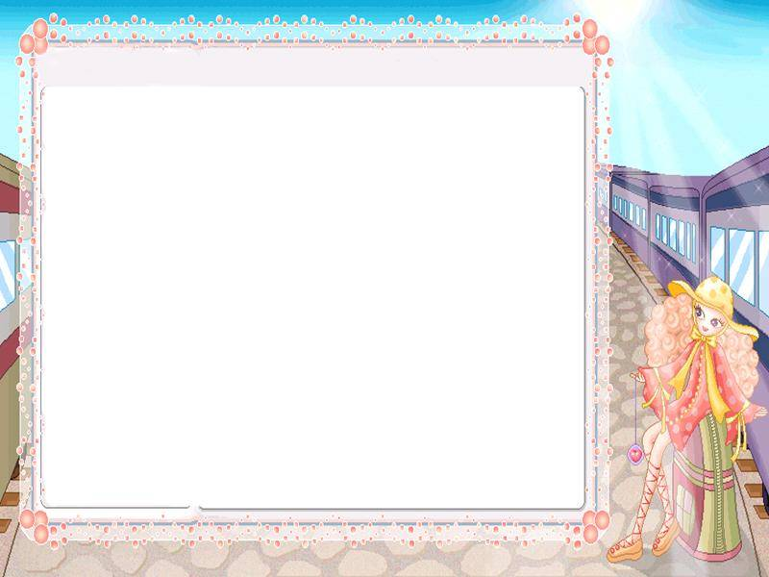
Listen to the tape and finish A2 on page 101.

Slide 16
Ask and answer the following questions in pairs.
When was UNICEF set up?
Why was UNICEF set up?
Where does UNICEF work?
What does UNICEF do to help?
How does UNCEF raise money?

Slide 17
Help to finish A4 on page 102.

Slide 18
Speak up
What’s the matter with the boy?
He has got toothache.
What can the boy do with it?
He can take the medicine after meals three times a day.

Slide 19
Speak up
Practice the dialogue in pairs.

Slide 20
Discussion
If you are an editor of Charities Around the World, what do you want to say to people and ask them to do something for charity.

Slide 21
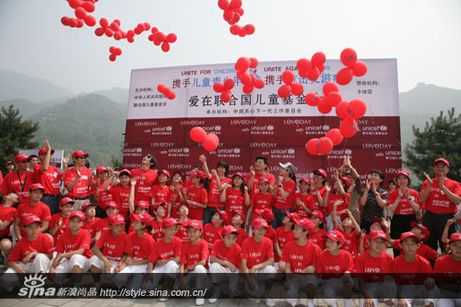
International charities
The world needs love.
UNICEF needs everyone’s help.
Donate your love to the people in need.
Let love fly Life is equal

Slide 22
International charities
Homework
1. Go over the content in this lesson.
2. Finish the exercises in the workbook.

