Slide 1
Unit 6 Plan for the Summer Get ready for a new school life!
WWW.PPT818.COM

Slide 2
Reading aims:
1.能通过阅读，理解文本的大体意思。
2.能听懂、会说、认读单词和词组：get ready, middle school, life, trip,term,miss,more,exciting；并能听懂、会说、认读句型：Everyone is getting ready for middle school life. I'll miss my friends.
3.能够灵活运用所学知识谈自己在这个暑假中打算怎样为新假期作准备，并讲明原因。

Slide 3
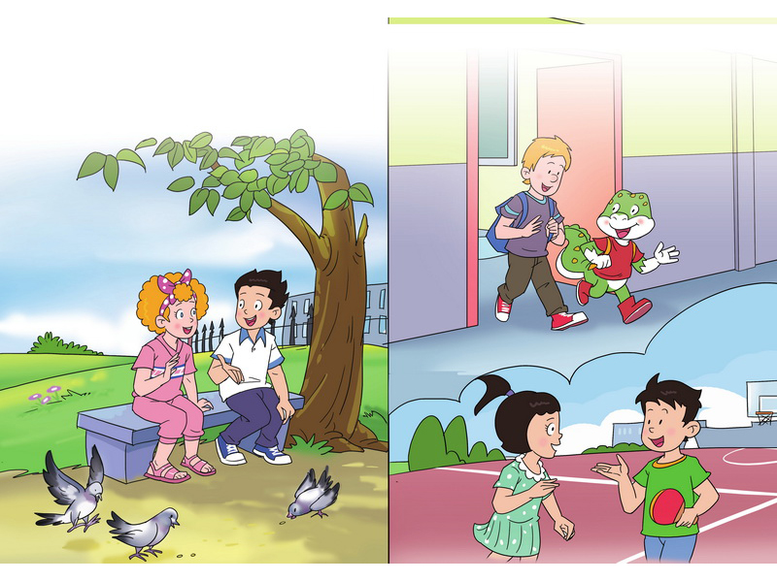
Plan for the summer

Slide 4
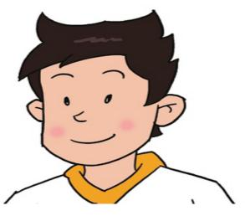
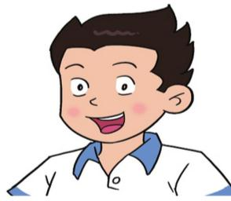

Slide 5
Read and answer.
(快速默读文本，试着划出下面问题的答案。)
1.Is this summer holiday different? Why？
Yes.
Everyone is getting ready for
middle school life.
get ready

Slide 6
iddle
r
life
m
school
different middle schools

Slide 7
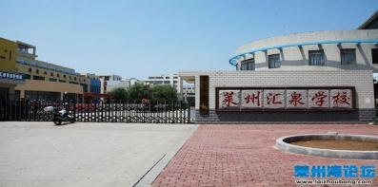
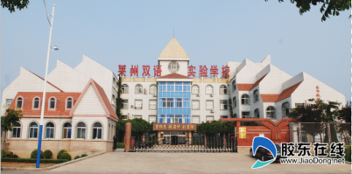
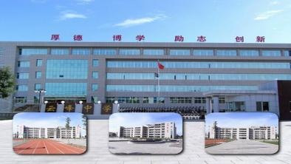
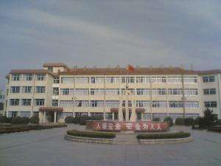
莱州市汇泉学校
莱州市双语学校
different middle schools
莱州市云峰中学
莱州市实验中学

Slide 8
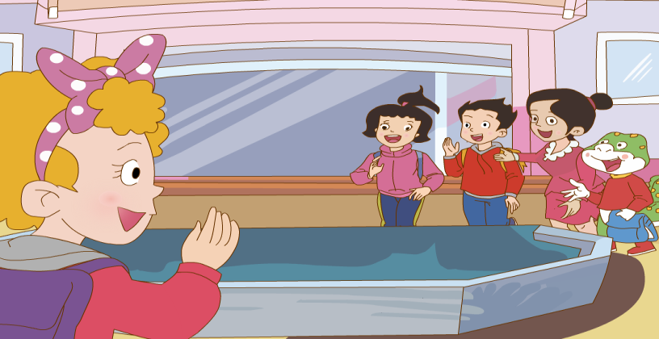
Goodbye, teachers and friends!
Goodbye, Jenny!
Goodbye, Jenny!

Slide 9
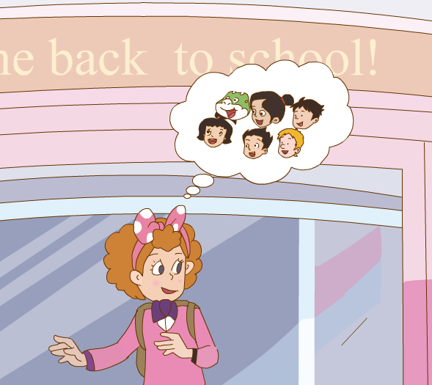
miss
Miss Zhang
I will my school. I will miss my teachers. I will miss my friends, too.
sad

Slide 10
Get ready for a new school life!
Name | Feelings | Why
Guo Yang
Jenny
miss her shcool, teacher and friends
sad
Li Ming

Slide 11
Read part 1 &part 3carefully, then answer.
(仔细、大声朗读1、3段，圈出下面问题的答案。)
2. What will Guo Yang do this summer holiday? Why?
3. Will Li Ming be excited? Why?

Slide 12
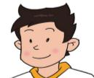
Read part 1 &part 3carefully, then answer.
(仔细、大声朗读1、3段，圈出下面问题的答案。)
2. What will Guo Yang do this summer holiday? Why?
He will travel around the country with his family. He can learn a lot from the trips.
Also, he will take swimming classes. He wants to be a swimming star in middle school!

Slide 13
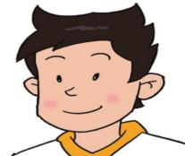
tree
tr
ship
ip
I will travel around the country with my family. I can learn a lot from the trips.

Slide 14
I will travel around the country with his family. I can learn a lot from the trips.
What are the differences from travel and trip?
(Travel 和trip有什么不同呢？)
Notes:
trip 是名词，一般指短时间，短距离的旅行。
travel 既可以做名词，一般指长时间，远距离的旅行；也可以做动词。

Slide 15
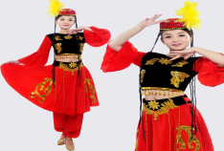
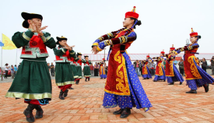
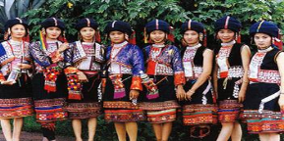
I can from the trips.
learn a lot
Different places different cultures, different places different customs.
(不同的地方有不同的文化，不同的地方有不同的风俗。)

Slide 16
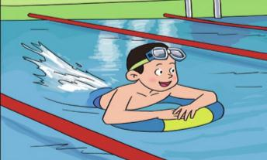
I want to be a swimming star in middle school.

Slide 17
Get ready for a new school life!
Name | Feelings | Why
Guo Yang
Jenny
Li Ming
travel around the country
take swimming classes
happy
sad
miss her shcool, teacher and friends

Slide 18
Read part 1 &part 3carefully, then answer.
(仔细、大声朗读1、3段，圈出下面问题的答案。)
3. Will Li Ming be excited? Why?
Yes, he willl.
It's really exciting to have a new school, new teachers and new friends.

Slide 19
Subjects in primary school
。…

Slide 20
Subjects in middle school
new subjects
。…

Slide 21
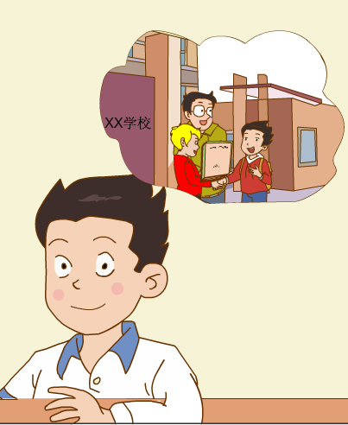
It's really exciting to have a new school, new teachers and new friends.

Slide 22
Get ready for a new school life!
Name | Feelings | Why
Guo Yang |  | travel around the country take swimming classes
happy
Jenny
different
sad
miss her shcool, teacher and friends
Li Ming
have a new school, new teachers and new friends
have new subjects
excited

Slide 23
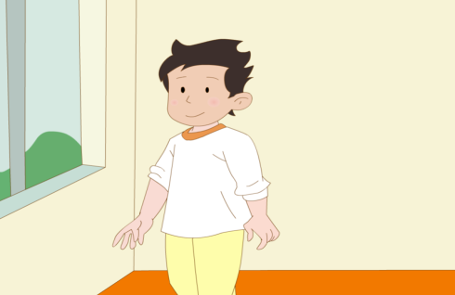
Read the text in groups, then try to retell the story.
(自己读课文，然后试着复述课文。)

Slide 24
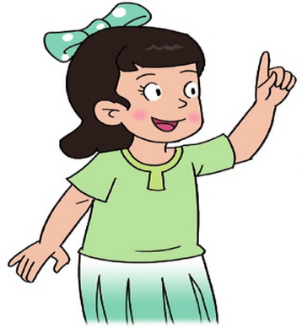
Lily

Slide 25
Read, choose and write.
My Plan for the Summer
Hello, friends! I'm Lily. The summer holiday is coming. I think it's ________. I will go to the library and _________. I'm going to ___________ the country with my family, too. And I will _________________. I want to be a swimming star. Next term we will go to different schools. I have to ___________to my friends. What about you?
travel around
take swimming classes
say goodbye
read books
different

Slide 26
Talk in goups, then show.
My Plan for the Summer
What do you think of this summer holiday? |  | Why?
What will you do? | learn?
 | travel?
 | read? ...

Slide 27
What have we learned today?
(今天我们都学习了什么?)

Slide 28
No pains, no gains.
Try your best, your dreams
will come true.
没有付出，就没有收获。
尽你最大努力, 你的梦想会成真。

Slide 29
Homework:
1. Listen and imitate the text 3 times and try to read it fluently.
2. Talk about your plan for this summer to your parents.

