Slide 1
Unit 6 Movies and Theatre
A Movie or a Play
WWW.PPT818.COM

Slide 2
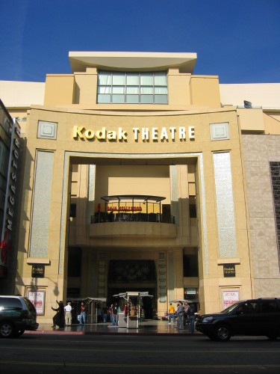
Have you ever been in a theatre?

Slide 3
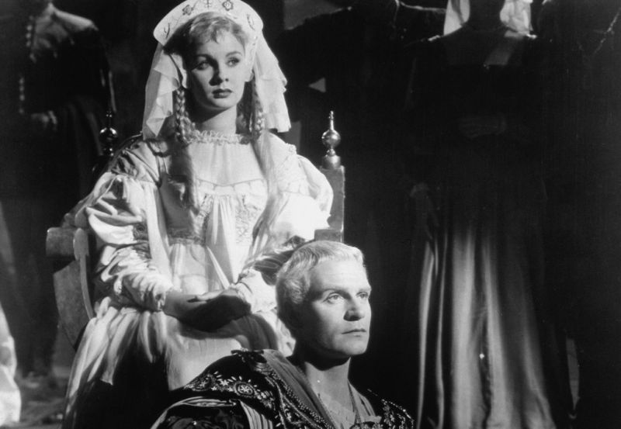
What did you watch?

Slide 4
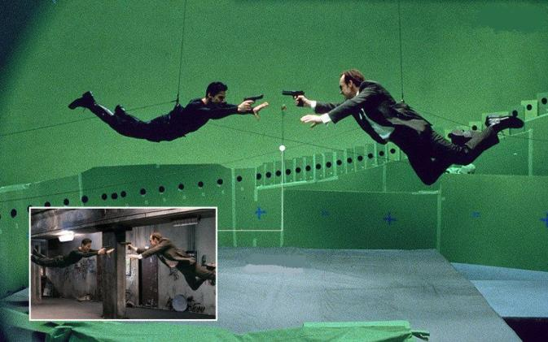
What do you know about making movies?

Slide 5
New words
1. involve v. (使)参加; 包含
2. script n. 剧本
3. director n. 导演; 院长; 校长; 主
任; 负责人
e.g. The director asks the actors to
start acting.
导演要求演员开始表演。

Slide 6
4. costume n. 服装; 戏剧
5. background n. 背景; 背景资料
e.g. Volunteers must have high
education background.
志愿者必须具有较高的教育背景。
6. task n. 任务; 工作
e.g. Can you finish the task quickly?
你能很快完成这项任务吗？

Slide 7
1. Read the lesson and write true
(T) or false (F)
1. Most of the students in Ms. Cox’s
class have been to a theatre before.
( )
T

Slide 8
2. Ms. Cox thinks making a short
movie or a play will interest the
students. ( )
3. We have to take care of lots of
things when making a movie or a
play. ( )
T
T

Slide 9
4. Actors are the people who direct
movies. ( )
5. Some background research is
necessary before making a movie.
( )
F
T

Slide 10
2. Fill in the blanks with the correct
forms of the given words.
singer
sang
1. Do you know that ______? She _____
many songs in the past. (sing/singer)
2. Our English _______ also _______ us
Chinese in our school. (teach/teacher)
3. _______ should be careful when they
______ in the dark. (drive/driver)
teacher
teaches
Drivers
drive

Slide 11
4. James Cameron, a famous _______,
________ Avatar. (direct/director)
5. The director tells the ______ what
to do and how to ____ in the
movie. (act/actor)
director
directed
actors
act

Slide 12
1. Most of you have seen movies or plays
in a theatre, but have you ever been
involved in making a movie or a play?
你们大多数人曾在剧院看过电影或戏
剧, 但你们曾参加拍电影或演戏剧吗?
involve在本句中意思是“使参与; 使卷
入; 牵扯”, 常搭配介词in或with。

Slide 13
e.g. That man likes to get involved in
everything.
那个人事事都爱管。
He became involved with the
accident.
他牵扯进了那次事故。

Slide 14
2. What do you think is needed to
make a movie or a play?
你认为拍电影或演戏需要什么呢?
do you think在本句中可看作是插入语,
因此回答这样的问题时, 要针对特殊疑问
句作答。

Slide 15
e.g. –Where do you think we will have
the meeting?
– Perhaps (we will have it) in our
classroom.
—你认为我们将在哪里开会？
—或许在我们教室里吧。

Slide 16
3. Let’s get to work in groups.
我们分组干起来吧。
本句中work用作名词, to是介词, get
to的意思是“开始; 着手处理”。
e.g. My mother got to worrying about
my health.
我母亲开始担忧起我的健康状况。

Slide 17
get to 还有“到达; 把……送到; 达到; 被……理解”的意思。
e.g. We always get to school on time.
我们总是准时到校。
The bus can get you to the hotel.
那辆公共汽车可以把你送到旅馆。

Slide 18
Where have you got to in the book?
这本书你看到哪儿了？
Your ideas are getting to me.
你的想法我渐渐明白了。

Slide 19
4. Do some research, decide what you
will make then divide up the tasks.
研究一下, 决定要排演什么, 然后分
配任务。
divide up在本句中意思是“分担;
分配; 分享”。
e.g. Tom divided up those apples.
汤姆把那些苹果分(配)了一下。

Slide 21
宾语补足语
宾语补足语是一种补足宾语意义的句子成分。通常置于宾语之后, 用来说明宾语的特征、状态、动作等。常用作宾语补足语的有名词(短语)、形容词、介词短语、不定式、v.-ing形式等。

Slide 22
1. 有些动词可接名词（短语）作宾语补足
语。如：make, call, name, think等。如：
They called their son Jack.
She thinks herself a great pianist.
2. 有些动词可接形容词作宾语补足语。如：
find, make, keep, get, think等。如：
He found his new job very boring.
The soft music makes us comfortable.

Slide 23
3. 有些动词可接介词短语作宾语补足语。如：
find, keep, leave等。如：
He found everything there in good order.
Mom left her handbag on the desk just now.
4. 有些动词可接不定式作宾语补足语。如：
ask, help, tell, advise, want, teach等。如：
He wanted me to go to the movies with him.
The doctor advised me to take more exercise.

Slide 24
在使役动词make, let, have以及感官动词see, feel, hear, watch等之后，作宾语补足语的不定式通常不带to。如：
I’ll let you know as soon as I hear from you.
I heard Zhang Ming sing in the next room.

Slide 25
5. 有些动词可接v.-ing形式作宾语补足语。
这类动词有see, hear, feel, watch等感官动
词以及find, keep等。如：
I saw her chatting with Mary.
She kept me waiting for half an hour.
感官动词后接不带to的不定式作宾语补足
语，表示动作的整个过程；后接v.-ing形
式作宾语补足语，表示动作正在进行。

Slide 26
Exercises
根据汉语意思完成英语句子, 每空一词。
1. 玛丽认为那是一个好主意。
Mary ______________ that __ _____
_____.
2. 锻炼能使你保持健康。
Exercising can keep ____ _______.
thinks / thought a good
idea
you healthy

Slide 27
3. 他发现书在床底下。
He ______ the book ______ ___ ____.
4. 我姐姐每天教我画画。
My sister _______ me ___ ______
every day.
found under the bed
teaches to paint

Slide 28
5. 听! 你能听到李红在唱歌吗？
Listen! Can you ______ Li Hong
________?
6. 我经常看见我妈妈弹钢琴。
I often ____ my mother ____ ____
______.
hear
singing
see play the
piano

Slide 29
PROJECT
HAVE A FILM AND THEATRE FESTIVAL
Divide your class into big groups. Throughout this unit, you will work with the same group to make a movie or a play for this special film and theatre festival.

Slide 30
As a group, choose a topic and brainstorm the main plot.
Decide what each student in the group
will do. You will need:
One or two students to write the script.
One student to be the director.
One student to be the camera person (only
if you’re making a movie).

Slide 31
One student for costumes.
One or two to take care of sound and music.
Three or more actors and actresses.
Make the movie or play and have fun!
Present your movie or play and have a
classroom awards show like the Oscars.

Slide 32
Homework
If you are a director, think about what you want every scene to look like and make some notes and drawings.

