Slide 1
Module 1 Greetings
Unit 2 How are you
WWW.PPT818.COM

Slide 2
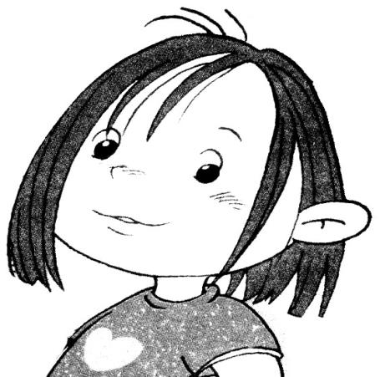
Hello, I’m Amy.

Slide 3
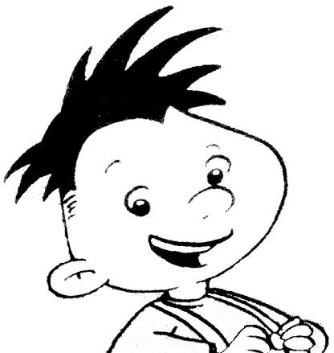
Hello, I’m Daming.

Slide 4
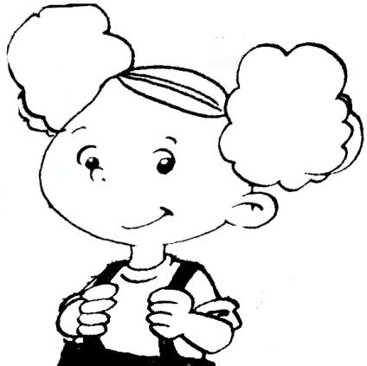
Hi, I’m Amy.

Slide 5
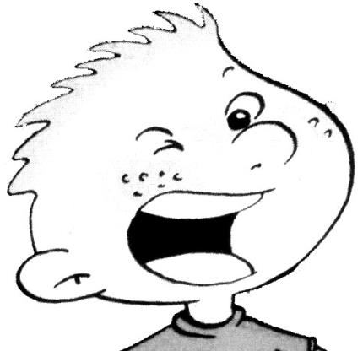
Hi, I’m Sam.

Slide 7
Hello, hello, hi.
Hello, hello, hi.
Goodbye, goodbye, bye-bye.
Goodbye, goodbye, bye.

Slide 8
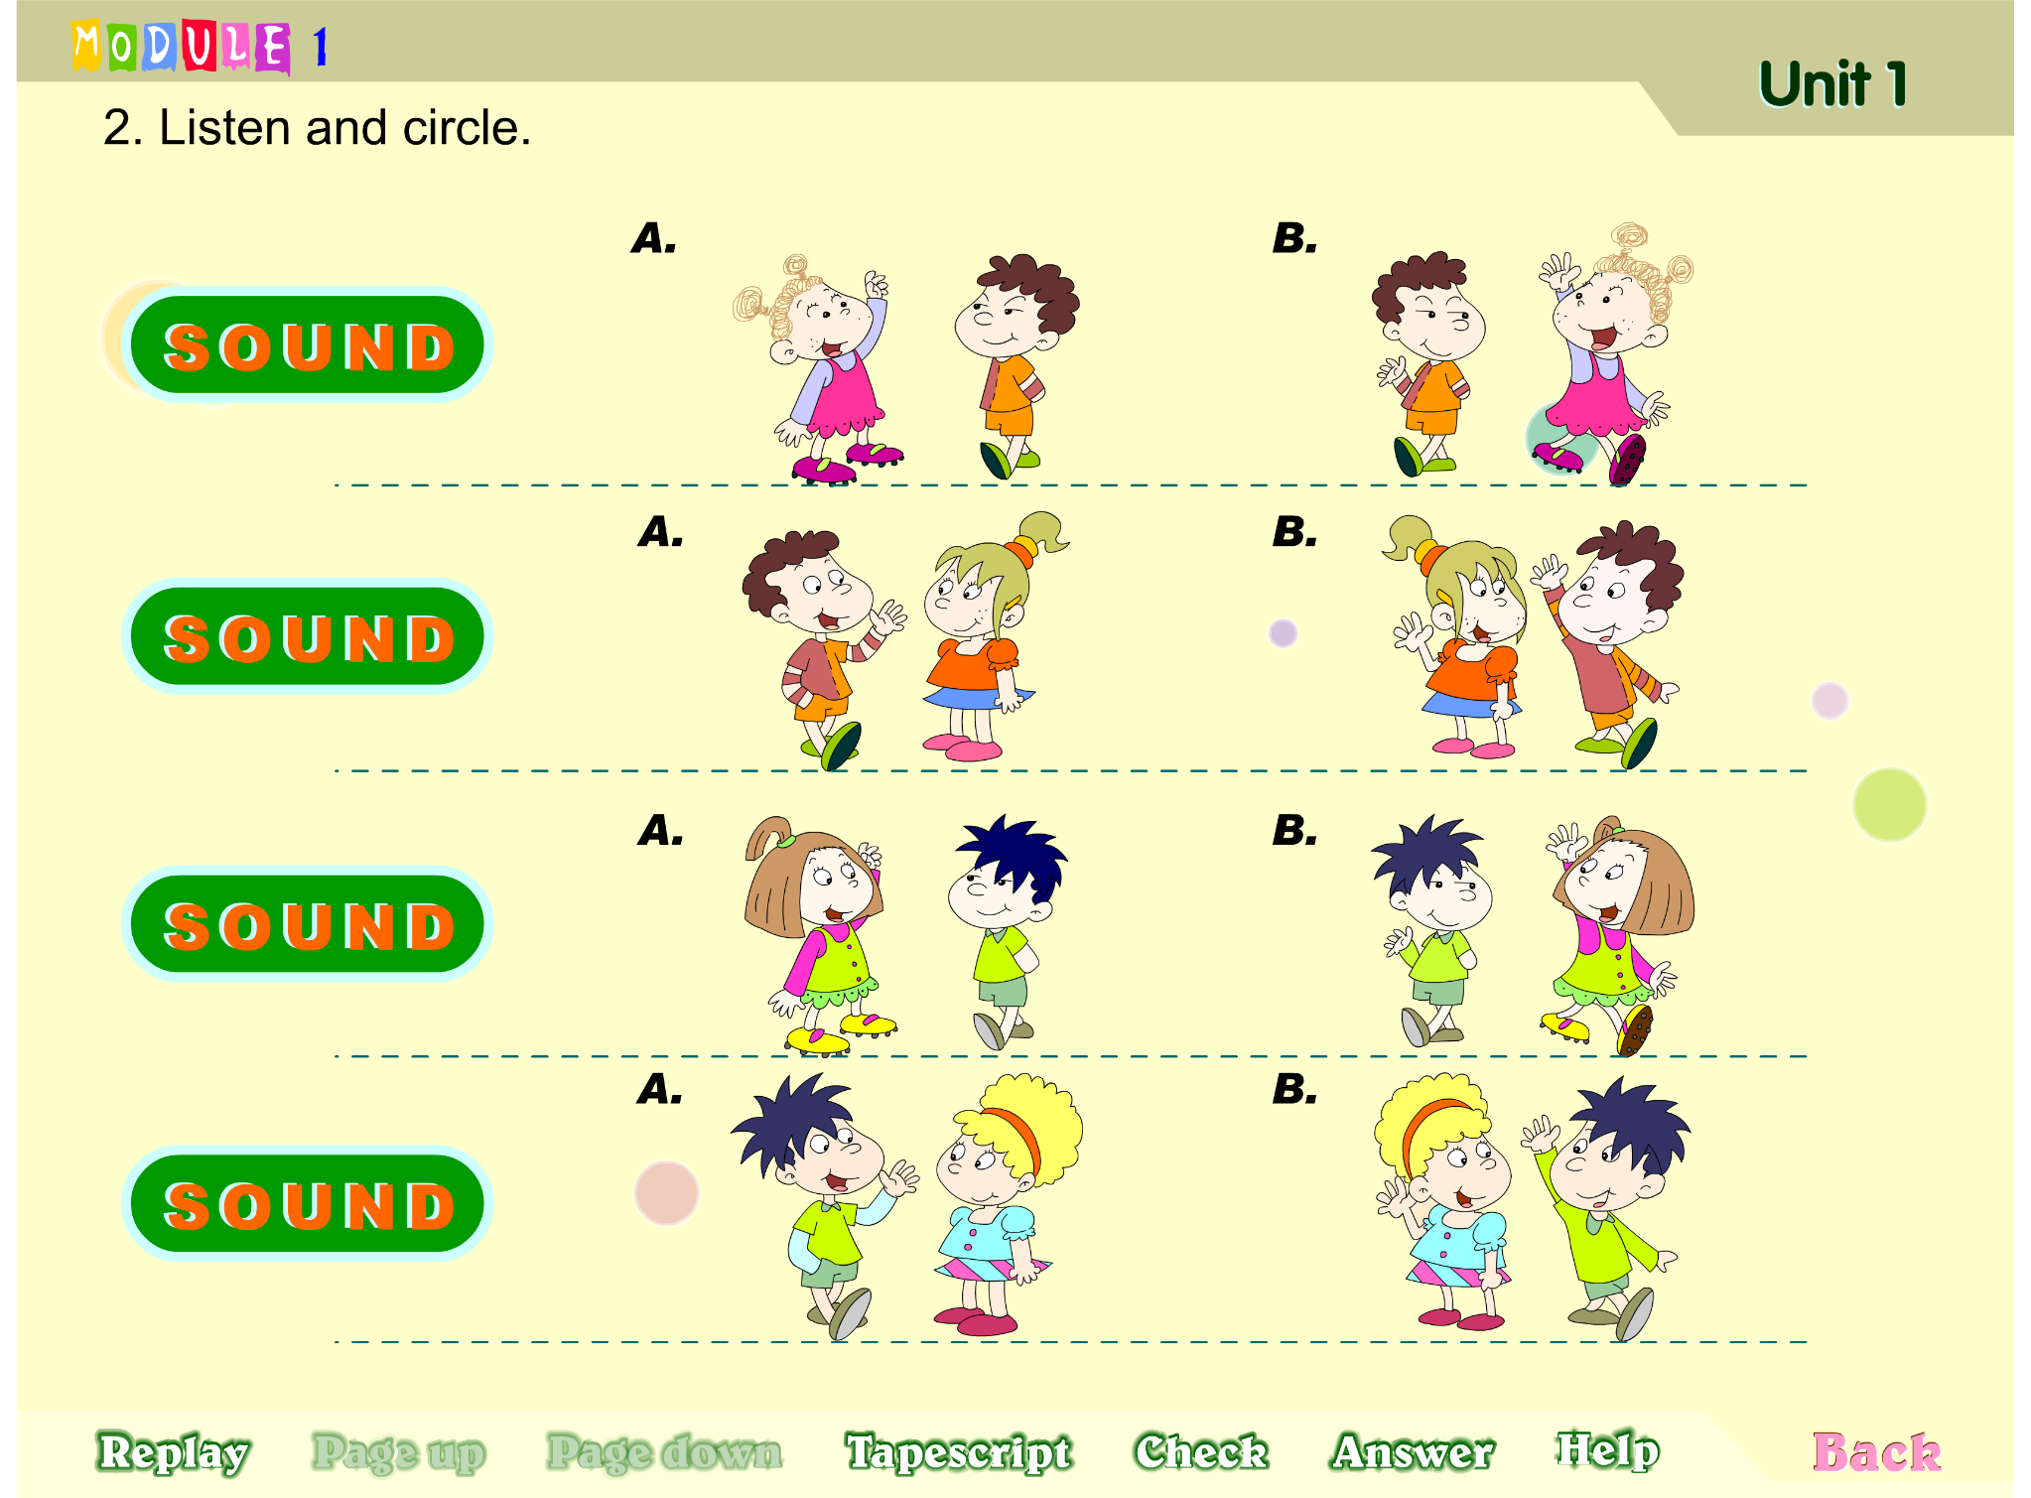

Slide 9
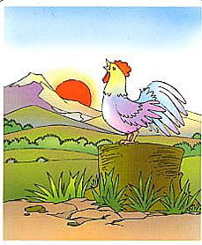
morning
Good morning,
boys and girls.

Slide 10
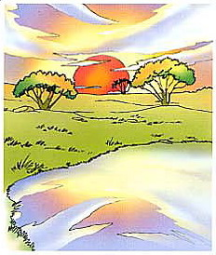
Good afternoon,
boys and girls.
afternoon

Slide 11
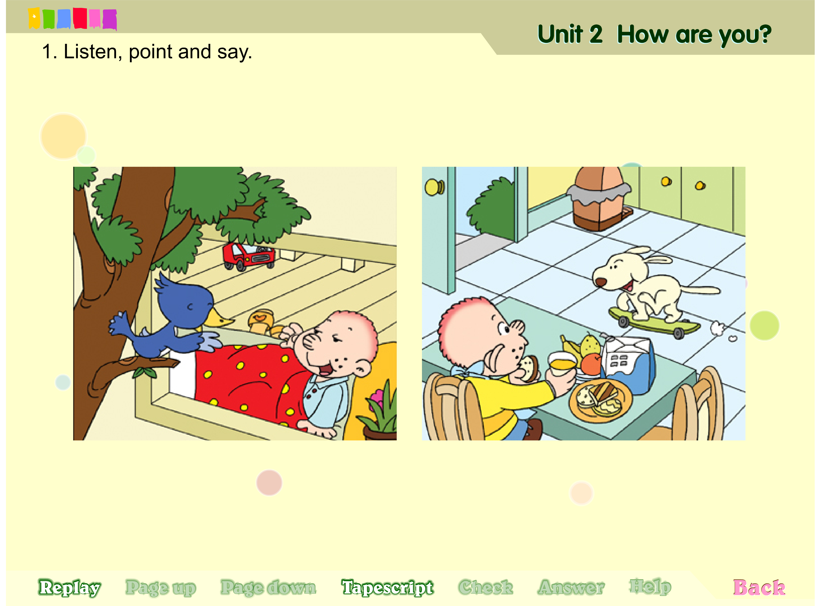

Slide 12
How are you, --- ?
---, 你好吗？
I’m fine, thank you.
我很好， 谢谢你。

Slide 13
Act it out

