Slide 1
Our school in the future
第一课时
WWW.PPT818.COM

Slide 2
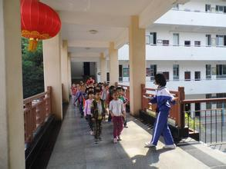
Warm up
Welcome to our school!

Slide 3
Warm up
In the future, what changes would you like to see in our school? Write your wishes down on a piece of paper. Then put your paper in this time box.
Time box

Slide 4
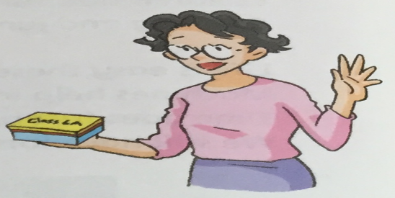
Presentation
Ms Guo has a Time box, too.
What are her students’ wishes?

Slide 5
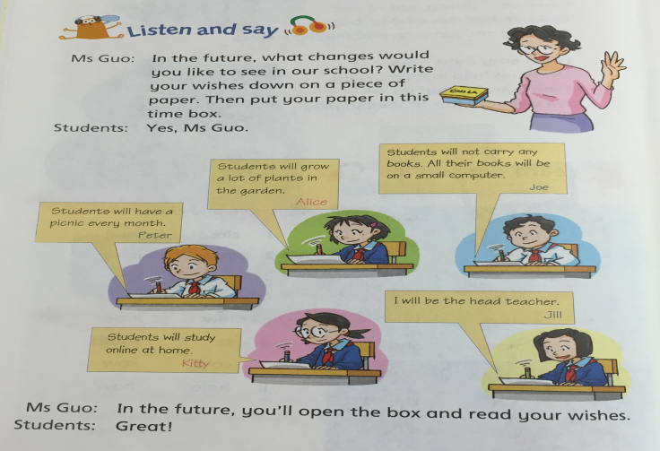
Listen and repeat
P14录音

Slide 6
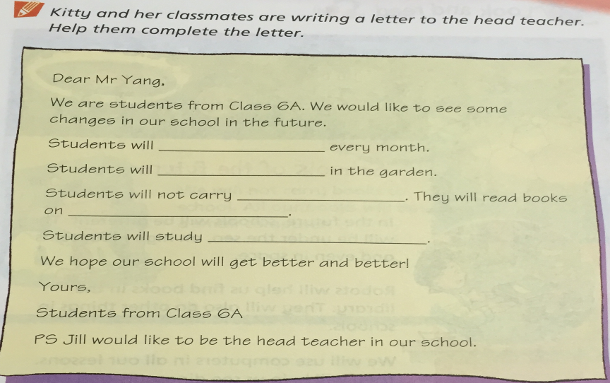
Read and write
have a picnic
grow a lot of plants
any books
a small computer
online at home

Slide 7
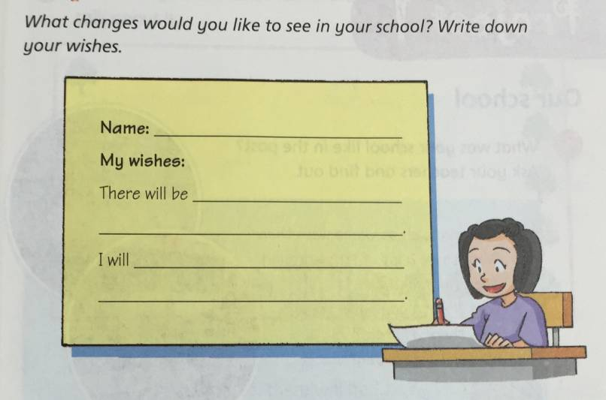
Think and write

Slide 8
Think and write
Time box
In the future, you’ll open the box and read your wishes.

Slide 9
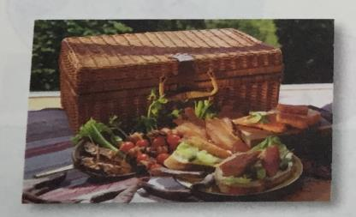
Presentation
have a picnic
Students will have a picnic every month.

Slide 10
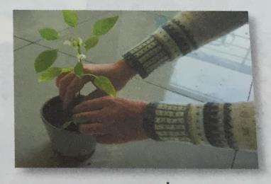
Presentation
grow a plant
Students will grow a lot of plants in the garden.

Slide 11
Practice
What changes would you like to see in our school?
I’d like to have a picnic every month.

Slide 12
Practice
What changes would you like to see in our school?
I’d like to grow a plant in each classroom.

Slide 13
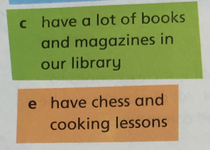
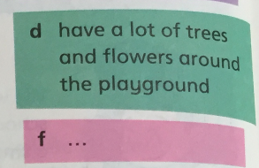
Practice
What changes would you like to see in your school? Do a survey.
Wishes | a | b | c | d | e | f
Number

Slide 14
Summary
本课重点句型：
主语+ will +动词原形 表示将要（发生）……

Slide 15
Homework
P18 Do a survey and give a report.

