Slide 1
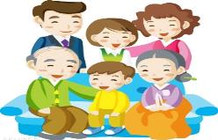
Unit 10
How many people are there in your family?
WWW.PPT818.COM

Slide 2
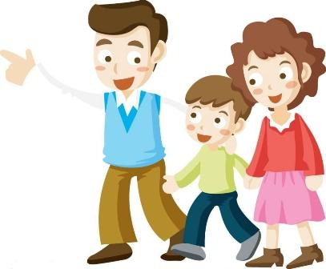
学习关于询问数量句型
How many ... are there ?
回答：There be + 数字
①There are+复数.
②只有一个物品时：
There is one.

Slide 3
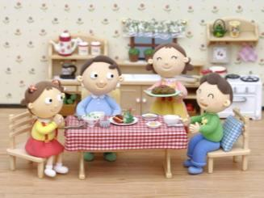
看图回答问题
How many people are there in your family?
There are four.

Slide 4
How many cats are there?
There are six cats.

Slide 5
How many bananas are there?
There are two bananas.

Slide 6
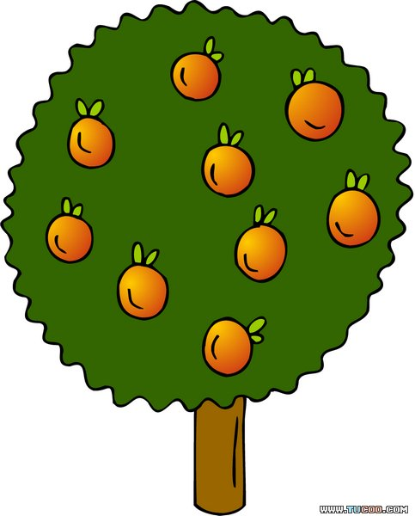
How many oranges are there?
2
3
1
6
4
9
5
7
8
There are nine oranges.

Slide 7
How many pencils are there?
There are eight pencils.

Slide 8
复习家庭成员称谓

Slide 9
brother
sister
aunt
father
Family You
cousin
uncle
mother
grandmother
grandfather

Slide 10
look and listen ,then act out dialogue.

Slide 11
Homework:
1.熟读Unit10的课文。
2.有How many...are there...?说5句话。

