Slide 2
前 言
Entrepreneurial activities differ substantially depending on the type of organization and creativity. Entrepreneurial activities differ Entrepreneurial activities differ substantially depending on the type of

Slide 3
目录
01.单击添加标题
02.单击添加标题
03.单击添加标题
04.单击添加标题

Slide 4
PART ONE
Entrepreneurial activities differ substantially depending on the type of organization and

Slide 5
单击此处添加标题
Click here to add words
儿童教学
Entrepreneurial activities differ substantially depending on the type of organization and creativity. Entrepreneurial activities differ

Slide 6
单击此处添加标题
Click here to add words
Entrepreneurial activities differ substantially depending on theEntrepreneurial activities differ substantially depending on the

Slide 7
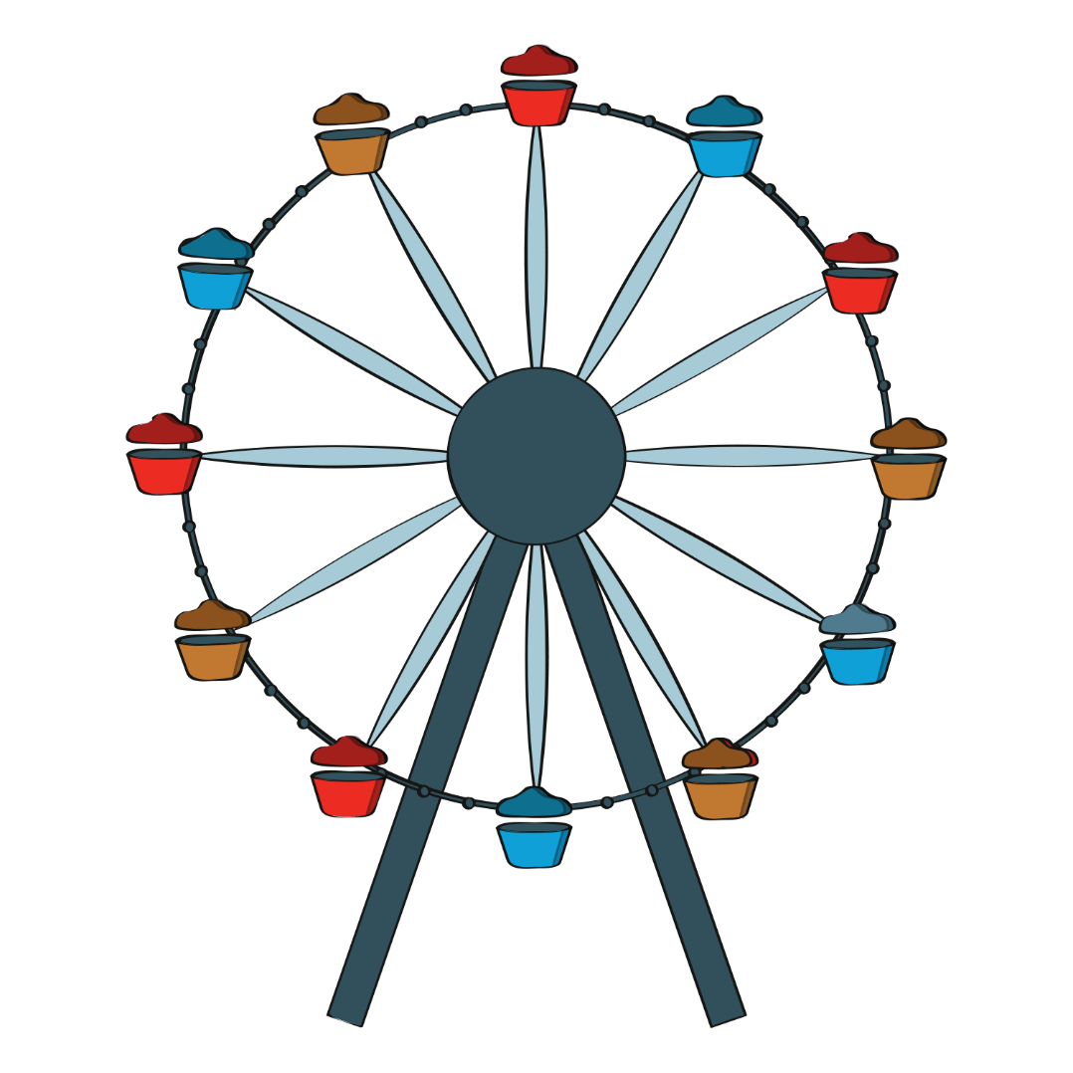
单击此处添加标题
Click here to add words
Entrepreneurial activities differ substantially depending on the

Slide 8
单击此处添加标题
Click here to add words
01
添加标题
Entrepreneurial activities differ substantially
02
添加标题
Entrepreneurial activities differ substantially
03
添加标题
Entrepreneurial activities differ substantially

Slide 9
PART TWO
Entrepreneurial activities differ substantially depending on the type of organization and

Slide 10
单击此处添加标题
Click here to add words
添加标题
Entrepreneurial activities differ substantially
添加标题
Entrepreneurial activities differ substantially
添加标题
Entrepreneurial activities differ substantially

Slide 11
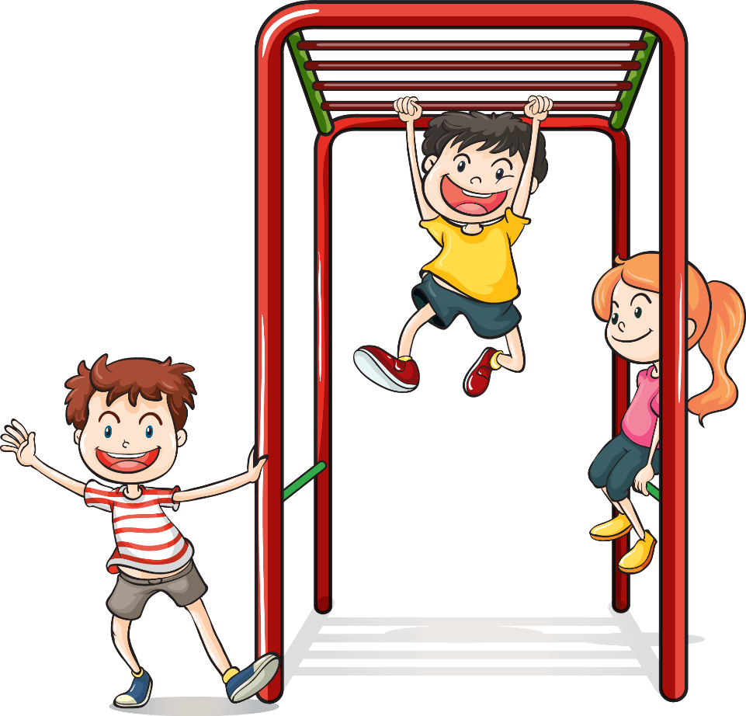
单击此处添加标题
Click here to add words
Entrepreneurial activities differ substantially depending on the type of organization and

Slide 12
单击此处添加标题
Click here to add words
儿童教学
Entrepreneurial activities differ substantially depending on the type of organization and creativity. Entrepreneurial activities differ

Slide 13
PART THREE
Entrepreneurial activities differ substantially depending on the type of organization and

Slide 14
单击此处添加标题
Click here to add words
儿童教学
Entrepreneurial activities differ substantially depending on the type of organization and creativity. Entrepreneurial

Slide 15
单击此处添加标题
Click here to add words
Entrepreneurial activities differ substantially depending on the
Entrepreneurial activities differ substantially depending on the

Slide 16
单击此处添加标题
Click here to add words
儿童教学
Entrepreneurial activities differ substantially depending on the type of organization and creativity. Entrepreneurial activities differ

Slide 17
单击此处添加标题
Click here to add words
儿童教学
Entrepreneurial activities differ substantially depending on the type of organization and creativity. Entrepreneurial activities differ

Slide 18
PART FOUR
Entrepreneurial activities differ substantially depending on the type of organization and

Slide 19
单击此处添加标题
Click here to add words
添加标题
Entrepreneurial activities differ substantially
添加标题
Entrepreneurial activities differ substantially
添加标题
Entrepreneurial activities differ substantially

Slide 20
单击此处添加标题
Click here to add words
Entrepreneurial activities differ substantially depending on theEntrepreneurial activities differ substantially depending on the

Slide 21
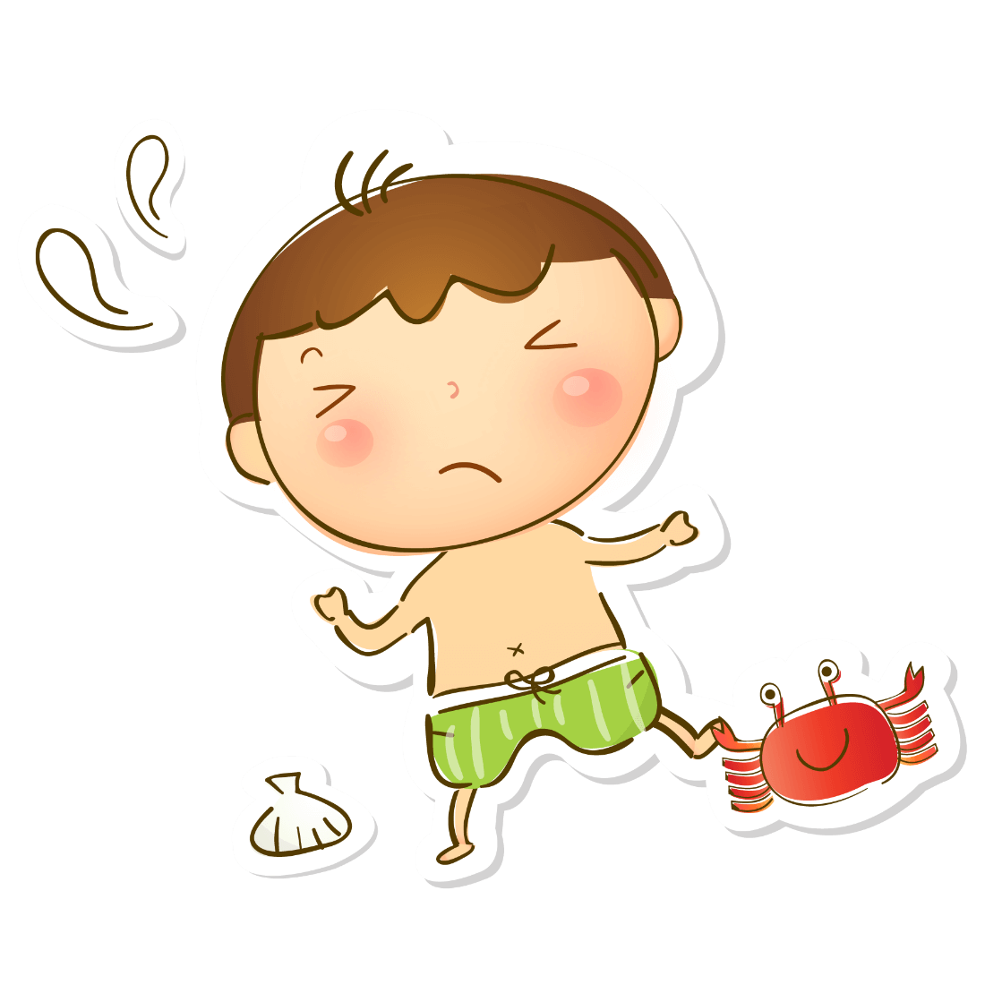
单击此处添加标题
Click here to add words
添加标题
添加标题
Click here to add words
Click here to add words
Click here to add words
Click here to add words
添加标题
添加标题
Click here to add words
Click here to add words
Click here to add words
Click here to add words

Slide 22
谢谢观看！

