Slide 1
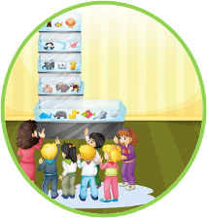
Unit5 Is this your schoolbag?
人教精通版五年级上册
WWW.PPT818.COM

Slide 2
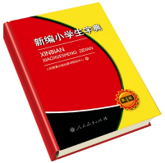
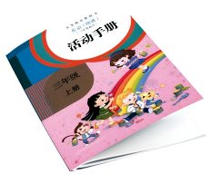
>>Review
Look and say
—Is this your …?
—Yes, it is. / No, it isn’t.
schoolbag
activity book
dictionary

Slide 3
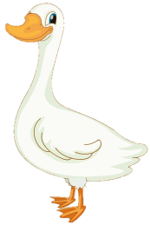
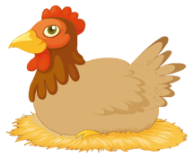
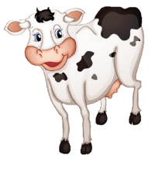
>>Presentation
Let’s learn
What a big farm!
goose
hen
cow

Slide 4
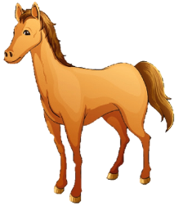
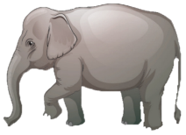
>>Presentation
Let’s learn
What a beautiful zoo!
horse
elephant

Slide 5
>>Presentation
Look and say
What beautiful sea!
fish

Slide 6
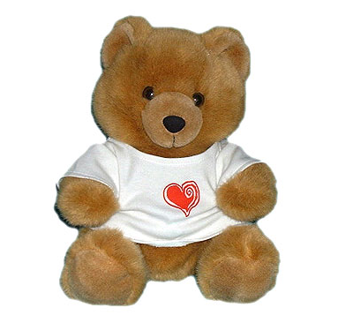
>>Presentation
This is my bear. I made it.

Slide 7
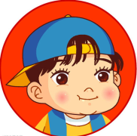
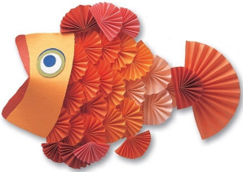
>>Presentation
Is that your fish?
Yes, it is.

Slide 8
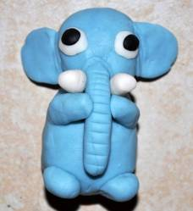
>>Presentation
Is that your elephant?
No, it isn’t.

Slide 9
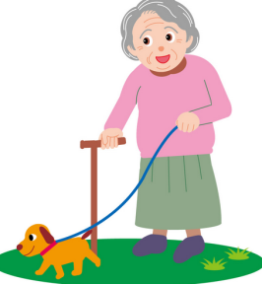
>>Presentation
Is that your
dog?
Yes, it is.

Slide 10
>>Presentation
Is that your
schoolbag?
No, it isn’t.

Slide 11
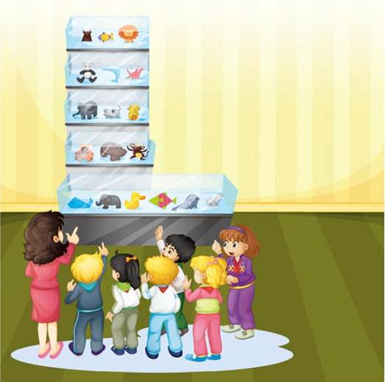
>>Presentation
Look and say
What can you see in this picture? Which animal do you like?

Slide 12
>>Presentation
Just talk
Let’s watch

Slide 13
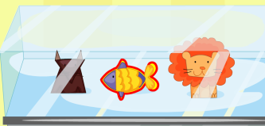
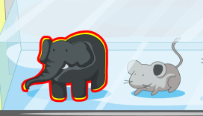
>>Presentation
Read and answer
1. It that Lisa’s fish?
Yes, it is.
2. Is that Peter’s elephant?
No, it isn’t.

Slide 14
>>Presentation
Just talk
Listen and imitate
Teacher: Oh, what a big zoo!
Students: It’s our zoo. We made all the animals.
Kate: Look! This is my bear. I made it.
Teacher: Is that your fish, Lisa?
Lisa: Yes, it is.
Teacher: Is that your elephant, Peter?
Peter: No, it isn’t. Look! This is my elephant.

Slide 15
>>Practice
Read it by yourself for one minute .
自读对话一分钟。
一分钟倒计时
60
Learning tip :
10
10
50
自己读对话，比一比看谁能在一分钟内读完，并且读得准确、流利！
20
20
40
30
30
开始

Slide 16
>>Practice
Show time
小组合作，练习对话并表演，其他同学评价。
Pronunciation (语音) |  | Fluency (流利) | Cooperation (合作)
OK!
Great!
Super!

Slide 17
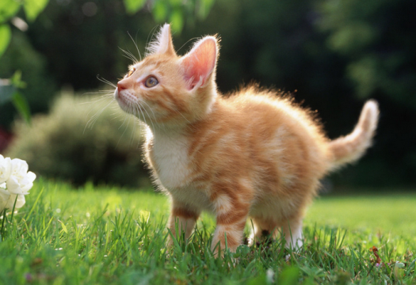
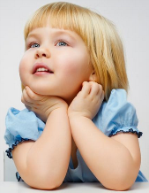
>>Practice
Look and guess
Is that a cat?
Yes, it is.

Slide 18
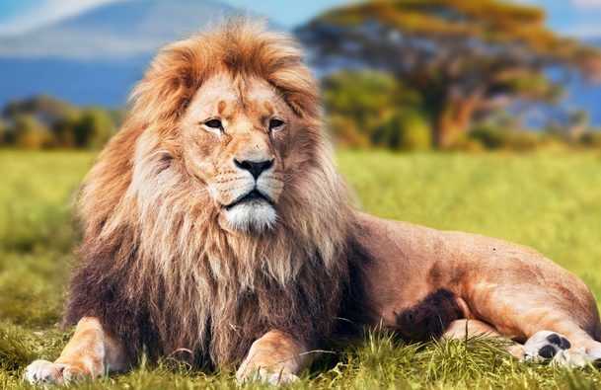
>>Practice
Look and guess
Is that a tiger?
No, it isn’t.

Slide 19
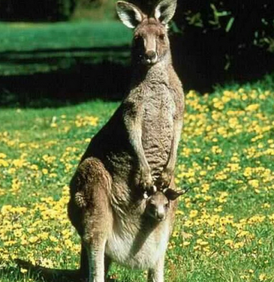
>>Practice
Look and guess
Is that a giraffe?
No, it isn’t.

Slide 20
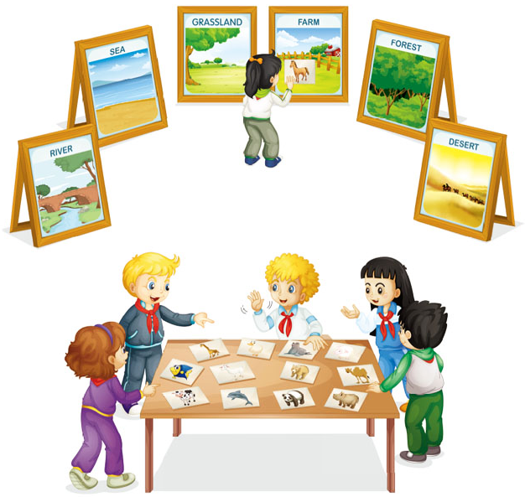
>>Practice
Let’s play
四人一组，合作完成以下任务：1.确认每张动物卡片是谁的？2.确认后把动物卡片按照 river, sea, grassland, farm, forest, desert 分类并摆在正确的背景图上。在合作过程中创设真实情景，学生自然运用英语询问动物卡片的归属并确认。
3
2
Is that your sheep?
No, it isn’t.
1
4
Yes, it is.
Is this your fish?

Slide 21
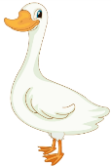
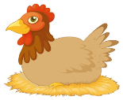
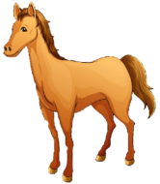
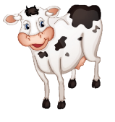
>>Summary
本课的学到的动物类单词有：
fish
goose
hen
horse
elephant
cow

Slide 22
>>Summary
如何询问某物是否属于某人，并作肯定或否定回答？
—Is that your …?
—Yes, it is. / No, it isn’t.

Slide 23
>>Homework
1.观看课文动画，按照正确的语音、语调朗读课文对话。 2.用纸折出或用笔画出你最喜欢的小动物，然后用英文给爸爸妈妈介绍一下它。
3.预习 Lesson 29。

