Slide 1
Unit 4
Don’t eat in class.
R 七年级下册
WWW.PPT818.COM

Slide 2
Lead-in
Do you have any rules at home?
Do you have to do your homework first after school？
Can you watch TV?

Slide 3
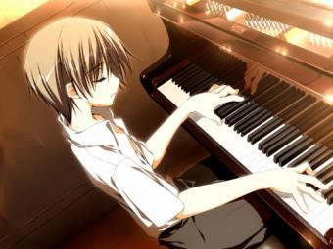
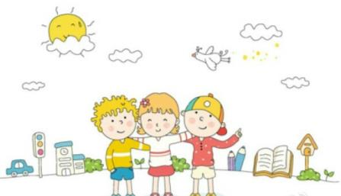
Do you have to play the piano？
Can you play with your friends?

Slide 4
Read the rules in the chart in 1b. Then match the pictures [a-h] with the rules.
1a
___ go out ___ see friends
___ do his homework ___ practice the guitar
___ do the dishes ___ watch TV
___ help his mom make breakfast
___ clean his room

Slide 5
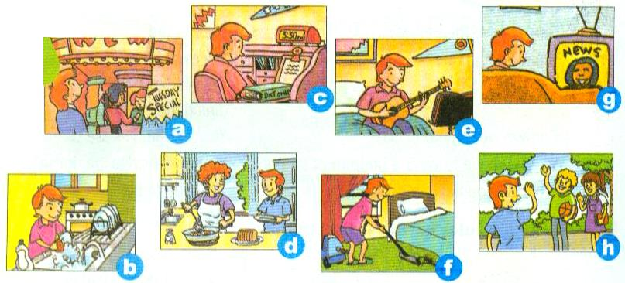

Slide 6
___ go out ___ see friends
___ do his homework ___ practice the guitar
___ do the dishes ___ watch TV
___ help his mom make breakfast
___ clean his room
a
h
c
e
b
g
d
f

Slide 7
Listen and put an × for things Dave can’t do and a√ for things he has to do.
1b
Rules | Can’t (×) | Have to /must (√)
go out
see friends
×
×

Slide 8
do his homework
practice the guitar
do the dishes
watch TV
help his mom make breakfast
clean his room
√
√
√
×
√
√

Slide 9
Listen again. Write when Dave has to follow the rules in the chart in 1b. Choose from the phrases in the box.
1c
on school nights on school days
every Saturday after dinner
before dinner after school
in the evening every morning

Slide 10
Rules | When
go out
see friends
do his homework
practice the guitar
on school nights
on school days
after school
before dinner

Slide 11
do the dishes
watch TV
help his mom make breakfast
clean his room
after dinner
in the evening
every morning
every Saturday

Slide 12
1d
Talk about the rules in Dave’s house.
Can Dave go out on school nights?
No, he can’t.

Slide 13
Can he watch TV in the evening?
No, he can’t.
Does he have to practice the guitar before dinner?
Yes, he does.

Slide 14
Language points
1. help his mom make breakfast 帮他的妈妈做早饭
help sb.(to) do sth. 帮助某人做某事
help sb. with sth.
例: 我帮妈妈做家务。
I help my mom do housework.
=I help my mom with housework.

Slide 15
make breakfast 做早饭
做，制作
make 的多种语意：
make the/one’s bed make tea
make dumplings make friends
make rules make a noise
整理床铺
沏茶
包饺子
交朋友
制订规则
制造噪音

Slide 16
2. on school nights在上学期间的晚上
介词at
泛指在晚上
night
介词on
指具体的某个晚上, 需有其他词修饰
例: 在冬天的晚上
on winter nights

Slide 17
辨析： night与 evening
 | 解释 | 含义 | 对应词
night
evening
一般指从天黑到天明之前的这段时间
夜晚；夜里
day
一般指从傍晚到晚上睡觉之前的这段时间
morning
傍晚；晚上

Slide 18
Exercise
1.You mustn’t play football on the road . (改为祈使句)
_____________ football on the road.
2. Lucy has to wear sports shoes for running .(改为否定句)
Lucy____________ to wear sports shoes for running .
3.I have to clean my room.（对划线提问）
_______ do you have to ______ ?
Don’t play
doesn’t have
What
do

Slide 19
4.She has to do the dishes.（改为一般疑问句）
_______ _______ _______ _______ do the dishes?
5.Run in the hallways. (改为否定句)
______ ______ in the hallways.
Does she have to
Don’t run
A
6. Healthy food and exercise help _____ to study better.
A.us B .we C. our

