Slide 1
Unit 5 I like those shoes
WWW.PPT818.COM

Slide 2
jeans

Slide 3
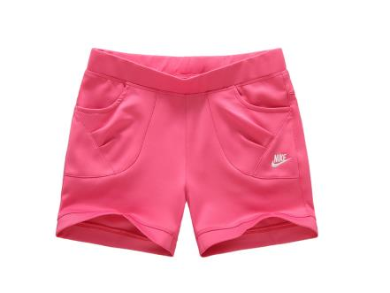
shorts

Slide 4
Can I look at the orange vest and the red skirt?
Here you are.

Slide 5
Can I look at the blue jeans and the green jeans?
Here you are.
我能看一下这条蓝色的牛仔裤和这条绿色的牛仔裤吗？
给你。

Slide 6
知识拓展
look at 看一看
eg：Can I look at it?
我能看一看它吗?
glare at 瞥一眼
eg：Why does she glare at you?
为什么她瞥了你一眼？

Slide 7
颜色看一看
blue 蓝色的
orange 橙色的
red 红色的
green 绿色的

Slide 8
jeans

Slide 9
vest

Slide 10
练一练
( )1.—What are they?—They are________．
A．bus B．jeans
( )2.Look at this vest.It is really ______．
A．cool B．cold
( )3.—Where are my blue jeans?—________！
A．Here it is B．Here they are
( )4.________ my vest.
A．They're B．It's

Slide 11
小朋友回家记得复习功课，并且多读课文，还有不要忘了完成课后练习哦！

