Slide 1
Unit 1 Topic 2
Where are you from?
Section C
WWW.PPT818.COM

Slide 2
Do you know him?
A: Who is he ?
B: He is Li Lianjie.
A: Where is he from?
B: He is from China.
Notes:
2

Slide 3
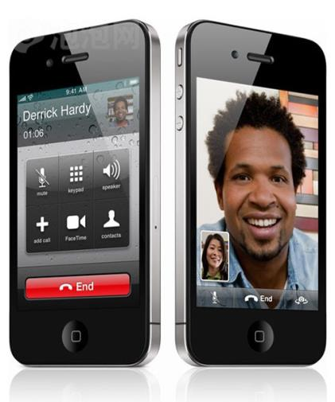
It is my telephone.
My telephone number is
16911467386.
Notes:
3

Slide 4
Numbers in English
three 三
one 一
two 二

Slide 5
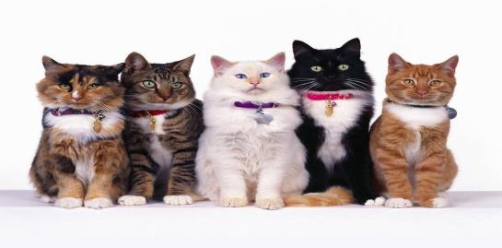
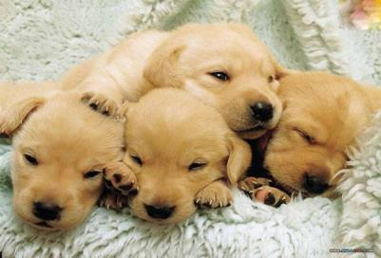
five五
four 四
six 六

Slide 6
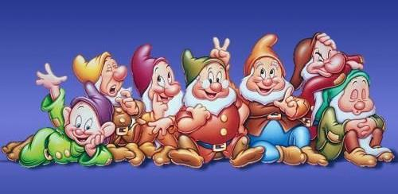
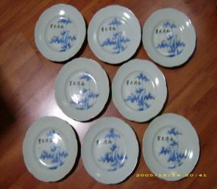
seven 七
nine 九
eight 八

Slide 7
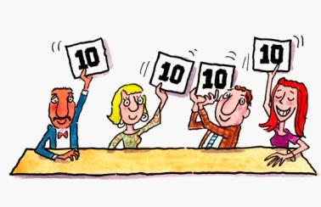
zero零
ten 十

Slide 8
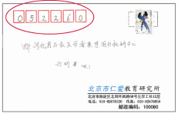
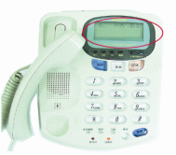
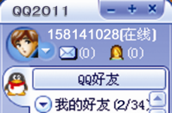
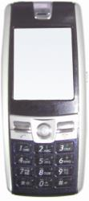
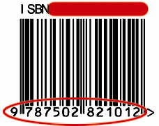
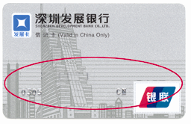
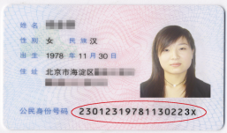
1b
Work alone
Look at the following pictures and read the numbers.
92676929
01092676929
169114
67385
9988 3762 0159 5481

Slide 9
Read these numbers in English
7892052236
3250418961
2780545247
3365949502
1425979954

Slide 10
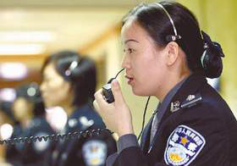
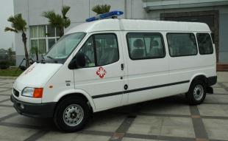
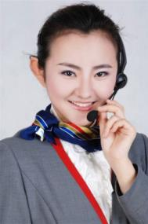
110
120
119
10086

Slide 11
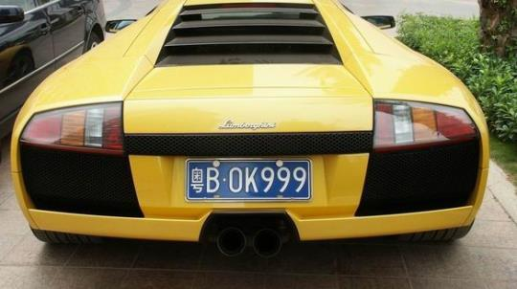
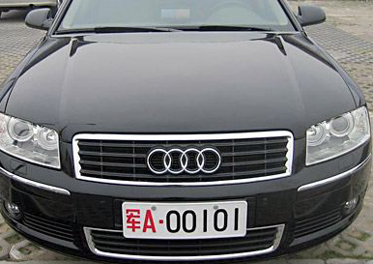
Car number

Slide 12
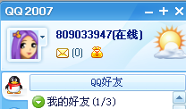
QQ number

Slide 13
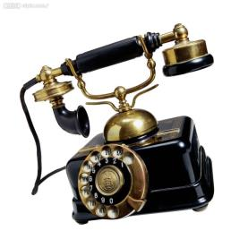
Phone number
0596-3456098
0592-7788432
010-56789341
0597-5634902

Slide 14
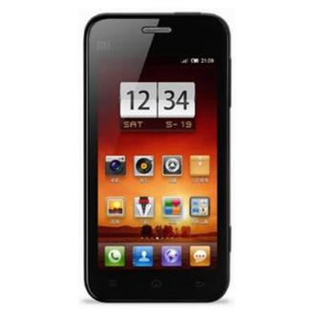
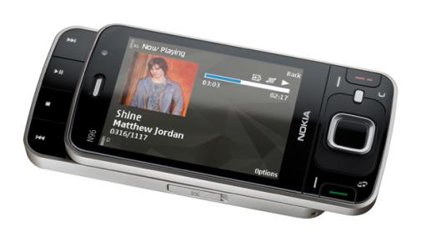
Mobile phone number
13729196971
13553517921
13531133783

Slide 15
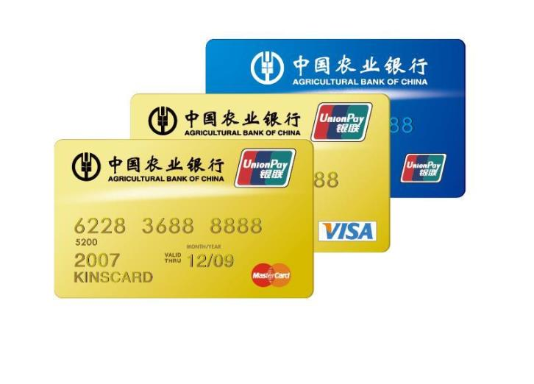
Bank number

Slide 16
3b Ask and answer in pairs. Then complete your partner’s name card.
A: What’s your name?
B: My name is _______.
A: Where are you from?
B: I’m from _______.
A: What’s your telephone number?
B: My telephone number is _______.

Slide 17
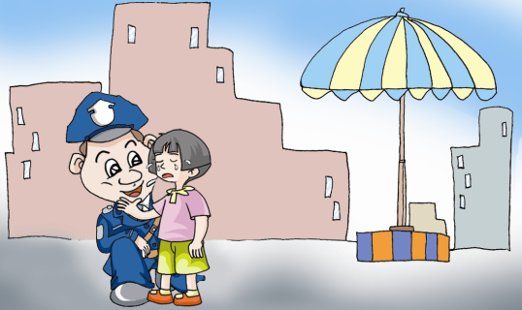
Name: ________________
From: ________________
Tel: ________________

Slide 18
Name card
Name: Alice
From: England
Tel:
776-8858

Slide 19
Name: Tian Liang
From: China
Tel: 8256011

Slide 20
Sum up
1.学习数字0--10。
2.学习如何询问别人的电话号码、名字、国籍及应答。
3.学习制作名片。

Slide 21
Homework
（1）描述自己的真实情况（姓名、国籍和电话号码)，并制作卡片。
（2）找一些电话号码、手机号码、门牌号码、车牌号码、邮编等至少6个，认读并书写。

