Slide 1
What does your mother do?
Unit3 Topic 2
Section A
WWW.PPT818.COM

Slide 2
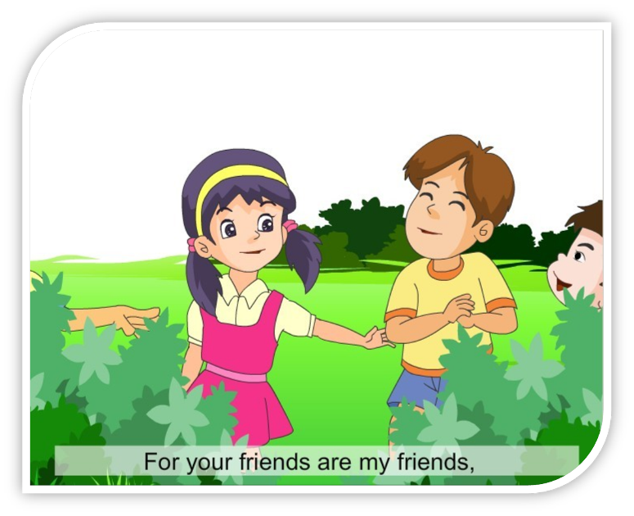
Warming up
Sing a song

Slide 3
Presentation
Look at the picture of the teacher’s family.
Then introduce the family members and their work
Ask and answer .
T: — What does your father do?
Ss: — He is a …. ...
T: — What do I do?
Ss: — You are a teacher.
T: — What do you do?
Ss: — I’m a student.

Slide 4
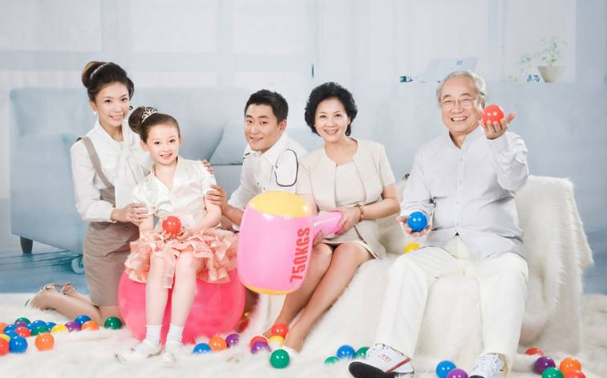
a big family

Slide 5
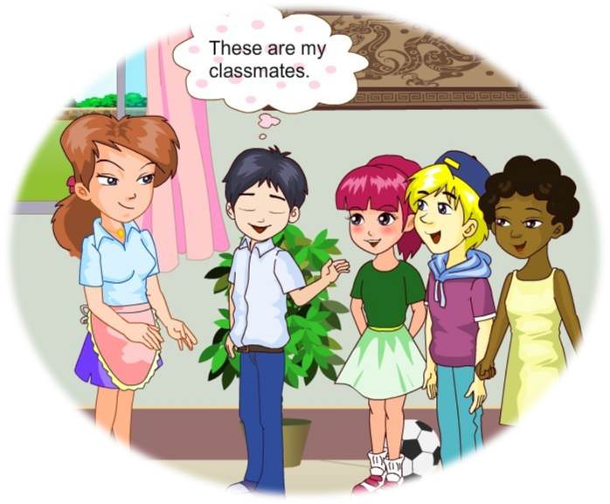
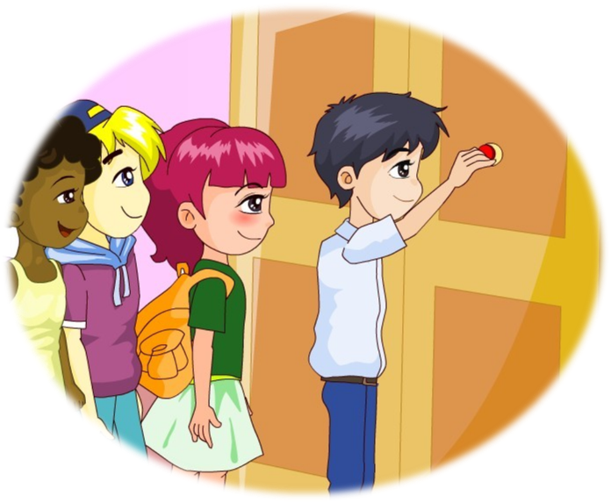
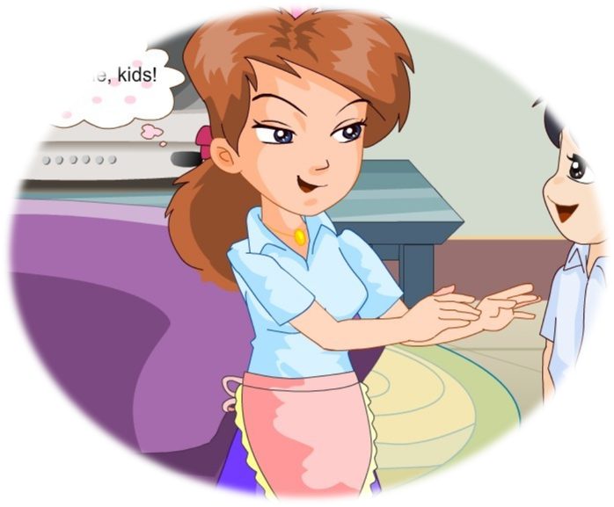
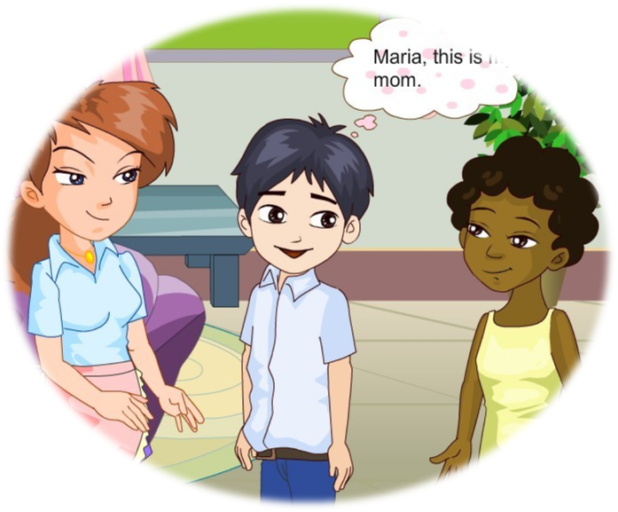
1a
Look, listen and say
1

Slide 6
What does he / she do? He is a (an) …
driver
cook
office worker
nurse
Notes:
6

Slide 7
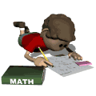
What does he / she do? He is a (an) …
farmer
doctor
teacher
student

Slide 8
Ask and answer.
1c
1. Pair work
Look at the pictures on your book (1c), then ask and answer in pairs.
2. Acting
1. Pair work.
2. Acting.

Slide 9
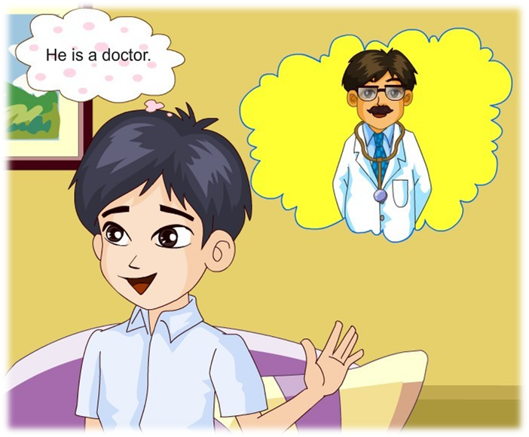
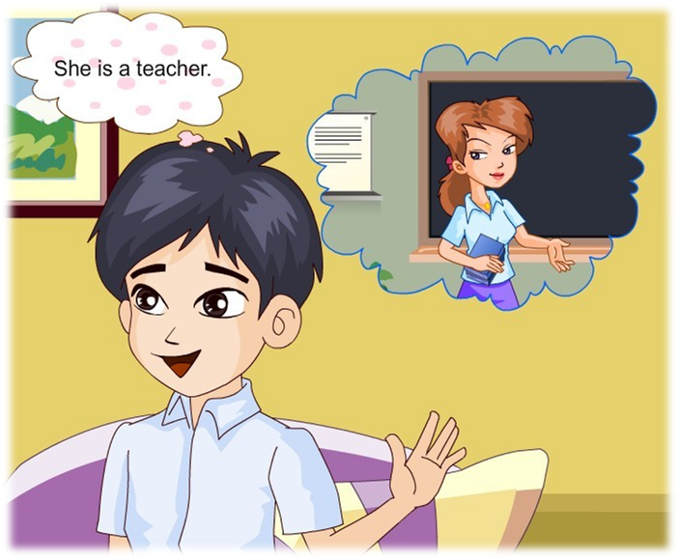
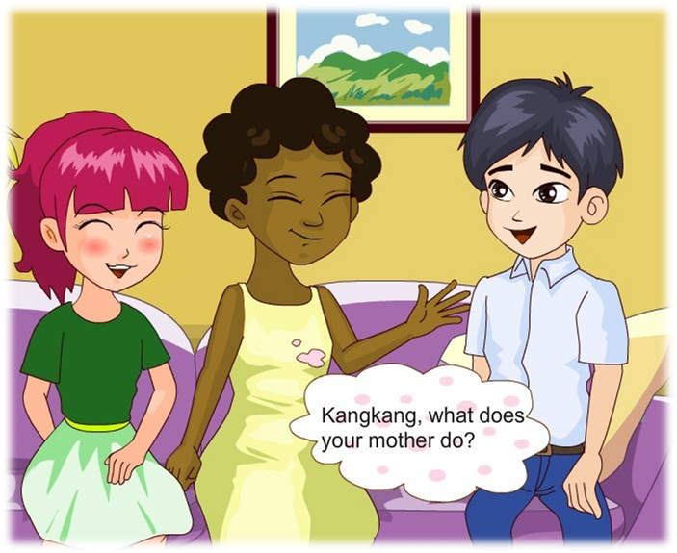
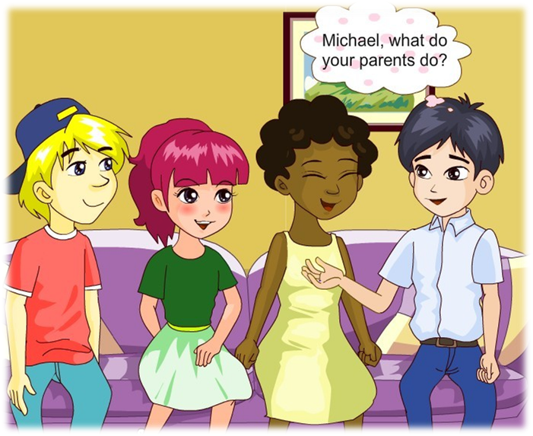
Listen, read and say
Is Kangkang's father a teacher?
2

Slide 10
Listen to 1a and complete the table:
Person | Job
Kangkang’s mother
Kangkang’s father
Michael’s mother
Michael’s father
a teacher
a doctor
an office worker
an office worker

Slide 11
Listen again and complete the following
dialogue:
Maria: Kangkang, what ______ your mother do?
Kangkang: She is a ________.
Jane: And your father?
Kangkang: He is a ________. Michael,
what ______ your parents do?
Michael: My parents are _______
office ________.
does
teacher
doctor
do
both
workers

Slide 12
Useful expressions:
— What does he/she do? = What is he /she? 他/她是干什么的？ — He/She is a driver/teacher …
他/她是一位司机/教师……
— What do you do? =What are you? 你是干什么的？ — I’m a student/nurse …
我是一名学生/护士……

Slide 13
Useful expressions:
both 两者都（放在be动词/助动词/情态动词
之后，行为动词之前。）
eg: We are both students.
我们两个都是学生。
They both have big eyes.
他们都长着大眼睛。

Slide 14
Listen and complete the passage.
2
Yukio’s father is a ____ (doctor, driver) and his mother is a ____ (teacher, nurse). His sister is an officer worker. Wang Junfeng’s mother is an ____ (office worker, actor), too. His father is a ____ (cook, farmer).
√
√
√
√

Slide 15
Introduce the family members.
Person | Age | Look | Clothes | Job | Workplace

Slide 16
Report.
I have a friend. His name is … He is 14 years old. He is a student. His father is a/an … and his mother is a/an … He has a happy family.

Slide 17
Exercise:
1. I am a teacher. (对画线部分提问)
______do you ______?
2. What do you do? (同义句)
What ______ you?
3. It’s Jim’s bag. (对画线部分提问)
_______bag ______it?
4. His sister is a nurse. (对画线部分提问)
______ ______ his sister ______
5. 他们俩都是医生。
They _____ ______ ______.
What
do
are
Whose
is
What
does
do
are
both
doctors

Slide 18
Sum up
What do you do? I am a student.
What do your parents do?
They are both office workers.
What does he/she do?
He/She is a (an) driver/teacher …

Slide 19
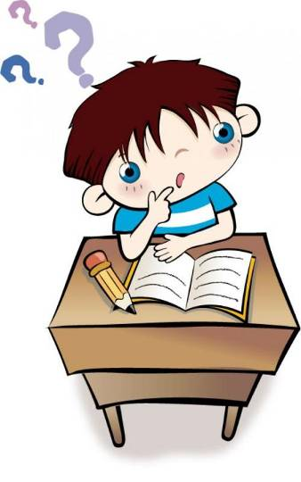
Homework
1. Recite the dialogue in 1a.
2. Make a survey about what your friend’s parents do, then make a report.
3. Preview Section B.

