Slide 1
Unit 5 Let’s celebrate! Integrated skills
WWW.PPT818.COM

Slide 2
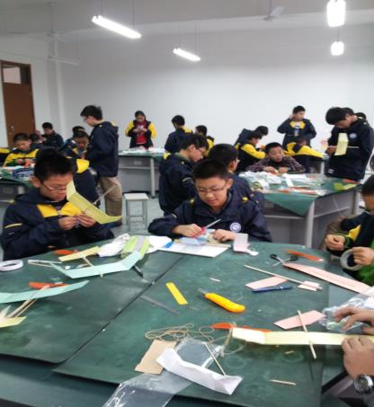
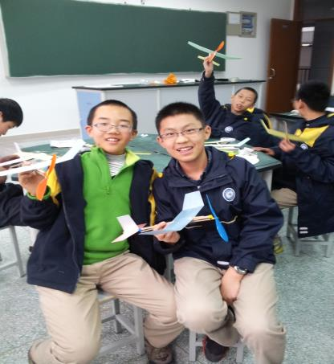
Lead-in
make model planes

Slide 3
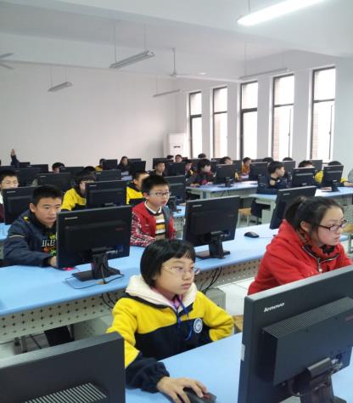
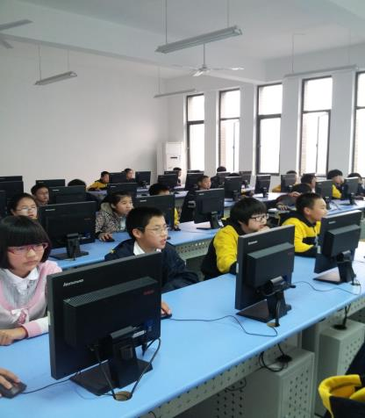
draw pictures

Slide 4
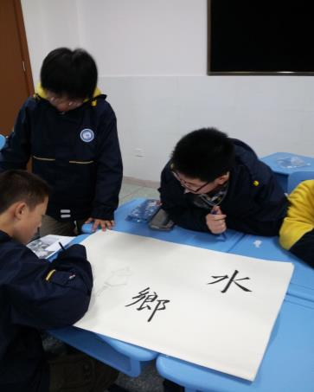
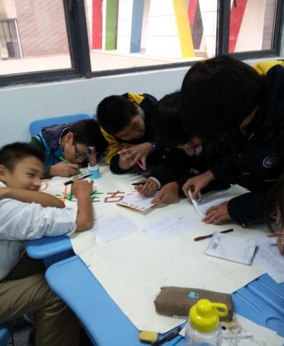
make posters about our hometown

Slide 5
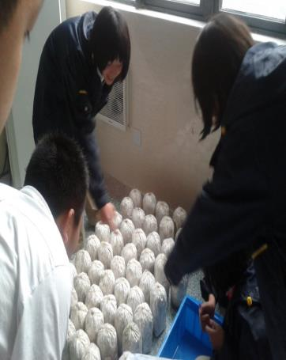
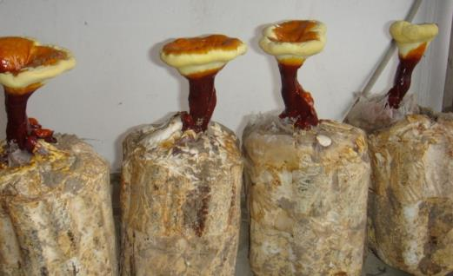
grow glossy ganoderma (灵芝)

Slide 6
Listen and answer
Speak up: Have a nice day!
1. Why does Millie seem happy?
Because there is a “Festival Week” at school.
2. What do they do?
They have shows about different festivals
around the world.
3. Where do they have the shows?
At the school hall.

Slide 7
Make up a dialogue
A: You seem very happy.
B: Good news!
A: What is it?
B: We will ...
A: Where are you going?
B: To … There is a show about … We can …
A: Sounds great! Have ...
B: Thank you.

Slide 8
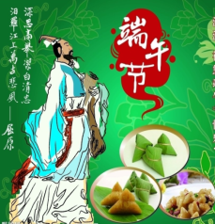
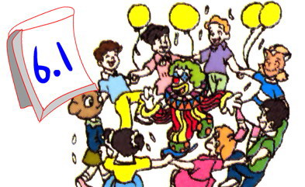
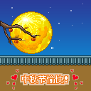
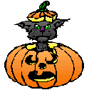
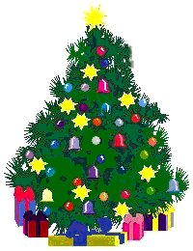
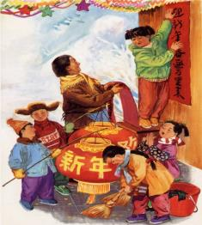
Which festival do you like best? Why?

Slide 9
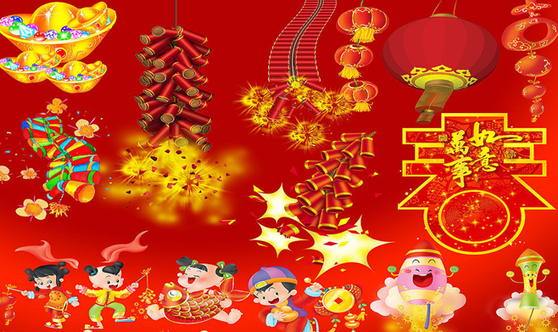
How much do foreigners (外国人) know about the Chinese New Year?
Enjoy a video

Slide 10
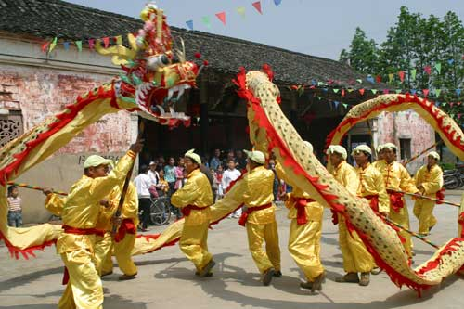
How do Chinese celebrate the Chinese New Year?
watch the lion dance

Slide 11
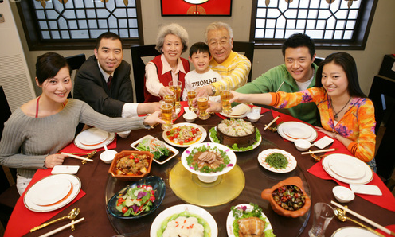
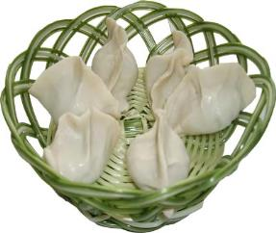
have a Chinese dinner
eat dumplings

Slide 12
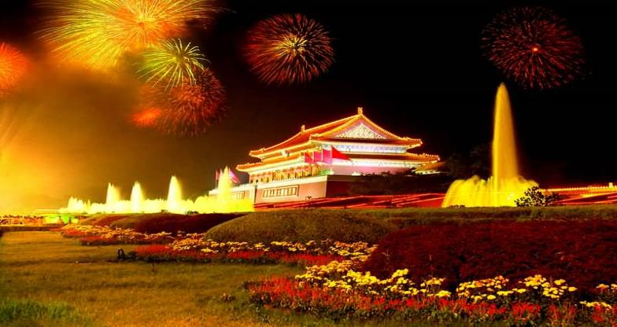
let off fireworks

Slide 13
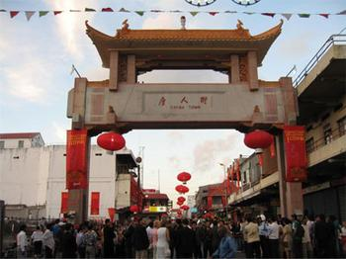
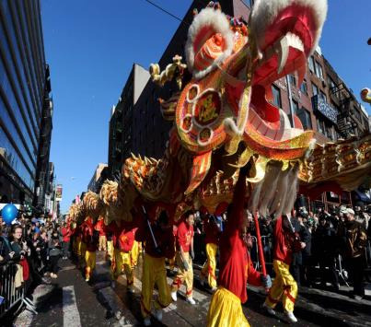
Chinatown, New York

Slide 14
Chinese New Year Party
Lion dance
Chinese dinner
Fireworks
Music and dance
Date: Saturday, February 9
Place: Chinatown, New York
Find out more on New York Radio

Slide 15
Read and answer
1. What do people do to celebrate the Chinese New Year?
They have a Chinese New Year party.
2. What do they eat?
A Chinese dinner.
3. What can they watch on that day?
A lion dance, fireworks and a music and dance show.
4. When and where do they have the party?
On Saturday, February 9 in Chinatown, New York.

Slide 16
Listen and fill in the table
Activity
Lion dance
Chinese dinner
Fireworks
Music and dance
Time
Place
1 p.m.
Peel
Street
5 p.m.
Peel
Street
8 p.m.
Mott
Street
9 p.m.
Mott
Street

Slide 17
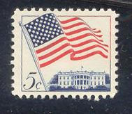
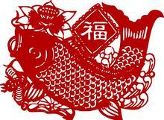
February 6
Dear Millie,
Happy new year! I am on holiday in
(1) __________. The Chinese people here always have a party to celebrate (2) _____________________.
There are lots of interesting things at the party. The (3) __________ starts first. People take a lot of photos. Then people can have a nice
(4) ______________. At night, they watch the (5) _________. After that, there is a (6) ________________ show.
What do you do to celebrate the Chinese New Year in Beijing?
All the best,
Wendy
New York
the Chinese New Year
lion dance
Millie
Flat 603
118 Garden Road
Beijing 100000
China
Chinese dinner
fireworks
music and dance

Slide 18
Discussion:
How to celebrate the Dragon Boat Festival?
an old festival
in May or June
eat rice dumplings
dragon boat races

Slide 19
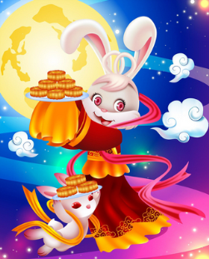
Discussion:
How to celebrate the Mid-Autumn Festival?
get together
have a big dinner
eat moon cakes
enjoy the full moon
listen to the story about Chang’e

Slide 20
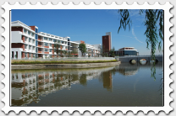
Write a postcard
Dear Wendy,
Thanks for your postcard. There are many festivals in China. I’d like to tell you something about …
To：
Wendy (the USA)
From：
(Tianyi Experimental School, Wuxi, Jiangsu, China)

Slide 21
Millie’s diary
Summary
Today, I enjoy shows about ___________ around the world. I like the show about _________________ best.
I know the people in Chinatown __________ to celebrate it. They watch ___________ first. Then they ___________________. At night, they enjoy _________ and _____________________.
I am very happy. I have _______ at school.
different festivals
the Chinese New Year
have a party
the lion dance
have a nice Chinese dinner
the fireworks
a music and dance show
a nice day

Slide 22
Homework
1. Recite the new words.
2. Write a postcard about
one of the Chinese
festivals to Wendy.

