Slide 1
陕旅版四年级上册 Unit4 When Do You Have Classes? 第1课时
WWW.PPT818.COM

Slide 2
教学目标：
学习“四会”单词：get up, have class, have lunch, play games, watch TV, go to bed.

Slide 3
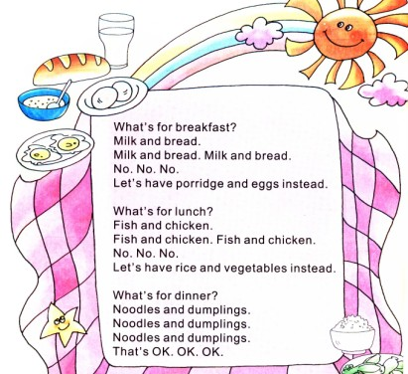
Let’s chant-What’s for breakfast?

Slide 4
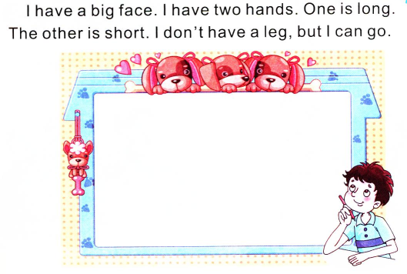
Guess and draw
答案

Slide 5
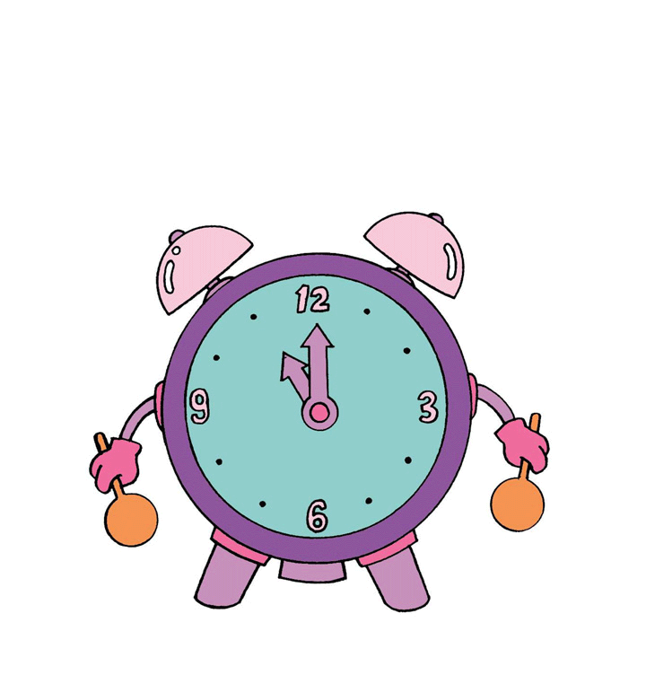
Guess and draw
The answer is clock.

Slide 6
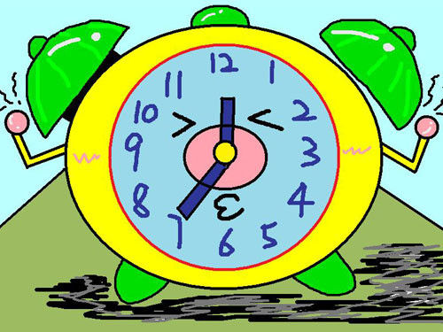
What time is it?
It’s 7 o’clock.

Slide 7
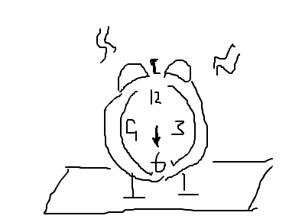
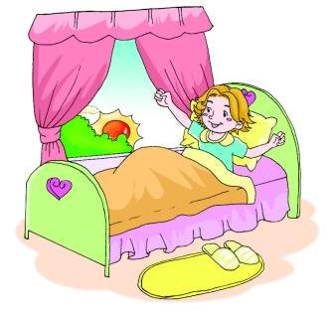
It’s 6 o’clock.

Slide 8
get up
have breakfast
go to school
吃早饭
In the morning
去学校
上课
have classes

Slide 9
Let’s learn
get up

Slide 10
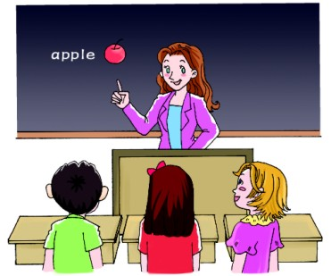
have a class

Slide 11
have a class
复数
have classes

Slide 12
In the afternoon and evening
play games
吃晚餐
heve dinner
看电视
watch TV
上床睡觉
go to bed

Slide 13
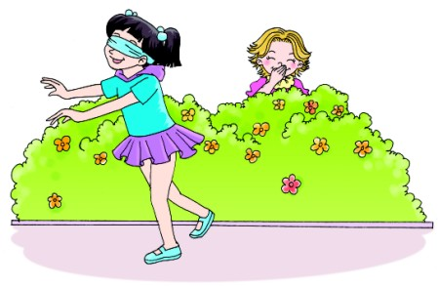
play games

Slide 14
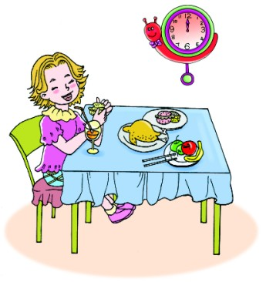
have lunch

Slide 15
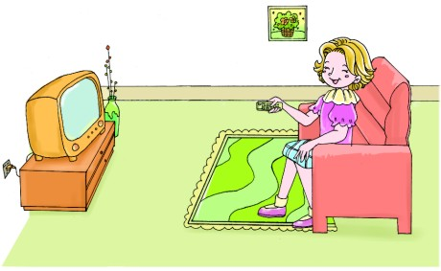
watch TV

Slide 16
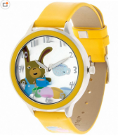
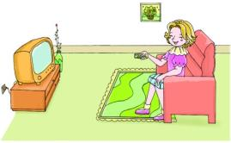
名词：手表
watch
动词：观看

Slide 17
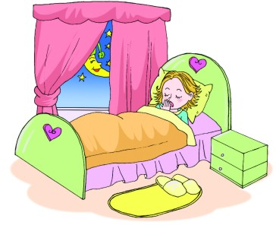
go to bed

Slide 18
Gold finger
get up have lunch play games have a class watch TV go to bed

Slide 19
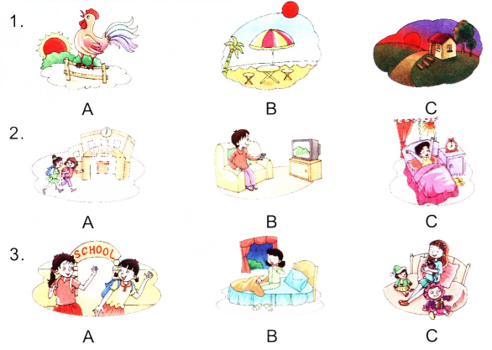
Listen and choose

