Slide 1
Unit4 At the Sports Meeting
陕旅版六年级下册
第三课时
WWW.PPT818.COM

Slide 2
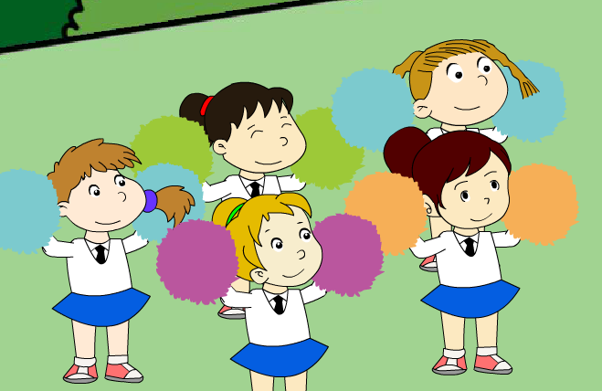
>>Warm-up
Sing a song

Slide 3
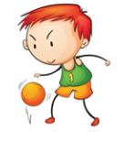
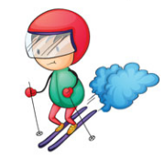
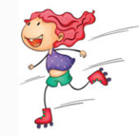
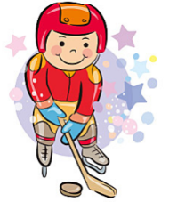
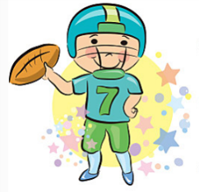
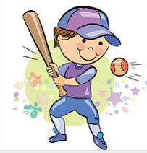
>>Lead-in
Free talk
What sports are they playing?

Slide 4
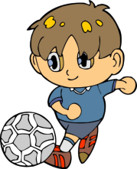
>>Lead-in
Make sentences
-What did … take part in?
-… took part in …

Slide 5
>>Presentation
Listen, then ask and answer
Q 1: When was the sports meeting?
It’s last week.
Q 2: How was the weather?
The weather is fine.
Q 3: Who won the girls’ throwing?
Kitty won the girls’ throwing.

Slide 6
>>Presentation
Let’s learn
①
excited
be/feel excited
They won the football game. So all of them felt excited.
②
do well (in)
Wu Min did very well. We should learn from him.
③
shout
Don’t shout at me.
④
finally
Finally, they lost the game.

Slide 7
>>Practice
Look and write
1. The girl was very ______ because she saw her favourite singer.
excited
well
2. My sister does very ______ in her work. And her students like her very much.
shout
3. Don’t ______ at her.
Finally
4. ______, they lost the game.

Slide 8
>>Presentation
Ask and answer
Read and answer
Q 1: Who won the boys’ 100-meter race?
Liu Zhaoyang won the boys’ 100-meter race.
Q 2: In which sport was Li Shan the first?
It’s the high jump.
Q 3: What sport did Colin take part in? Did he win?
He took part in the boys’ 1500-meter race.
And he won it.

Slide 9
>>Practice
Read again and tick or cross
×
( )1. Ma Li’s school had sports meeting last week.
×
( )2. Wu Chen was from Class Three and Colin was
from Class One.
√
( )3. Liu Zhaoyang ran very fast.
( )4. Kitty won the girls’ high jump.
×
√
( )5. Colin was the first in the boys’ 1500-meter race.

Slide 10
>>Practice
Listen and match
Peter A. the girls’ high jump.
Lily B. the boys’ throwing.
Tina C. the girls’ 200-meter race.
Kevin D. the boys’ 60-meter race.

Slide 11
>>Practice
Choose and complete
① Yours,
② Best wishes!
③ Dear Wu Chen,
④ Ma Li
③
______
Your class did well in the sports meeting. I feel very happy! We had our sports meeting last week.
I won the girls’ 100-meter race. I was very excited!
Let’s do sports every day and be healthy.
______
______
______
②
①
④

Slide 12
>>Summary
本课所学的重点单词：
excited
be/feel excited
They won the football game.
So all of them felt excited.
do well (in)
Wu Min did very well. We should learn from him.
shout
Don’t shout at me.
finally
Finally, they lost the game.

Slide 13
>>Homework
1.听课文录音并跟读，按照正确的语音、语调朗读并表演课文对话。 2.仿照课文Let’s learn more,创编对话。
3.预习 Unit5 A Let’s learn。
close

