Slide 1
Unit4 After-School Activities
Join Our Club!
WWW.PPT818.COM

Slide 2
Learning Targets
★ Key words:
join, improve, thinking, skill, meeting, act, useful, role, team, shape, level, pool
★ Key phrases :
make friends, think hard, have fun, after school, role play games, enjoy doing sth. , stay in shape, have a good time, all levels, on weekends, stop by

Slide 3
★ Key sentences:
1. Do you want to improve your thinking skills？
2. Join our chess club！
3. Chess challenges you and makes you think hard.
4. You will learn and have fun at the same time.
5. Acting is fun and useful.
6. We do lots of role play games in our classes.
7. Join us today or stop by the pool to learn more.

Slide 4
Objectives:
To understand the passages about the school clubs
2. To be able to talk about school clubs
3. To learn some words and expressions
PPT模板：www.1ppt.com/moban/ PPT素材：www.1ppt.com/sucai/
PPT背景：www.1ppt.com/beijing/ PPT图表：www.1ppt.com/tubiao/
PPT下载：www.1ppt.com/xiazai/ PPT教程： www.1ppt.com/powerpoint/
资料下载：www.1ppt.com/ziliao/ 范文下载：www.1ppt.com/fanwen/
试卷下载：www.1ppt.com/shiti/ 教案下载：www.1ppt.com/jiaoan/
PPT论坛：www.1ppt.cn PPT课件：www.1ppt.com/kejian/
语文课件：www.1ppt.com/kejian/yuwen/ 数学课件：www.1ppt.com/kejian/shuxue/
英语课件：www.1ppt.com/kejian/yingyu/ 美术课件：www.1ppt.com/kejian/meishu/
科学课件：www.1ppt.com/kejian/kexue/ 物理课件：www.1ppt.com/kejian/wuli/
化学课件：www.1ppt.com/kejian/huaxue/ 生物课件：www.1ppt.com/kejian/shengwu/
地理课件：www.1ppt.com/kejian/dili/ 历史课件：www.1ppt.com/kejian/lishi/

Slide 5
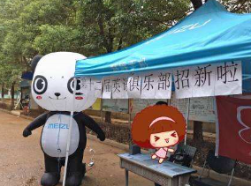
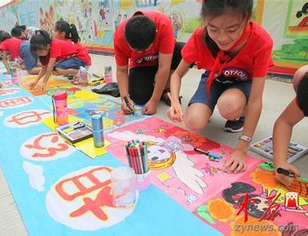
Warming up
What clubs do you have in your school?
English Club
Art Club

Slide 6
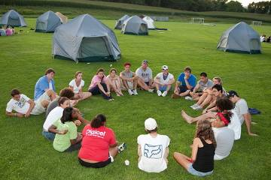
What clubs do you have in your school?
Music Club
Camping Club

Slide 7
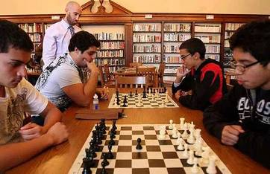
What clubs do you have in your school?
Chess Club
Photography Club

Slide 8
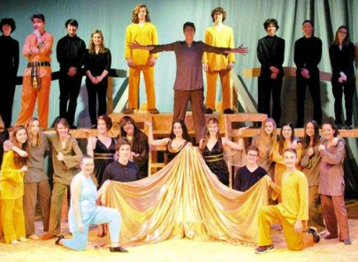
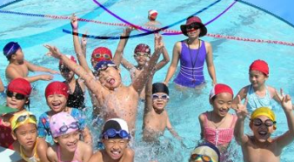
Observe the pictures below and figure out
which clubs they are.
Acting Club
Science club
They're...
club.
Swimming Club

Slide 9
Words and expressions
join
improve
thinking
skill
challenge
meeting
act
v. 参加
v. 提高；改善
adj. 思想的；理性的
n. 技能；技巧
v.&n. 挑战
n. 聚会；会议
v.&n. 行动；扮演

Slide 10
useful
role
team
shape
level
pool
make friends
adj. 有用的；有益的
n. 职能；角色
n. 队；组
n. 样子；形状
n. 水平；标准；质量
n. 小池；水塘
交朋友

Slide 11
think hard
have fun
after school
role play games
enjoy doing sth.
stay in shape
have a good time
凝神思索
玩得开心
放学之后
玩角色扮演游戏
喜欢做某事
保持形状
玩得开心

Slide 12
Presentation
1
Listen to the statements and match the
people with the clubs they want to join.
Li Lin
Zhang Lei
Wang Tao
Acting Group
Swim Team
Chess Club

Slide 13
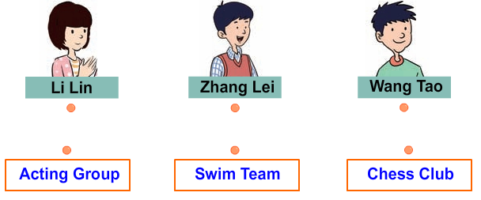
Let's check the answers.
I’m LiLin. I need to stay in shape.
I’m Zhang Lei. I want to improve my thinking skills.
I’m Wang Tao. I like role play games and enjoy acting.

Slide 14
2
Read the lesson and fill in the table.
Club Name | What is good about this club? | Club Meeting Days
Chess Club
Acting Group
Swim Team
improve thinking skills,
make friends
Tuesdays and Thursdays
meet lots of new people, improve your social skills
every Monday, Wednesday and Friday
stay in shape and have a good time
after school and on weekends

Slide 15
3
Fill in the blanks with the correct forms of the words in the box.
join pool swim skill level
A: It’s so hot today. Let’s go ___________!
B: Yeah. That’s a great idea!
2. A: I am going out for dinner with some friends. Would you like to _______ us?
B: Yes, I’d love to.
swimming
join

Slide 16
join pool swim skill level
3. She can sing, dance, cook and draw. She has many__________.
4. His English is very good. He is at a high ________.
5. There is a __________ near my house. I like to go swimming there.
skills
level
pool

Slide 17
Task 1
Read the passages again and fill in the blanks.
Club | Time | Place
Chess club
Acting Group
Swim Team
Tuesdays and Thursdays after school
Room 288
every Monday, Wednesday and Friday
school theatre
after school and on weekends
the pool

Slide 18
Task 2
Translate the following phrases into English.
交朋友
同时
享受......;喜欢......
保持体型
玩得开心
学校剧院
提高社交技能
不同级别
make friends
at the same time
enjoy doing...
stay in shape
have a good time
school theatre
improve the social skills
different levels

Slide 19
Task 3
Fill in the blanks according to the passage.
improve your thinking skills
___________________________________
you think hard. You will learn and
_________.
___________________
at the same time
are going to
on

Slide 20
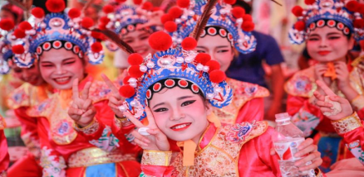
__________________.
social skills
role play games
_________________
acting
at

Slide 21
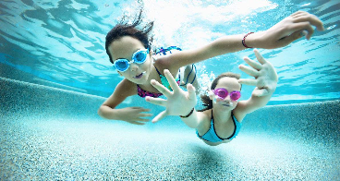
also
stay in shape
_______________________
and have a
all different levels
_______________________
on weekends
_______________________
Join

Slide 22
Group work
4
Work in groups. Discuss the questions below and present your answers to the class.
☺ What clubs do you have at your school?
☺ What clubs do you want to have at your school?
Why?

Slide 23
Individual work
Think about a club that you have joined or would like to join. Then write a short passage about it. You may mention the following points:
☺ What club is it?
☺ What is good about the club?
☺ Do you enjoy it?
☺ What do you think of the club?

Slide 24
Language points
1. Do you want to improve your thinking skills？
(1)want v. 想要。常用短语：want sth. 想要某物；want to do sth. 想要做某事；want sb. to do sth. 想要某人做某事。例：I want to buy a pen. 我想买支笔。
(2) skill n. 技能，技巧。主要是用来指实际工作或操作中运用的技巧和能力。例：The smart boy has a strong listening skill. 这个聪明的男孩子有很强的听力技能。

Slide 25
2. Do you want to make new friends？
make friends 交朋友。make friends with sb. 意为“和某人交朋友”。
例：She wanted to make friends with the popular students at school. 她想与在学校里受欢迎的学生交朋友。
【练习】他们互相交朋友，在一起玩得很开心。
They ________ ________ ________ each other and had a great time together.
made friends with

Slide 26
3. Join our chess club！
join是动词，意为“加入”。它常用来表示加入某个组织、团体、党派等，并成为其中的一员。
常用短语：join sb. in (doing) sth. 加入到某人当中一起做某事。
例：They joined our music club last year.他们去年加入我们音乐俱乐部的。
【拓展】表示“加入，参加”的词还有 take part in 、attend 等。

Slide 27
4. You will learn and have fun at the same time.
at the same time 与此同时。相当于in the mean time。
例：The two runners reached the finishing line at the same time. 这两个跑步运动员同时跑到终点。
In the meantime，they took part in various contests and games．与此同时，他们参加了各种比赛和游戏。

Slide 28
5. Club meetings are going to start next week.
(1) meeting是可数名词，意为“会议，聚会”。
常用短语：hold/have a meeting开会；sports meeting 运动会。
(2) 辨析start与begin
二者都意为“开始”，一般情况下可以互换使用，且后面都跟名词、代词、不定式或动名词。
例：The sports meeting starts/begins at 8 o'clock.
运动会八点钟开始。

Slide 29
二者的区别：
例：

Slide 30
6. Acting is fun and useful.
(1) Acting 在此句中作主语。当动名词 (短语) 作主语时，谓语动词要用单数形式；但是如果多个动名词(短语)并列作主语，则表示复数，谓语动词则要用复数形式。
例：Seeing is believing. 眼见为实。
Watching TV and reading books are really helpful for students. 对于学生来说，看电视和读书都很有用。

Slide 31
(2) useful是形容词，意为“有用的”。
该词是由use 加形容词后缀­ful构成的形容词。
其反义词为 useless（无用的）。
例：This dictionary is very useful.
这本词典非常有用。
It can be useful to write a short summary after a lesson. 一节课结束后，写一个短短的总结很有用。
Don't just sit watching TV! Make yourself useful!
别光坐着看电视! 帮一下忙吧！

Slide 32
7. We do lots of role play games in our classes.
role是名词，意为“职能，角色”。常用短语：play a role of ... 扮演……的角色；play a role/part in在……中起作用。
例：He was invited to play a role in this TV play.
他受邀在这个电视剧里扮演一个角色。
Computers play an important part in our daily life.
电脑在我们的日常生活中扮演着重要的角色。

Slide 33
8. You can stay in shape and have a good time.
stay in shape保持体形。其中shape是名词，意为“样子，形状”。如：She eats little to stay in shape.她吃得很少以保持体形。
9. Join us today or stop by the pool to learn more.
stop by 停在……旁边。也可意为“顺便拜访”，相当于drop in at，其后接地点名词。例：I can stop by the shop to buy some fruit for you.我可以顺便去商店为你买些水果。

Slide 34
Exercises
一、单项选择。
C
1. Our English teacher wants us ________ English stories out of class.
A．read B．reading
C．to read D. reads
2. The Internet is really________to us. We can easily find the information we need.
A．safe B．hard
C．boring D．useful
D

Slide 35
3. She and I both arrived at ________ same time by
pure coincidence(纯属巧合)．
A．the B．a C．an D．\
4. Going to school by bus usually________ me about half an hour.
A．take B．takes C．is taking D．took
5. —Jenny, I hear there will be an art club in our school.
—Wonderful！I can't wait to________it.
A．repeat B．forget C．receive D．join
A
B
D

Slide 36
二、根据汉语意思完成句子。
1. 尽管约翰在这里只住了一年，但他交了很多朋友。 John lived here for only one year, but he ________ _______ ________ ________.
2. 她每天做瑜伽来保持体型。 She does yoga every day to ________ ________ _________. 3. 跑步是有益的运动。 Running is ________ ________.
made
lots of friends
stay
in
shape
good exercise

Slide 37
4.他同时告诉了我他和他父亲的地址和电话号码。 He told me his and his father’s addresses and
telephone numbers ______ ________ _________
_________. 5. 在英语课上，我们有时做角色扮演游戏。 We sometimes ________ ________ _______
________ in English class.
6. 我和一些朋友要出去吃晚餐。
I am ______ _____ for dinner with some _______.
at
the same
time
do role
play
games
going out friends

Slide 38
三、按要求改写句子。
1. I am going to sing a song at the party.
(对划线部分提问 ) ________ _______ you ________ ________
________ at the party? 2. Grace is going to give Mike a card tomorrow.
(改为否定句 ) Grace _______ ________ ________ give Mike a
card tomorrow.
What are going
to
do
isn’t going to

Slide 39
3. We are going to make some apple juice this evening.
(改为一般疑问句并作否定回答) ________ you going to make any apple juice this
evening? No, _______ _______. 4. It will be sunny soon. (改为同义句 ) _______ ______ _______ ________ sunny soon. 5. They moved into a new house last month.
(用 be going to改写句子) ________ ________ ________ ________ into a new
house.
Are
we aren’t
It’s going to be
They’re going to move

Slide 40
Summary
1. We learned some useful words and phrases
2. We learned how to use the “be going to” structure.

Slide 41
Homework
1. Write a paragraph about two or three clubs in your school.
2. 完成本课时的对应练习。
3. 复习lesson 19-20 的单词、短语以及重要句子。
4. 读熟 P52 的课文。

