Slide 1
Unit 1 What’s in your room?
WWW.PPT818.COM

Slide 2
Revision:介词
in 在…的里面
on 在…的上面
under 在…的下面
near 在...的附近
beside 在…的旁边
behind 在…的后面
in front of … 在…的前面

Slide 3
next to 在…附近，与…相邻
There are some purple flowers next to a computer.
有一些紫色的花在计算机的旁边。

Slide 4
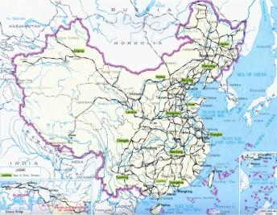
between 在…中间
There is a map between two windows.
在两个窗户的中间有一张地图。

Slide 5
It’s very big. We sleep on it every day. What’s this?
It’s a bed.

Slide 6
It looks like a TV. We use it play games and surf on the Net. What’s this?
It’s a computer.

Slide 7
window 窗户

Slide 8
map 地图

Slide 9
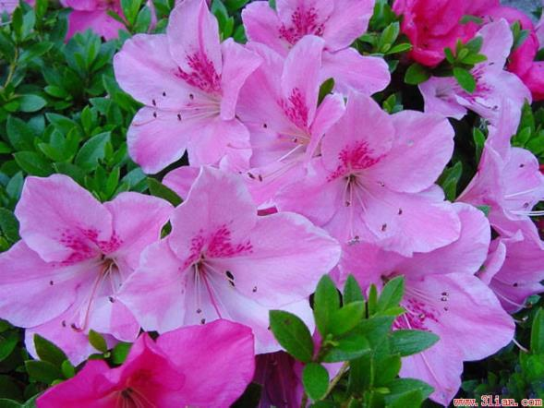
What’s this?
They’re flowers.

Slide 10
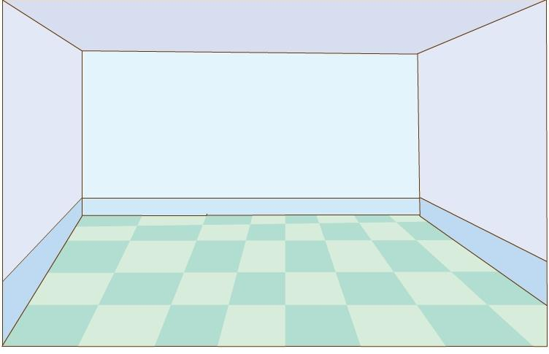
wall 墙

Slide 11
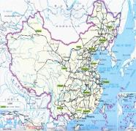
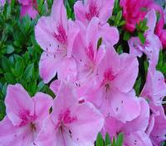
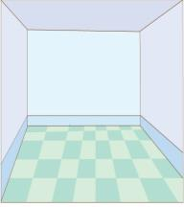
computer
map
flowers
window
wall
bed

Slide 12
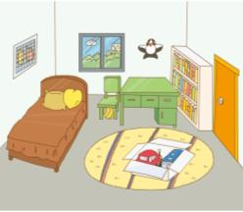
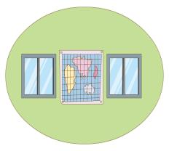
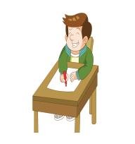
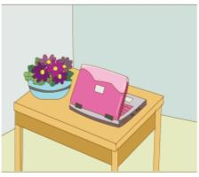
bedroom
between
child
pink
next
draw

Slide 13
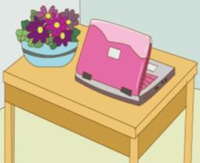
bedroom
There is / are ….

Slide 14
Guess!
What is in Jiamin’s bedroom?

Slide 15
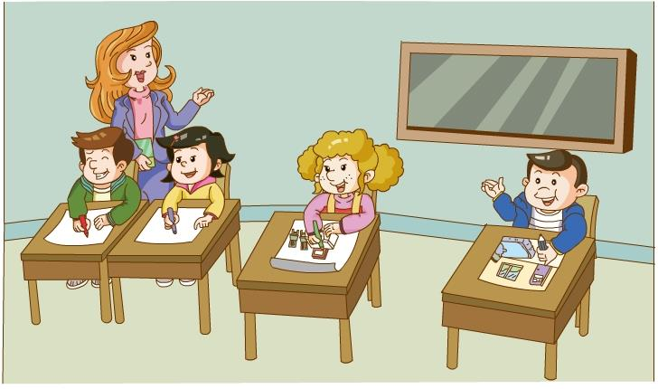

Slide 17
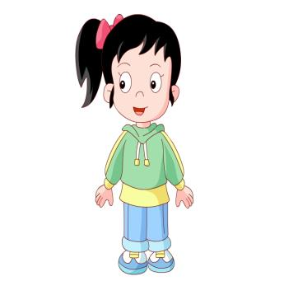
Think and say!
There is /are…

Slide 18
在门后面有两只白色的狗。 There are two white dogs behind the door.
在床下面有两只棕色的猫。There are two brown cats under the bed.

Slide 19
Homework

