Slide 1
Unit 13
We’re trying to save the earth!
Section A Period 1 1a-2d
WWW.PPT818.COM
Notes:
1

Slide 2
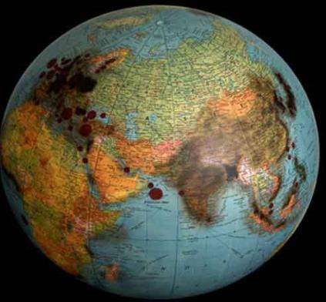
the earth song by Michael Jackson !!!
We are harming our planet in so many ways.

Slide 3
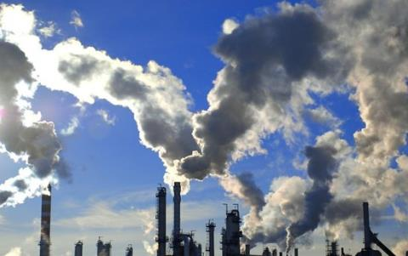
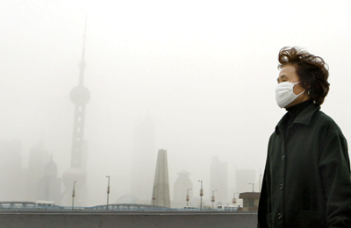
air pollution
n. 煤炭
The factories that
burn coal pollute
the air with a lot of
black smoke.

Slide 4
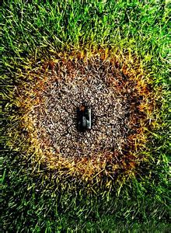
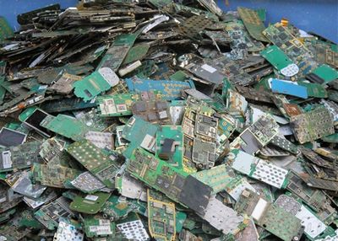
mobile phone pollution

Slide 5
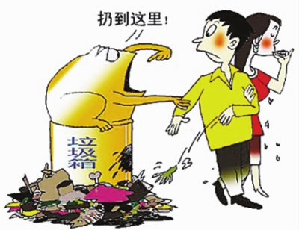
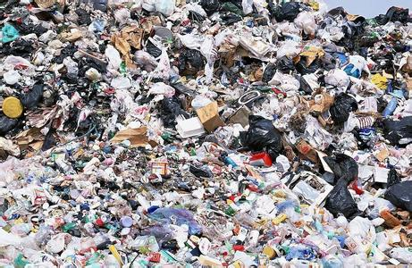
litter v. 乱扔
n. 垃圾
rubbish waste
垃圾，废弃物
People should throw away litter in the bin.
n. 垃圾箱

Slide 6
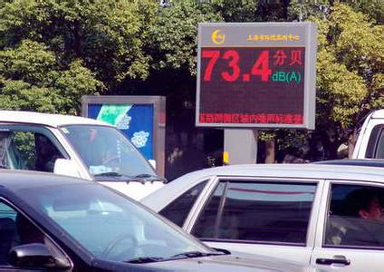
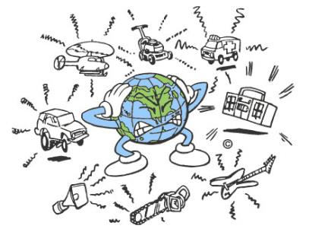
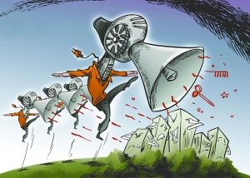
noise pollution
There are more
cars on the road.

Slide 7
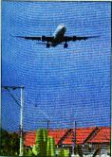
Here are some words related to different kinds of pollution. Write them in the box below. Then add more words.
1a

Slide 8
loud music cars rubbish planes littering ships factories smoking building houses mobile phones
noise pollution
____________
____________
____________
____________
air pollution
___________
___________
___________
___________
water pollution
____________
____________
____________
____________
loud music
ships
factories
planes
rubbish
smoking
mobile phones
littering
cars
building houses
building houses
factories

Slide 9
1b
Listen and complete the sentences.
What was the problem?
The river was _____________. Even the bottom (底部) of the river was full of _________. There were no more ______ for fishermen (渔民) to catch.
really dirty
rubbish
fish

Slide 10
What caused the problem?
People are throwing _______ into the river. Factories are putting ______ into the river.
How should the problem be solved?
We should write to the ____________ and ask them to ___________ the factories. Everyone should help to __________ the river.
litter
waste
government
close down
clean up

Slide 11
Listen again and check (√) the sentences you hear.
1. We could go fishing in the river.
2. The river was really dirty.
3. The river has always been the nicest
river in this town.
4. We should ask the teachers for help.
√
√

Slide 12
1c
Role-play the conversation
The river was dirty. Even the bottom of the river was full of rubbish.
But it used to be so clean!

Slide 13
Yes, but people are throwing litter into the river.
Everyone in this town should play a part in cleaning it up!

Slide 14
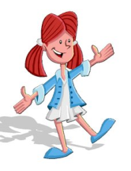
Practice
Make conversations using the pollution in 1a.
The river has always been the nicest river in this town.
Yes, it used to be so clean.

Slide 15
But I was there last weekend and the river was really dirty.
What caused the problem?

Slide 16
People are throwing litter into the river.
What should we do?
Factories are also putting waste into the river.
Yes, everyone in this town should play a part.

Slide 17
We should write to the government and ask them to close down the factories.
What else can we do?
Everyone should help to clean up the river.

Slide 18
Listen to the interview. Circle the kinds of pollution that Jason and Susan talk about.
2a
land pollution B. air pollution
C. noise pollution D. water pollution

Slide 19
Listen again and complete the sentences.
2b
1. The air is badly polluted because there are ___________ on the road these days.
2. Factories that burn coal also ________ the air with a lot of black smoke.
more cars
pollute

Slide 20
3. There is also too much rubbish and waste. People _________________ things every day.
4. People are also littering in ______________ like parks. This is turning beautiful places into
ugly (丑陋) ones.
are throwing away
public places

Slide 21
Listen and answer the questions.
1. Who is the interviewer talking to?
2. What are they talking about?
3. What other problems do they see?
Susan and Jason.
The environmental problems.
There’s too much rubbish and waste in the streets.

Slide 22
2c
Role-play conversations between Jason and Susan.
The air has become really polluted around here. I’m getting very worried.
Yes, I used to be able to see stars in the sky.
The problem is that…

Slide 23
2d
Read 2d and complete the chart.
Problems | Solving problems
air pollution
waste pollution
wooden (木头的) chopsticks or plastic forks
rubbish
take the bus, subway or ride a bike instead of driving.
bring a bag to go shopping.
use chopsticks or forks at home.
throw rubbish in the bins.

Slide 24
Role- play the conversation
Jason and Susan, what are your ideas for solving these problems?

Slide 25
Well, to cut down air pollution, we should take the bus or subway instead of driving.
Yeah, or ride a bike. There are other advantages (优点) of bike riding. It’s good for health and it doesn’t cost (花费) anything!

Slide 26
Great ideas! What about waste pollution?
Me, too. Also, I never take wooden chopsticks or plastic (塑料) forks when I buy takeaway (外卖食品) food. I
use the ones at home.
Mmm, I think simple things like bringing a bag to go shopping can help. I started doing that a year ago.

Slide 27
And remember to throw rubbish in the bins and keep public places clean and beautiful for everyone.
So together, our actions can make a difference and lead to a better future!

Slide 28
Make a poster!
Save the earth!
The earth is badly polluted. Please make a poster and think of what we can do.

Slide 29
Homework
1. Copy the new words and remember them.
2. Read the listening materials of 1b, 2a.

