Slide 1
Unit 2 Making a difference
Part Ⅱ Using language——动词-ed形式作定语
WWW.PPT818.COM

Slide 2
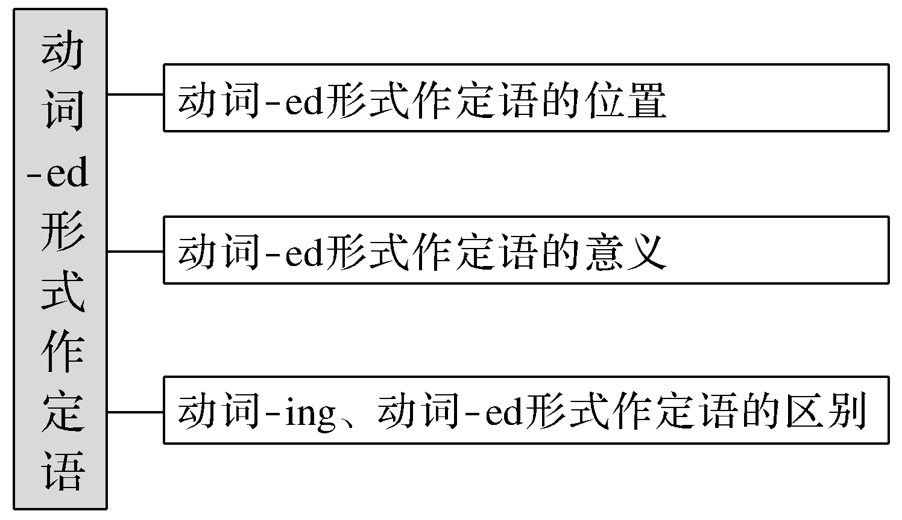
【思维导图】

Slide 3
1.动词-ed形式作定语相当于形容词。
2.动词-ed形式作定语，既可以放在被修饰名词的前面也可以放在被修饰名词的后面，即“名词＋动词-ed形式”或者“动词-ed形式＋名词”。
3.作定语的动词-ed形式，绝大多数是及物动词，只有少数几个是不及物动词。过去分词作定语表被动、完成或两者兼有。

Slide 4
一、基本特征感悟
【感悟用法】
①The lost time can never be found again.
②What’s the language spoken in that area?
③I thought I would be punished for the broken glasses but I ended up being praised for my honesty.
④Is there anything planned tonight?
⑤The movie called Hero was famous for its special techniques.

Slide 5
⑥The student dressed in white is my daughter.
⑦This will be the best novel of its kind ever written.
⑧Who were the so-called guests invited to your party last night?
⑨This is the funniest news found on the Internet.
⑩We were told we would meet at given time and place.

Slide 6
【自我总结】
1.过去分词作前置定语的有：____________句，过去分词作后置定语的有：____________________句。
2.单个分词作定语的有：____________句。
3.表被动意义的有：____________句；表完成意义的有：____________句；表被动完成的有；____________句；表状态的有____________句。
①③⑩
②④⑤⑥⑦⑧⑨
①③④⑦⑩
②⑤
①⑩
③④⑦⑧⑨
⑥

Slide 7
二、主要用法精讲
1.动词-ed形式作定语的位置
(1)单个的动词-ed形式作定语，通常置于被修饰词前。
the broken clock坏了的钟表 the stolen backpack被偷走的背包
(2)动词-ed短语作定语，常置于被修饰词后，相当于一个定语从句。
Most of the people invited to the party didn’t come.
＝Most of the people who were invited to the party didn’t come.
大部分被邀请参加派对的人没有来。

Slide 8
2.动词-ed形式作定语的意义
不及物动词的动词-ed形式作定语，只表示动作已完成；而及物动词的动词-ed形式作定语，表示被动意义或已完成，抑或两者兼具。
(1)只表示完成，不表示被动。
boiled water＝water that has boiled开(过的)水
the fallen leaves＝the leaves that have fallen落叶
a developed country＝a country which has developed发达国家
(2)表示被动。
an honoured guest一位受尊敬的客人 deeply moved people深受感动的人们
(3)表示被动和完成。
the broken glass碎了的杯子 the question discussed yesterday昨天讨论的问题

Slide 9
3.动词-ing形式与动词-ed形式的区别
(1)动词-ing形式表示主动意义，动词-ed形式一般表示被动含意。
(2)动词-ing形式表示正在进行，动词-ed形式表示状态或做完(完成)的事。
He rushed into the burning house.他冲进了正在燃烧着的房子。
The child standing over there is my brother.站在那儿的男孩子是我弟弟。
The room facing south is our classroom.朝南的房间是我们的教室。
Have you got your watch repaired? 你拿到那个修好的表了吗？
He is an advanced teacher.他是个先进教师。

Slide 10
(3)动词-ing形式和动词-ed形式作定语的区别
动词-ed形式作定语时用于描述某人或某物的感受或状态；动词-ing形式作定语时用于描述由什么原因引起某人的感受。
Interested members will meet at two o’clock.感兴趣的会员在两点碰头。
As far as I’m concerned，this is an interesting film.
就我而言，这是一部令人感兴趣的影片。

Slide 11
名师提醒
(1)有些单个的动词－ed形式，在习惯上往往置于被修饰词后。
There is little time left.
时间不多了。
(2)动词－ed形式修饰something，everything，anything，nothing，nobody等不定代词或those时，常置于这些词的后面。
There will be something changed.
有些东西要改变了。
He is one of those invited.
他是那些被邀请的人之一。

Slide 12
(3)有些过去分词作定语，前置和后置的意义不同。
the tool used使用过的工具
the used tool 旧的工具
the concerned expression担忧的表情
the student concerned有关的学生

Slide 13
名师提醒
(1)英语中有很多与感觉有关的及物动词，其动词－ed形式有被动意义，即“使人产生某种感觉”。
moved受感动的
amused 感到有意思的
pleased 高兴的

Slide 14
(2)有些及物动词的动词－ed形式作定语，并不强调被动意义，而表示一种状态或结果。
Dressed in white，she looked very beautiful.
穿着白衣服，她看起来很漂亮。
The boy seated at the back of the classroom is clever.
坐在教室后面的这男孩很聪明。

Slide 15
名师提醒
人的表情、声音如look，expression，voice，sound，tear等用过去分词修饰。
There was a surprised look on her face seeing what have happened.
看到所发生的事情后，她脸上出现了惊讶的表情。

Slide 16
即学即练
①The first textbook ____________(write) for teaching English as a foreign language came out in the 16th century.
②Don’t use words，expressions or phrases ____________(know) only to people with specific knowledge.
③The ____________(break) glass cup was broken by Jim.
④I like eating ____________(freeze) food while he doesn’t.
written
known
broken
frozen

Slide 17
⑤You’d better use the ____________(boil) water to make tea.
⑥Have you read the novel ____________(write) by him?
⑦The ____________(fall) leaves will be collected by the cleaners.
⑧Tsinghua University，____________(found) in 1911，is home to a great number of outstanding figures.
boiled
written
fallen
founded

