Slide 1
Module 6 Eating together
Unit 1 When is the school-leavers’ party?
WWW.PPT818.COM

Slide 2
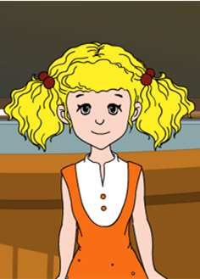
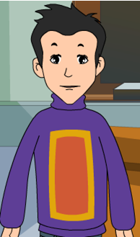
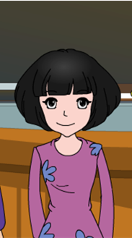
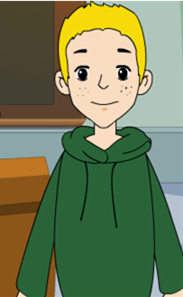
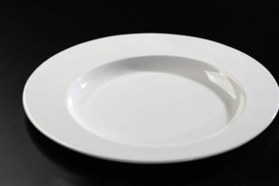
The school-leavers’ party
Bring some ballons paint some pictures
Play the dance music

Slide 3
The school-leavers’ party
Bring some ballons paint some pictures
Play the dance music
cheeseburgers
hot and sour soup
Jiaozi
pizza

Slide 4
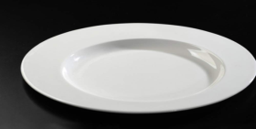
 | Dish | Made with …
 |  | Not mentioned
Lingling
Betty
Daming
Tony
hot and sour soup
chicken and vegetables
hamburgers and cheese
cheeseburgers
Jiaozi
pizza
cheese, tomato and ham

Slide 5
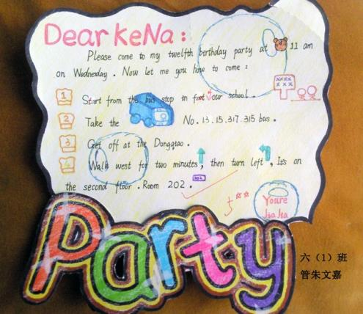
Warm-up
Is this an invitation?

Slide 6
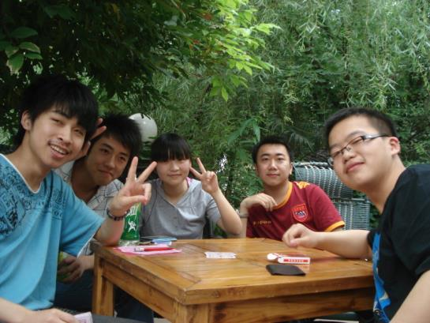
Have you ever been invited to the party?

Slide 7
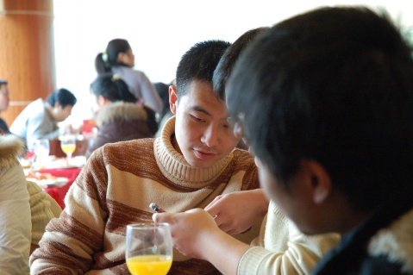
What will you take to join the party?

Slide 8
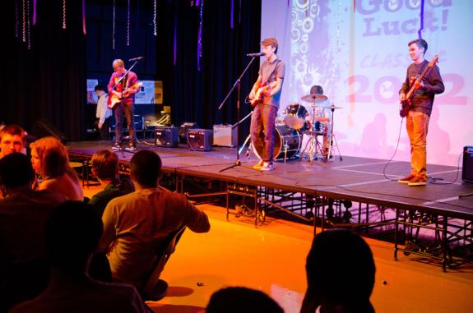
What do you usually do at the party?

Slide 9
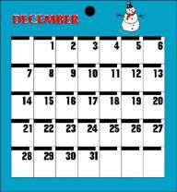
比一比，看谁能快速说出下面的单词。
balloon n.
气球
calendar n.
日历；历书
invitation n.
邀请；请柬

Slide 10
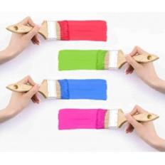
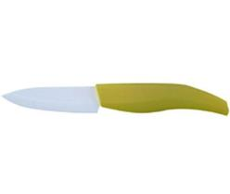
paint v.
绘画
heat v.
使变热；给……加热
knife n.
餐刀；刀具

Slide 11
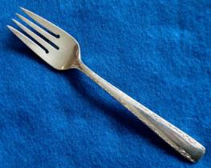
fork n.
餐叉
spoon n.
匙；勺子

Slide 12
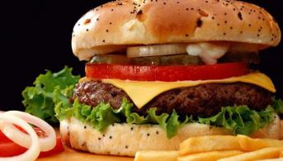
cheeseburger n.
干酪汉堡包
Italian
adj.意大利的；意大利人的
n. 意大利语；意大利人

Slide 13
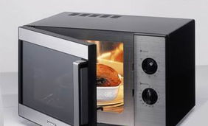
比一比，看谁能快速说出下面的短语。
heat up 使变热；给……加热

Slide 14
Presentation
1. Listen and complete the invatation
Invitation
You are invited to the________________
on Saturday, 30th May at ____________
in ________________________________.
Bring a traditional dish (______________________)
Come and enjoy the food, music and dancing.
school-leavers' party
5 p.m.
the school hall
make sure it's finger food

Slide 15
2. Listen and read.
1. What is Daming going to make?
Jiaozi.
2. Who is going to make hot and sour
soup?
Lingling.

Slide 16
Now complete the note.
Dish
Lingling ___________________
Betty ___________________
Daming ___________________
Tony ____________________
hot and sour soup
cheeseburgers
jiaozi
pizza

Slide 17
Made with …
Lingling _______________________
Betty ________________________
Daming ________________________
Tony ________________________
chicken and vegetables
hamburgers and cheese
Not mentioned in the passage
cheese, tomato and ham

Slide 18
3. Answer the questions.
1. What was Daming chosen to do at the
school-leavers' party?
He was chosen to play the dance music.
2. Where are they going to prepare the food?
They are going to prepare the food at home.
3. Why does Tony call pizza a traditional
English dish?
Because it's eaten everywhere in England.

Slide 19
4. Complete the passage with the
words in the box.
balloons calendar fork
knife paint spoon
The day for the school-leavers'party is an important date in the school (1) _________. Tony is going to bring some (2) _________ and (3)_______ some pictures for the party.
calendar
balloons
paint

Slide 20
balloons calendar fork
knife paint spoon
Everyone is going to bring a traditional dish that can be eaten with their fingers. Soup is no good because it is not finger food and people need a (4) _______ for it. Anything that needs a (5) _______ and (6) _______ is not finger food either.
spoon
knife
fork

Slide 21
Everyday English
Soup's no good then.
And you?
I see what you mean.

Slide 22
Language points
1. Look at the school calendar!
看看学校的校历！
calendar表示“日历”，school calendar
表示“校历”。
e.g. Look at the school calendar! We
will have an exam next week.
看看学校的校历！我们下周将有
一次考试。

Slide 23
2. We're all invited.
我们都被邀请了。
这个句子为一般现在时的被动语态。
invite是动词，表示“邀请”。
invitation是名词，也表示“邀请”。

Slide 24
3. And I was asked to bring some balloons
and paint some pictures for the party.
我被要求带一些气球并且为这个聚会画一
些画。
balloon表示“气球”。
paint表示“绘画”，是动词。
e.g. Please paint a balloon for me in the
paper.
请为我在纸上画一个气球。

Slide 25
4. We can heat it up in the school kitchen.
我们能在学校厨房加热它。
heat up表示 “使变热，给…加热”。
e.g. Light the cooker and heat up the
food.
点着厨具加热食物。

Slide 26
5. The teachers have asked everyone to
prepare a traditional dish from their
home country.
老师要求每人准备一道家乡的传统菜。
dish表示“烹制好的菜肴，一道菜”。
e.g. When I was in Italy, I had a
wonderful pasta dish.
我在意大利的时候，吃过一次很
棒的意大利面。

Slide 27
dish还表示“盘子”。dish的复数还可以表示“待洗的餐具”。
e.g. I’ll do the dishes before we go.
我们走之前，我会把餐具洗好的。

Slide 28
6. Oh, soup's no good then.
哦，汤不行。
no good表示“不适合”。
e.g. These glasses are no good for
champagne.
这些玻璃杯不适合用来喝香槟。

Slide 29
no good的用法有四条：
(1) it is no good doing 做某事没用
e.g. It's no good talking to him—he
never listens.
跟他讲没用，他从来不听。
(2) no good for sth. 不适合某物/某事
e.g. This medicine is no good for
headache.
这药治不了头痛。

Slide 30
(3) no good to sb.对某人没有好处或没有
帮助
e.g. A car is no good for me, since I
can't drive.
汽车对我没用，因为我不会开车。
(4) do no good 没用处，不成功
e.g. I'll talk to him, but it will do no
good.
我会和他谈的，但不会有用。

Slide 31
7. That means you eat it with your
fingers, not with a knife, fork or
spoon.
那意味着你吃饭用你的手指，不会用
刀、叉、勺子。
knife表示“餐刀”，复数为knives.
fork表示“餐叉”。 spoon表示“匙”。
a knife and fork表示“一副刀叉”。

Slide 32
8. Is she invited to the school-leavers’
party too?
她也被邀请参加学校的毕业晚会了吗？
be invited to do sth.表示“被邀请去做某
事”。
e.g. I was invited to his birthday party.
我被邀请去参加他的生日聚会。

Slide 33
Learning to learn
You can use English to communicate with people from all over the world – take your chance to learn something about how they live and what they eat. Learning about other cultures is not only interesting, it will also help you understand the world better.

Slide 34
Pronunciation and speaking
5. Read and mark the pauses.
Lingling: Can we cook it at school?
Betty: We can heat it up in the
school kitchen, but it should
be cooked at home. What are
you going to make?

Slide 35
Now listen and check.
Lingling: Can we cook it at school?
Betty: We can heat it up in the
school kitchen, but it should
be cooked at home. What are
you going to make?

Slide 36
6. Work in pairs. Read the
conversation in Activity 5 aloud.
Lingling: Can we cook it at school?
Betty: We can heat it up in the
school kitchen, but it should
be cooked at home. What are
you going to make?

Slide 37
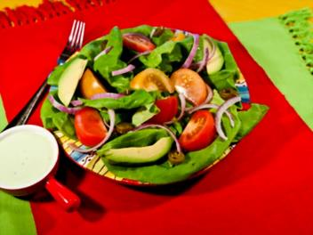
7. Work in pairs. Make plans for a
party. Think about:
food and drink
music and dancing

Slide 38
8. Work with another pair. Talk
about your party plans.
– What's your plan for the party?
– Everyone will be asked to bring
something to eat …

Slide 39
Exercise
B
1. Mrs Li bought a ____ for her daughter
and it made her very happy.
A. calendar B. balloon
C. invitation D. fork
2. People usually use cooker to _____ the
dishes.
A. go up B. heat up
C. get up D. fix up
B

Slide 40
D
3. He was sad because he wasn't ______
go to his classmate's party.
A. Invite B. be invited
C. be invited to D. invited to
4. The book is no good ____ the little
children.
A. with B. at
C. for D. about
C

Slide 41
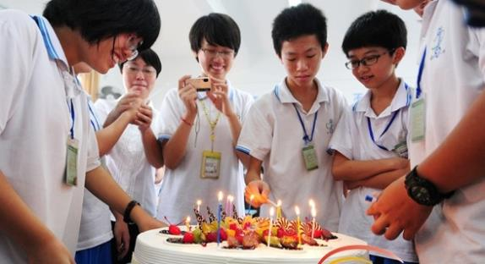
Homework:
如果你下周日过生日，请用英语给你的朋友写一封邀请函，希望他们能够参加你的生日聚会。

