Slide 1
Unit 5 Sports
What club would you like to join?
WWW.PPT818.COM

Slide 2
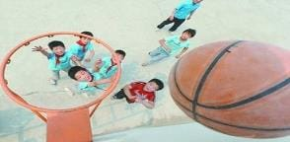
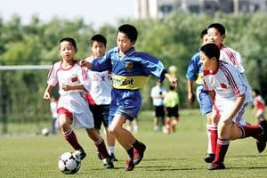
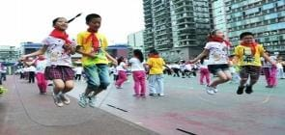
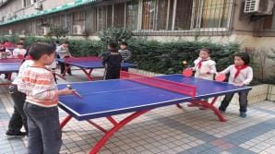
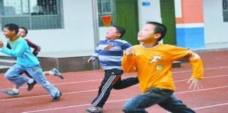
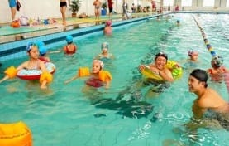
What sport do you like?
I like skipping.

Slide 3
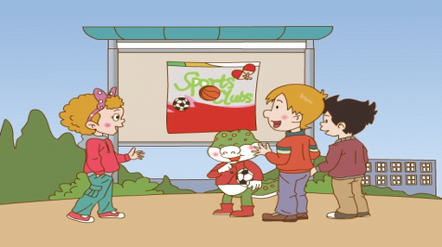
What are they talking about?
A. Sports Clubs
B. Sports Films

Slide 4
Sports clubs
What sports clubs do they have?
Basketball Club
Football Club
Table Tennis Club
Swimming Club
Skipping Club

Slide 5
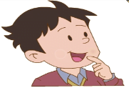
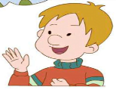
What club would they like to join?
point
coin

Slide 6
What club would they like to join?
Table Tennis Club
Football Club
Basketball Club

Slide 7
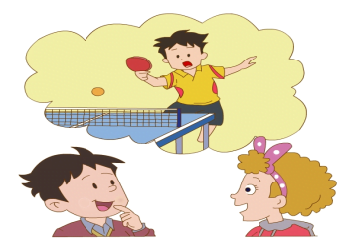
What club would you like to join?
the Table Tennis Club
I’d like to join __________________.
I like table tennis.

Slide 8
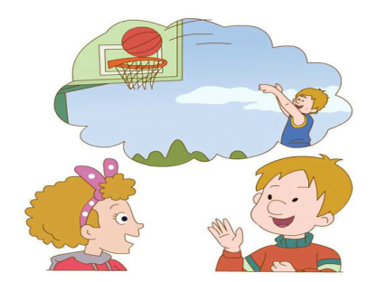
What club would you like to join?
I’d like to join _________________.
the Basketball Club

Slide 9
Yes.
Would you like to join the Basketball Club?
I like basketball.
I’m good at it.
擅长

Slide 10
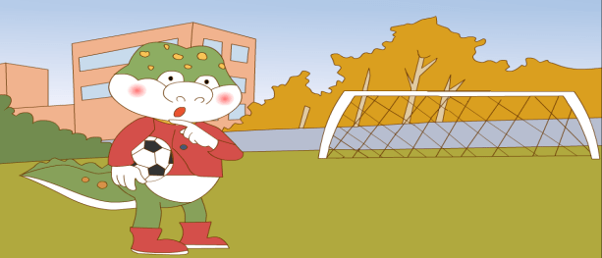
What club would you like to join?
the Football Club
I’d like to join _______________.

Slide 11
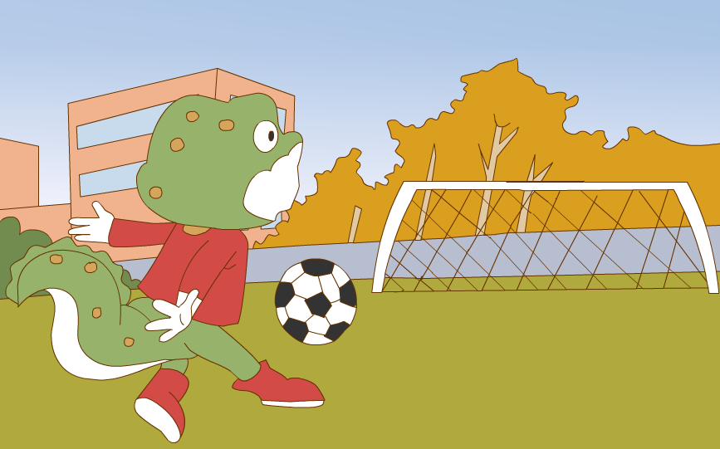
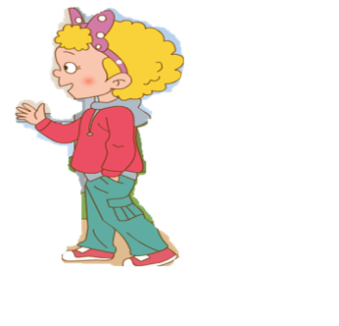
Can Danny play football well?
Don’t worry, Danny. Try again.
Oops!

Slide 12
Great!
OK, try again.

Slide 13
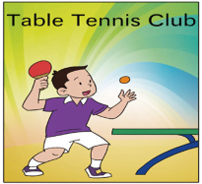
What club would you like to join?
I’d like to join _________________.
the Swimming Club
Try, try, have a try.

Slide 14
Sports Day is coming!

Slide 15
A: What sport do you like?
B: I like football and running.
A: What club would you like to join?
B: I’d like to join the Football Club.
I’m good at football. What about you?
A: I like skipping. It’s very interesting.
I’d like to join the Skipping Club.

Slide 16
A: What sport do you like?
B: I like _______ and _______.
A: What club would you like to join?
B: I’d like to join the ______ Club.
I’m good at ________. What about you?
A: I like _______. It’s very ______.
I’d like to join the ______ Club.

Slide 17
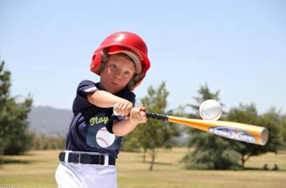
Baseball Club

Slide 18
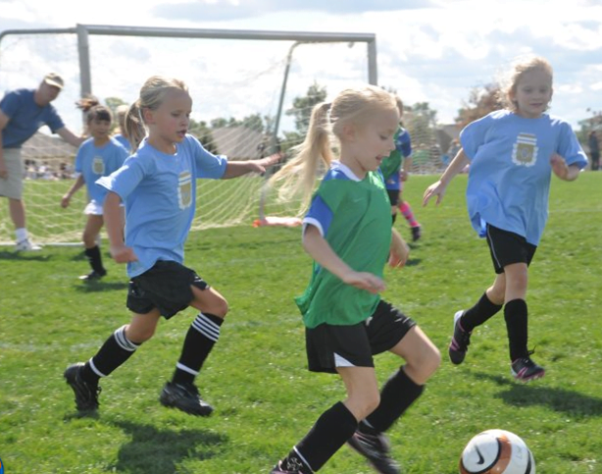
Soccer Club

Slide 19
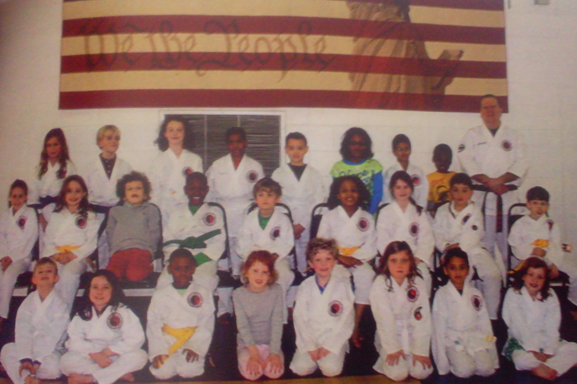
Karate Club

Slide 20
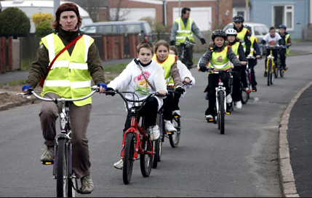
Cycling Club

Slide 21
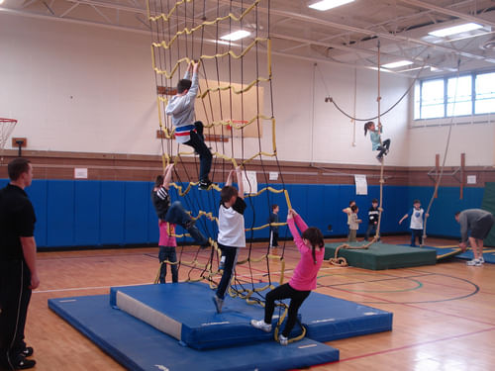
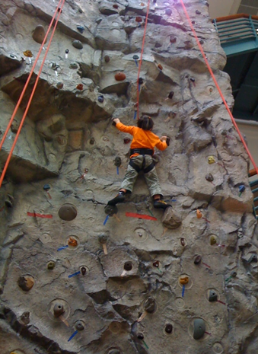
Climbing Club

Slide 22
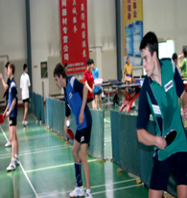
Table Tennis Club

Slide 23
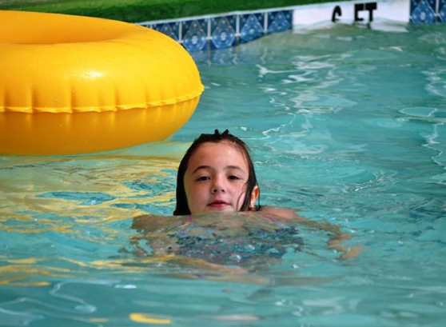
Swimming Club

Slide 24
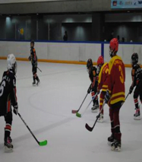
Hockey Club

Slide 25
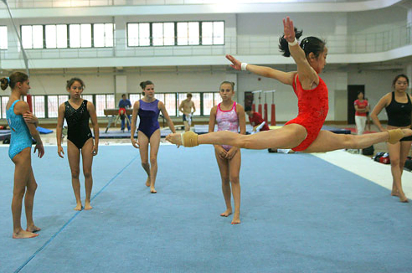
Gymnastics Club

Slide 26
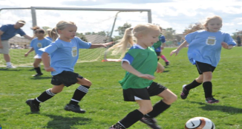
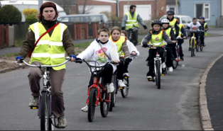

Slide 27
Join the sports clubs,
do some sports,
Happy and healthy every day.

Slide 28
Homework:
1. read for 3 times.
2. Research and talk with your friends:
“What club would you like to join?”

Slide 29
Thank You

