Slide 1
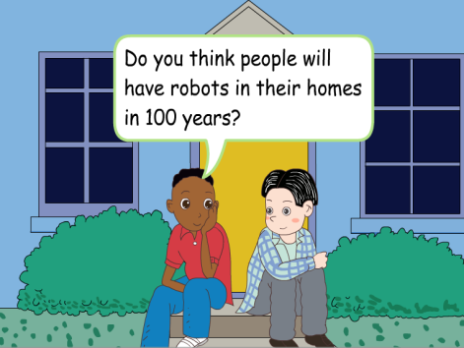
人教版八年级上册
Unit 7
Will people have robots?
Section B（第2课时）
WWW.PPT818.COM
0

Slide 2
1. New words: human servants/human/snake/shape/building/over and over again 2.Ability objects: 1）Students can obtain information by reading 2）Students can improve their reading skills (scanning for the main idea, careful reading for detailed information and further understanding) 3.Moral objects: 1） Develop students’ imagination to make predictions about our future. 2） Encourage students to get ready for a better future.
学习目标

Slide 3
自学互研
新词自查
根据句意及汉语提示完成句子
1. The robot can do many things like a servant (仆人).
2. My father are making many robots in this factory (工厂).
3. My brother is very clever and he can make model planes
with different kinds of shapes (形状).

Slide 4
present
New words
1. dangerous adj. 有危险的；不安全的
名词danger +后缀ous → dangerous
e.g. Some animals are in great danger.
一些动物处于极大的危险中。
Lions are dangerous animals.
狮子是危险的动物。

Slide 5
2. factory n. 工厂
e.g. There will be more factories in the future.
将来会有更多的工厂。
3. fall v. (fell/ fel/) 倒塌；跌倒；掉落
fall down 突然倒下；跌倒；倒塌
e.g. The house might fall down in a few months. 几个月内这所房屋也许就会倒塌。

Slide 6
4. disagree v. 不同意；持不同意见；有分歧
前缀(dis) + agree (同意)→disagree
e.g. My father agrees, but my mother disagrees.
我爸爸同意，但我妈妈不同意。
5. believe v. 相信；认为有可能
believe sb. 相信某人说的话
believe + that 从句
e.g. I believe that you can finish the work on time.
我相信你会按时完成工作。

Slide 7
6. shape n. 形状
e.g. What is the shape of your kite?
你的风筝是什么形状的？
7. hundreds of 许多；大量= lots of
e.g. There are hundreds of flags in front of the building.
在那个高楼前有很多旗帜。
【辨析】具体数字+ hundred
如：three hundred 三百

Slide 8
8. over and over again 反复地；多次
还可以说over and over
e.g. He called over and over again but nobody answered.
他多次打电话但没有人接。
9. possible adj. 可能的；可能存在或发生
(前缀)im+ possible →impossible 不可能的
e.g. Do you think it’s possible to beat them?
你认为战胜他们有可能吗?
To cross this river seems impossible.
穿过这条河中似乎不可能。

Slide 9
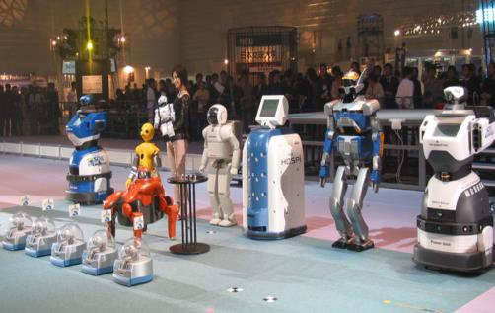
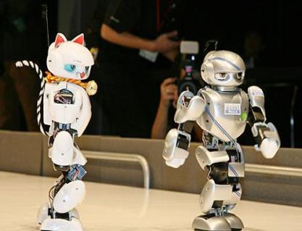
导学达标
2a Tell your partner what you know about robots. What do they look like and what can they do?

Slide 10
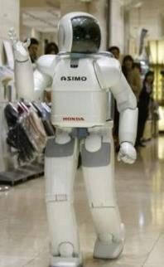
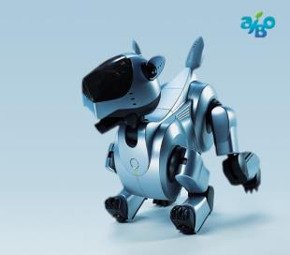
What do they look like?
What does it look like?
They look like humans.
It looks like a dog.

Slide 11
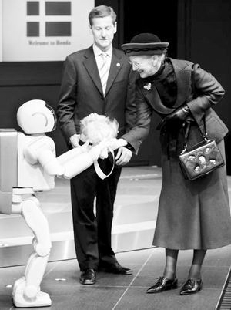
What will robots do for us in the future?
Let’s make predictions.
After 100 years….

Slide 12
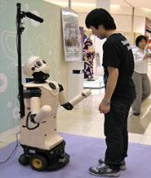
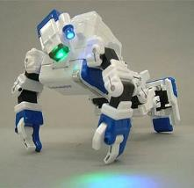
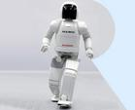
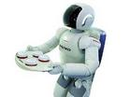
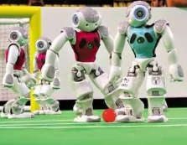
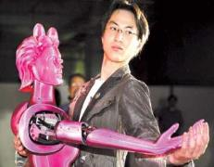
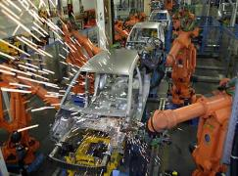
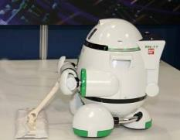
speak
do exercise
run
cook
play football
dance
help people do the most unpleasant jobs
help with the housework

Slide 13
Fast reading
2b Read the article and match each paragraph with the question it discusses.
Para.1 Will robots think like humans in the future?
Para.2 What will robots be like in the future?
Para.3 What can robots do today?
Para.4 What are robots like in movies?

Slide 14
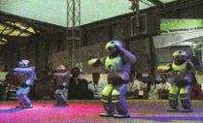
Do You Think You Will Have Your Own Robot?
When we watch movies about the future, we sometimes see robots. They are usually like human servants. They help with the housework and do jobs like working in dirty or dangerous places.
2.Today there are already robots working in factories. Some can help to build cars, and they do simple jobs over and over again. Fewer people will do such jobs in the future because they are boring, but robots will never get bored.

Slide 15
3. Scientists are now trying to make robots look like humans and do the same things as we do. Some robots in Japan can walk and dance. They are fun to watch. However, some scientists believe that although we can make robots move like people, it will be difficult to make them really think like a human. For example, scientist James White thinks that robots will never be able to wake up and know where they are. But many scientists disagree with Mr. White. They think that robots will even be able to talk like humans in 25 to 50 years.

Slide 16
4. Some scientists believe that there will be more robots in the future. However, they agree it may take hundreds of years. These new robots will have many different shapes. Some will look like humans, and others might look like animals. In India, for example, scientists made robots that look like snakes. If buildings fall down with people inside,
these snake robots can help look for people under the
buildings. This was not possible 20 years ago, but computers and rockets also seemed impossible 100 years ago. We never know what will happen in the future!

Slide 17
短语翻译
1.科幻小说
2.帮忙做家务
3.花费好几百年的时间
4.看起来像
5.让机器人走路或跳舞
6.和人一样做相同的事
science fiction
help with the housework
take hundreds of years
look like
make robots walk and dance
do the same things as a person

Slide 18
7.例如
8.与人交谈
9.做简单的工作
10.一遍又一遍
11.变得烦躁
12.寻找
13.看起来有可能的
for example
talk to people
do simple jobs
over and over again
get bored
look for
seem possible

Slide 19
Careful reading
Read and answer the questions.
In some science fiction movies, what will
people have in the future?
2. Which country has robots that can walk
and dance?
3. Where are the huge arm robots working now?
Robots.
Japan.
In factories.

Slide 20
4. What does James White think?
5. What kind of job can a snake robot do?
He thinks that robots will never be able to
wake up and know where they are.
After an earthquake, it could help look for
people under buildings.

Slide 21
2c Read the article again quickly. Complete the sentences about what robots can do now.
1. Robots can build ____ in factories.
2. They can do _______ jobs many times and never get bored.
3. Some can _______ and __________.
4. Some can help _______ people under ___________.
cars
simple
walk
dance
look for
the buildings

Slide 22
2d Fill in the blanks in this paragraph with words from the article.
指导：
此类短文填空题，考查同学们全面掌握短文内容，以及综合运用语言的能力。
首先，应将通读本段文字，掌握大意。可知在短文中列举了科学家们的两种观点。
然后，根据2b中短文的内容填空。

Slide 23
Some robots are very human-like. They can walk and ______ like people. Some scientists think that in the future they will _______ robots more like humans. This may not _________ in the near future, but at some point, robots will even be able to ______ like people. However, some scientists _________. James White believes that robots will not be able to do the ________ things as we can. For example, he thinks that robots will ______ be able to wake up and know where they are. Which side do you ________ with?
dance
make
happen
talk
disagree
same
never
agree

Slide 24
2e What kind of animals might robots look like in the future? What do you think these robots will be able to do? Write your ideas and discuss them with your partner.
I think some future robots might look like ___________. They will ___________________
____________________________________________________________________________________________________________________________________________________________

Slide 25
I think some future robots might look like
spiders. They will be able to help us clean the window and sweep the floor.
Some robots might look like snakes. They will be able to help look for people under the buildings if buildings fall down with people inside.
________________________________________________________________________________________________________________________________________________________________________________________________________________________________________________________________________________________

Slide 26
________________________________________________________________________________________________________________________________________________________________________________________________________________________________________________________________________________________________________________________________
Some robots will look like people. They will be able to sing, dance and talk with us.
They will also be able to serve us. They can make dinner, do the dishes and cook coffee for us.
Some robots might look like big arms. They will be able to work in factories. They can help make cars and do simple jobs over and over again.

Slide 27
问题探究
1.Today there are already robots working in factories. 现在已经有机器人在工厂里干活了。
此句中的working in factories的逻辑主语是robots，但是在这个there be句型中，谓语动词已经有了are，所以work就不能再作本句的谓语动词，而应用-ing形式。这一点在学习和使用there be句型时需要特别注意。

Slide 28
2. Fewer people will do such jobs in the future because they are boring, but robots will never get bored.
此句中的get bored 译为“ 感到厌烦，感到无聊”。其同义词为：be bored
二者的区别：get bored强调动作； be bored 强调状态
英语中有很多过去分词或形容词都可以和get, be 连用。比如：tired，angry 等。例如：
You won’t be bored when you are hungry.
当你饿的时候你就不会觉得无聊了。
If you do the same things month after month, you may get bored.
如果你每月都做同样的事情，你可能会感到厌烦。

Slide 29
3. Some robots are very human-like. 一些机器人十分像真人。
在human-like （形似真人的；真人一样的）一词中，-like 为形容词后缀，用在名词之后，与其构成一个完整的形容词，表示“ 形似……的；像……一样的；类似于…..的”。
又如： a bird-like building （像鸟一样的建筑）
a cabbage-like vegetable（一种形似卷心菜的蔬菜），the ball-like thing on the top of the building（楼顶上那个像球一样的东西。）

Slide 30
4. It will be difficult to make them really think like a human. 把机器人做的像人一样思考将会很难。
通常用it 做形式主语，将不定式和动名词置于谓语后面，特别是主语较长时，或在一些习惯用法中。当谓语是系表结构（be + 形容词/ 名词）时，常将不定式后置，构成句型 “it + be + 表语（形容词 / 名词）+ 不定式”。
e.g. It is not an easy thing to master a foreign
language. 掌握一门外语不是件容易的事。

Slide 31
5. Scientist James White thinks that robots will never be able to wake up.
be able to “能够…..”
can 与 be able to 相同点：两者都表示能力
不同点：
can只有现在式和过去式。
be able to可用于现在时、过去时和将来时。
表示经过努力而成功的某一次动作, 只能用be able to.

Slide 32
6. If buildings fall down with people inside, these snake robots can help look for people under the buildings.
fall down 的意思如下：
1）掉下，落下，跌倒：
The old lady fell down in the street and broke her leg.
老妇跌倒在大街上，摔坏了腿。
2）拜倒，跪倒：
They fell down before him.他们拜倒在他面前。
3）倒塌：
The old house soon fell down.这座老房很快就倒塌了。

Slide 33
7. So I’ll probably just keep a bird.
keep: v. “保持; 维持; 喂养”
1) keep + sb. / sth. +形容词 “使某人/某物……”
e.g. The job kept them busy for a year.
2) keep +形容词 “保持”
e.g. The man ran up and down to keep warm.
3) keep + sb. / sth. doing “让某人/某物继续做某事”
e.g. She kept us waiting for her at the station for an hour.
4) keep + doing “继续做, 坚持做”
e.g. He kept running after her, trying to catch her.

Slide 34
课堂评价
一、根据文章内容填空，然后判断正误 1.In many (科幻电影), people in the future(在将来) will have their own planes. 2.These robots are just like .（人类） 3. These robots can do . (最愉快的工作)---the most unpleasant job
science fiction movies
F
T
humans
the most pleasant jobs
F

Slide 35
4.Some scientists think that it will take (成百年的)to have such robots . 5.New robots won’t have many (不同形状)。 6.Some snake-shaped robots could （寻找） injured people under the buildings after an (地震).
hundreds of years
F
different shapes
F
look for
earthquake
F

Slide 36
Homework
Read the passage for at least 20 minutes and try to recite some of it.
Finish the exercise book.

