Slide 1
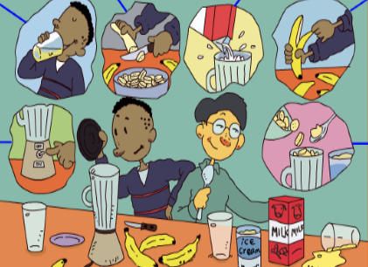
人教版八年级上册
Unit 8
How do you make a banana milk shake?
Section A（第2课时）
WWW.PPT818.COM
0

Slide 2
1.能准确运用how much, how many短语询问不可数名词和可数名词的数量。 2.能恰当运用表示顺序的副词表达制作步骤的先后顺序。 3.懂得不同的国家地区有不同的生活饮食习惯，并学会尊重。 4.能有自己动手制作食物的生活情趣，并与他人分享美食。 5.能从品尝美食想到珍惜食物。
学习目标

Slide 3
自学互研
新词自查
根据句意及汉语提示完成句子
1. I would like some tea with sugar (食糖).
2. My sister likes to have cakes with cheese (奶酪).
3. Before you plant a tree, you must dig (挖) a hole first.
4. Could you please tell me how to use this machine (机器)?
5. Look! There is a big hole (洞) on your coat.

Slide 4
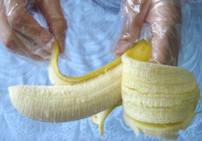
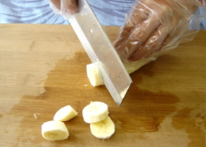
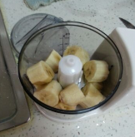
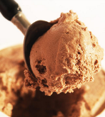
情景导入
How do you make a banana milk shake?
Peel the bananas.
Cut up the bananas.
Put the bananas and ice-cream in the blender.

Slide 5
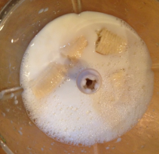
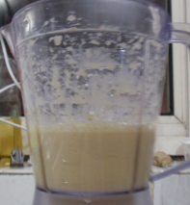
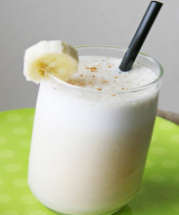
Pour the milk into the blender.
Turn on the blender.
Finally, drink the milk shake.

Slide 6
How do you make Russian soup?
1. First, buy some beef, one cabbage, four
carrots, three potatoes, five tomatoes
and one onion.
2. Then, cut up the vegetables.
3. Next, put the beef, carrots and potatoes
into a pot and add some water.
4. After that, cook them for 30 minutes.

Slide 7
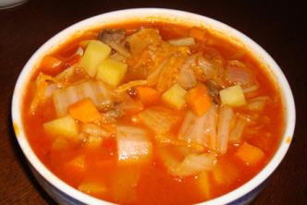
5. Then add the cabbage, tomatoes and onion and cook for another 10 minutes.
6. And don’t forget to add some salt.

Slide 8
Grammar focus
导学达标
根据课本内容，完成下列句子。
1. 你怎样做香蕉奶昔？
_____ do you _____ a banana milk shake?
2. 首先，将香蕉剥皮。
______, _____ the bananas.
3. 接下来，将香蕉放入果汁机中。
____, _____ the bananas in the blender.
4. 然后，将牛奶倒进果汁机中。
_____, _____ the milk ____ the blender.
How make
First peel
Next put
Then pour into

Slide 9
5. 最后，打开果汁机。
______, _______ ___ the blender.
6. 我们需要多少香蕉？
______ _____ bananas do we need?
7. 我们需要三只香蕉。
We ______ three _________.
8. 我们需要多少酸奶？
_____ _____ yogurt do we need?
9. 我们需要一杯酸奶。
We need ___ ____ ____ yogurt.
Finally turn on
How many
need bananas
How much
one cup of

Slide 10
如何问答名词的数量：
1. 询问不可数名词的数量：
_________ + 不可数名词 ……?
How much
2. 询问可数名词的数量：
__________ + 可数名词复数……?
How many
3. 回答不可数名词的数量：
___________ + 不可数名词
一杯 ________; 一碗 __________
数量词
a cup of
a bowl of

Slide 11
完成下列句子。
1. We need three cups of sugar. (提问)
_____ ______ sugar do we need?
2. They need ten tomatoes for the soup. (提问)
_____ ______ tomatoes do they need?
3. The T-shirt is twenty dollars. (提问)
_____ _____ is the T-shirt?
4. We have six bottles of juice. (提问)
____ ______ bottles of juice do you have?
How much
How many
How much
How many

Slide 12
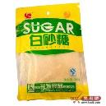
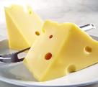
Circle the correct word in each question.
1. How (much/many) bananas do we need?
2. How (much/many) sugar do we need?
3. How (much/many) bread do we need?
4. How (much/many) tomatoes do we need?
5. How (much/many) cheese do we need?

Slide 13
Present new
words
1. machine n. 机器；机械装置
e.g. Do you know how to handle this machine?
你知道如何操作这个机器吗？
2. dig v. 掘（地）；凿（洞）挖（土）
e.g. It takes a lot of time to dig a well.
挖一口井要花费很多时间。
3. hole n. 洞；孔；坑
e.g. There is a hole in the wall. 在墙上有个洞。
4. corn n. 玉米；谷物
popcorn n. 爆米花

Slide 14
Complete the questions and answers. Then match them.
___ 1. ___________ do you make popcorn?
___ 2. ___________ corn do we need?
___ 3. ___________ do we do next?
___ 4. ___________ salt do we need?
___ 5. Now can we eat it?
a. Half a cup.
b. ___, put the corn into the popcorn machine.
c. Yes, we can!
d. Next, ___ on the machine. ___, add the salt.
e. Just one spoon.

Slide 15
指导
1. How; 句意“你如何制作爆米花？”
2. How much; 空格后是不可数名词corn，动词为need，可推知：我们需要多少玉米？
3. What; 本句有动词do，故空格处应用特殊疑问词what。
4. How much; 空格后是不可数名词salt，动词为need，可推知：我们需要多少盐？
b. First; 句意“将玉米放进爆米机里”，由常识可知，这是爆爆米花的第一件事情。
d. turn; 由空格后的on the machine，一词可知空格处为turn一词，turn on打开。Finally; 由最后的一词“加点盐”，可知这是最后一件事情，故应填finally一词。

Slide 16
1. b; 由问句可知应回答爆米花的制作过程。
2. a; 由常识可知，爆米花时所用玉米的数量大约为半茶杯。
3. d; 本句所答为接下来所做的事情，符合问句的意思。
4. e; 由常识可知我们所需的盐不用太多，有一小匙便可，故选e。
5. c; 问句为一般疑问句，故应用yes或no来回答。

Slide 17
Check the answers.
b
___ 1. ___________ do you make popcorn?
___ 2. ___________ corn do we need?
___ 3. ___________ do we do next?
___ 4. ___________ salt do we need?
___ 5. Now can we eat it?
How
a
How much
d
What
e
How much
c
a. Half a cup.
b. ______, put the corn into the popcorn machine.
c. Yes, we can!
d. Next, ____ on the machine. _____, add the salt.
e. Just one spoon.
First
turn
Finally

Slide 18
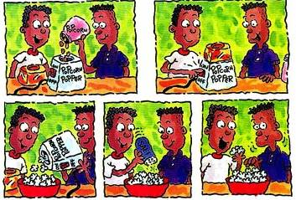
Talking
First, put the corn into the popcorn machine.
Next, turn on the machine.
Finally, add the salt. And you can eat it now.

Slide 19
Write how to do one of the following things. Then tell your partner how to do it.
plant a tree make beef noodles wash clothes take out a book from the library
Try to do it!

Slide 20
指导
1. 根据生活经验，将如何做这些事情的过
程写出来。如果自己不会做，可以让会
做的同学分享下他们的做法。
2. 注意，恰当用first, next, then, finally等
表示做事情顺序的词汇，让你的描述更
加清晰。

Slide 21
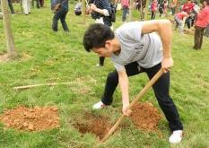
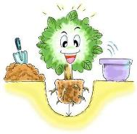
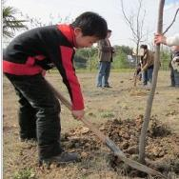
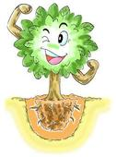
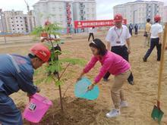
Dig a hole.
Put the tree in the hole.
Put the soil back into the hole.
It’s OK now.
Water the tree.

Slide 22
重排下列句子，成为一段完整的对话。
2
A. First, put the water into the pot.
B. Next, put the noodles into the pot and
cook for five minutes.
C. How many noodles do we need?
D. How much water do we need?
E. How do we make egg noodles?
F. What do we do next?
G. Four bowls.
H. Half a kilo.
I. Finally, put the egg into the pot and cook for
another five minutes.
6
7
3
1
5
4
8
9

Slide 23
问题探究
▲可数名词与不可数名词
凡是可计数的名词叫可数名词；凡是不可计数的名词叫不可数名词。
1）可数名词分为单数和复数两种形式，前面可以用不定冠词、数词或some、many等词语修饰。如：an apple 一个苹果，some children一些孩子，many women很多妇女
2）不可数名词没有复数形式，前面不能用不定代词、数词或many等词语修饰，但可以用some，a little, much等词语来修饰。有时可以与一些量词

Slide 24
短语搭配，量词一般是可数的，有单数形式，也可以是复数形式。如：some water一些水，a little milk一点牛奶，much food很多食物，a piece of bread一片面包，two bottles of ink 两瓶墨水，some glasses of water 几杯水

Slide 25
课堂评价
单项选择
（ ）1. She is new here. She has ____ here.
A few friend B a few friends
C few friends D little friends
( ) 2.How much ___do we need to make a sandwich?
A oranges B bread C tomatoes D potatoes
( ) 3.I think ___ honey is enough.
A one B two spoons C two spoon of D two spoons of
( )4. Do you need ___for the children?
A so much eggs B two box of eggs C two boxes of egg D two boxes of eggs
A
B
D
D

Slide 26
Homework
1. 复习Grammar Focus中的内容。
2. 从3c中选择一个活动项目，用英语将其过程描写出来。注意正确运用表示顺序的词汇：fist, next, then, after that, finally。

