Slide 1
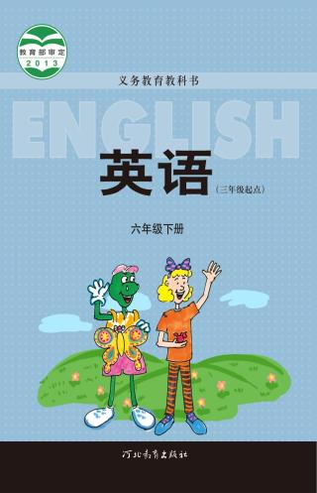
Unit 1 Lesson 6
A Famous Football Player
WWW.PPT818.COM

Slide 2
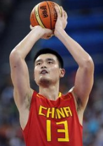
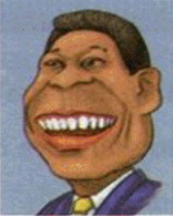
Warm-up
Do you know him?
Yao Ming
???

Slide 3
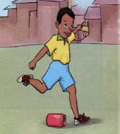
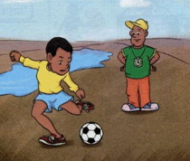
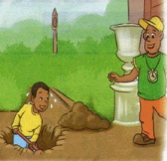
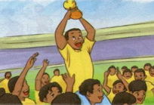
Story time
Fast reading
His name is Pele.
the world famous football player

Slide 4
Story time
Intensive reading
Why did the boy use boxes and bottles as his footballs?
Read Part1
Because he liked to play football very much, but his parents couldn't buy him a football.

Slide 5
Story time
Intensive reading
Why did the coach give him a football as a gift?
Read Part2
Because he thought that the boy would be a good player.
coach

Slide 6
Story time
Intensive reading
Read Part3
What did the boy do for the coach at Christmas time?
He dug a hole for the
Christmas tree.
dig a hole

Slide 7
This is the best
Christmas gift.
I can't buy you a Christmas gift. But I can dig a hole for your Christmas tree.

Slide 8
Story time
Intensive reading
Read Part4
What happened in 1958?
The boy and his team won the Football World Cup.

Slide 9
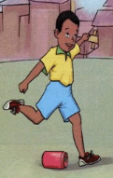
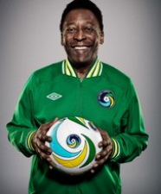
Story time
Intensive reading
Read Part5
Who is the boy?
He is Pele - the world famous football player.

Slide 10
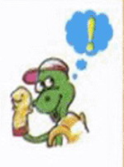
Story time
Intensive reading
What can you learn from Pele?
Where there is a will. There is a way.
有志者事竟成

Slide 11
Listen to the story and check the words you hear.
coach front
bottle hole
around answer

Slide 12
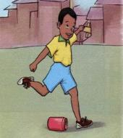
Retell the story
Say something about the pictures.

Slide 13
Summary and evaluation
What have you learned in this class?
A excellent B good C adequate D need improvement
内容 | 学生自评 | 小组互评
我能认真听老师讲课，听同学发言
遇到我会回答的问题主动举手了
活动中坚持使用英语来交际
我能积极参与小组讨论活动，能与他人合作。

Slide 14
Homework
1. Retell the story.
2. Do you know other famous people?

