Slide 1
Unit 6 Sunshine for all
Reading 1
WWW.PPT818.COM

Slide 2
Lead-in
Talk about the people who need help

Slide 3
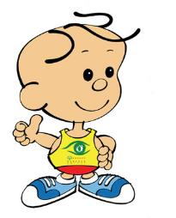
Pre-reading
The 12th Special Olympic World Games
be held in Shanghai
be held in October, 2007

Slide 4
Pre-reading
The 12th Special Olympic World Games
include many events similar to those in the Olympics

Slide 5
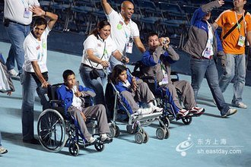
Pre-reading
The 12th Special Olympic World Games
Children and adults with intellectual disabilities show their skills to the world.

Slide 6
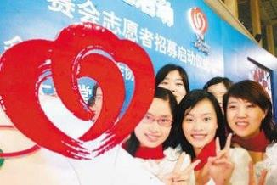
Pre-reading
The 12th Special Olympic World Games
work as volunteers
volunteer for …
receive training
provide support for the athletes

Slide 7
While-reading
Listen and answer
1.What does Liu Ming think of volunteering for the Special
Olympics ?
2. How many volunteers take part in the games?
3. What game did Li Hai take part in?
It was the most amazing experience.
Over 40,000 people .
He took part in the swimming competition.

Slide 8
While-reading
Read and match
An introduction to the Special Olympics World Games
Para 1
Para 2
Liu Ming’s experience
Liu Ming’s feeling about the event
Para 4,5
What volunteers do for the event
Para 3

Slide 9
While-reading
Replace the underlined parts with a word or phrase from the report.
the Special Olympics World Games
Simon: Have you heard of the international sports festival
for people with intellectual disabilities?
Annie: Yes, and I know some people offer to help without
getting paid for the event. How do they help?
Simon: They give up their time when they’re not working
or busy to provide help and support. I read about
one volunteer. He was the person who provided
swimming lessons for a boy called Li Hai.
S
volunteering
spare time
swimming coach

Slide 10
While-reading
Replace the underlined parts with a word or phrase from the report.
Annie: Did Li Hai win first prize?
Simon: No. He finished fourth, but he feels more sure he
can do better now.
Annie: It’s great to help those special athletes make their
dreams come true.
Simon: Yes. Maybe that’s why this event is so different
from other usual games!
the gold
S
confident
achieve
special

Slide 11
after-reading
Choose T or F
T
Liu Ming was a volunteer for the 2007 Special Olympics World Games.
Liu Ming knew what to expect before he became a volunteer.
There were only a few events in the 2007 Special Olympics World Games.
There were over 40,000 volunteers for the 2007 Special Olympics World Games.
Li Hai was born with intellectual disabilities.
Li Hai was sure to win the swimming competition.
F
F
T
T
F

Slide 12
Homework
Read the report frequently.
Search more information about the 2007 Special Olympics World Games.

