Slide 1
Unit 6 Do you like bananas?
单元同步作文导练
WWW.PPT818.COM

Slide 2
本单元以食物为主线，围绕着谈论喜欢与不喜欢的食物以及一日三餐等语言功能展开了一系列的任务活动。写作任务就是一篇介绍自己或他人的喜欢和不喜欢的食物，以及饮食习惯的文章。
教材中出现的相关句型：
①I like…and…我喜欢……和……
②I don't like…or…我不喜欢……和……
③I have… for breakfast/lunch/dinner.我在早饭/午饭/晚饭吃……
④For breakfast，I like eating…早饭时，我喜欢吃……
⑤They are not healthy.它们不健康。
⑥I really like it.我真地喜欢它。
⑦I don't want to be fat.我不想长胖。

Slide 3
拓展常用相关句型：
①My favorite food is…我最喜欢的食物是……
②They are good for our health.它们对我们的健康有好处。
③I have/He/She has a good eating habit.我有/他/她有一个好的饮食习惯。

Slide 5
要求：1.内容应包括表格中的所有信息；
2．60词左右。

Slide 7
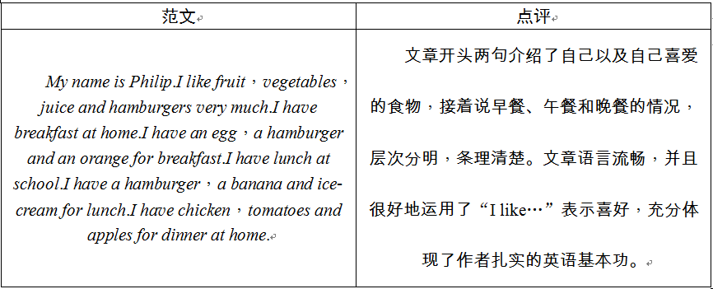

Slide 8
要求：1.内容要点完整，语言流畅；
2．60词左右。

Slide 9
Sandra likes hamburgers and apples for breakfast，but she doesn't like bananas. For lunch，she likes French fries and tomatoes，but she doesn't like strawberries. She likes chicken，carrots and ice­cream for dinner. It's not healthy to eat too many hamburgers or French fries. Sandra wants to eat less hamburgers and French fries and eat more fruit and vegetables.

