Slide 1
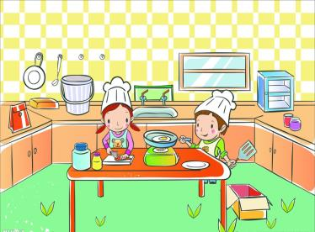
Unit 6
In the kitchen
第二课时
WWW.PPT818.COM

Slide 2
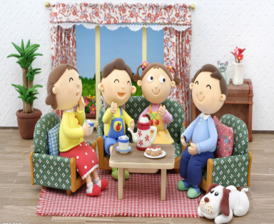
Introduce
What is Liutao’s father cooking?
How’s the meat?
What is his mother cooking?
How is the soup?

Slide 3
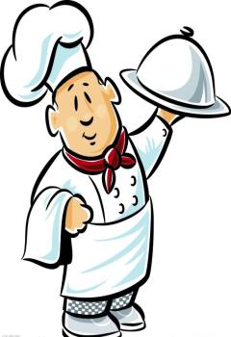
Words
quick [kwik]
形容词，意为“快的，迅速的。”
eg： These cakes are very quick and easy to make.
这些蛋糕做起来又简单又快。
小练习：汉译英：
快点 ________
be quick

Slide 4
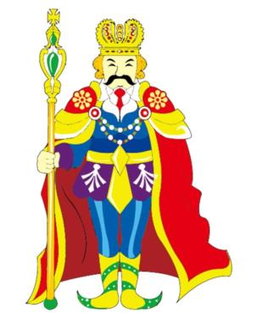
Words
wear [wɛə]
动词，意为穿着。
eg： The king isn’t wearing any clothes.
国王没有穿衣服。
小练习：用所给词的适当形式填空：
He often ____（wear） black coat.
wears

Slide 5
Words
golden [ˈɡəuldən]
形容词，意为“金色的”
eg： a golden sun 一轮金色的太阳
小练习：汉译英：
金发 ________
golden hair

Slide 6
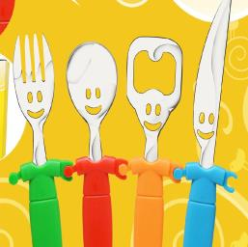
Expressions
I eat with a knife and a fork我用刀和叉吃饭。
eat with...为固定词组，意为“用...吃饭”。
eg： He usually eats with spoons.
小练习：选择合适的介词填空：
He usually eats____（with / on）chopsticks.
with

Slide 7
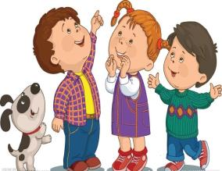
Expressions
Through our little town.经过我们的小镇。
through作介词，意为从一端到另一端。
eg： the doctor pushed his way through the crowd.
医生挤进人群。
小练习：汉译英：
穿过这座城市 ____________
through this city

Slide 8
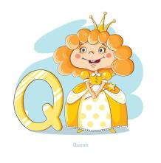
Dialogue
Quick, the queen is coming.
快，王后来了。
Through our little town.
经过我们的小镇。
Quick, the queen is coming.
快，王后来了。
Wearing her golden crown.
戴着她金色的王冠。
I eat with chopsticks.
我用筷子吃饭。
I eat with a knife and a fork.
我用刀和叉吃饭。

Slide 9
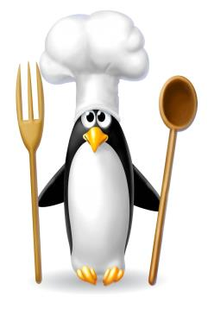
Expand
在中餐餐桌上，一般有盘、碗、碟、匙、筷、杯。其中筷子是中餐的主要特征。而在西餐餐桌上，一般摆有三副刀叉及匙.在欧洲，当右手握刀左手拿叉切好东西后，直接就用左手叉起食物送入嘴中，这是可以被接受的，但到了美国，就不可以了，应放下刀子，将叉子交到右手，再用右手叉起食物。

Slide 10
Expand
Good的一词多用
1.Good thing...还好，幸好......
在美语当中若要表达中文里“还好，幸好......”的语气，你就可以用“Good thing...”做开头。这个句型非常简单又好用，你只要在“Good thing”后面加上完整的句子就可以。

Slide 11
Expand
Good的一词多用
2.There is nothing good playing. 没好电影可看
这里的“There’s nothing good playing.”是接着问句而来的，指的是“没有好电影可看。”同样地，若是电视上没有好节目可看，你就可以说“There’s nothing good on TV.”

Slide 12
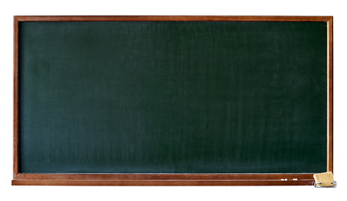
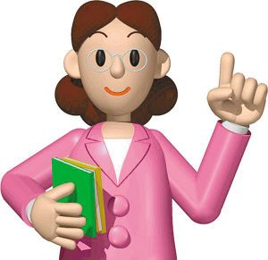
Summary
wear
golden
quick
I eat with a knife and a fork.

Slide 13
Exercise
按照要求改写句子。
1.There is some peach juice in the fridge.（对划线部分提问）
_____________________________
2.He is flying kites in the field.（改成一般疑问句并作肯定否定回答）
______________________________
3.We are doing some shopping.（根据问句写出答句）
_____________________________
4.How many days are there is a week?（根据实际情况回答问题）
_____________________________
What's in the bookcase?
Is he flying kites in the field? Yes, he is. / No, he isn't.
What are you doing?
There are seven.

Slide 14
Exercise
问句答句配对连线
A B
How many boys are there in the playground? a. Yes, there are.
Do you like eating meat? b. There are three.
Is there any juice in the glass? c. Yes, there is.
How is the meat? d. It’s nice.
Are there any eggs in the fridge? e. No, I don’t.
I like vegetable. f. Me too.

Slide 15
Homework
Talk about your favorite fruits.

