Slide 1
Unit 6
Sunshine for all
Welcome to the unit
WWW.PPT818.COM

Slide 2
New words
the Olympic Games = the Olympics
We should support our national athletes at the Olympic Games.

Slide 3
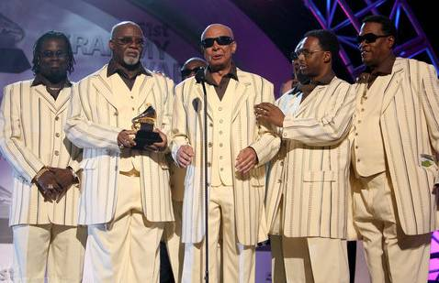
blind adj. 盲的
We should help blind people cross the road.

Slide 4
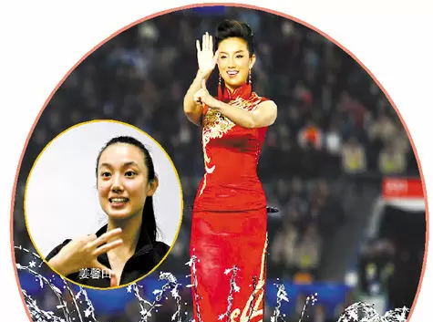
deaf adj. 聋的
Deaf people can talk with hand language.

Slide 5
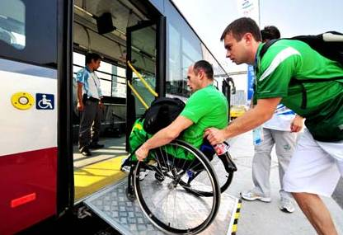
disabled adj. 残疾的
It is difficult for disabled people to go upstairs.

Slide 6
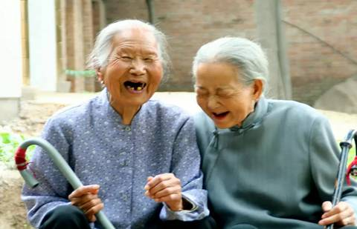
elderly adj. 年老的
The elderly should be taken good care of.

Slide 7
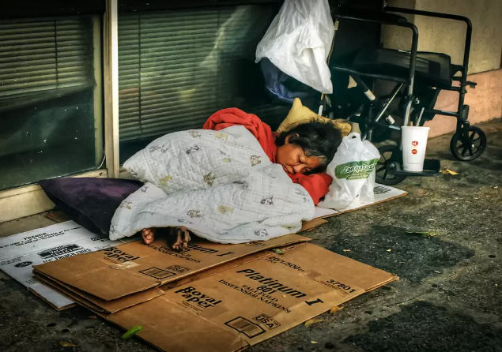
homeless adj. 无家可归的
Homeless people have nowhere to live.

Slide 8
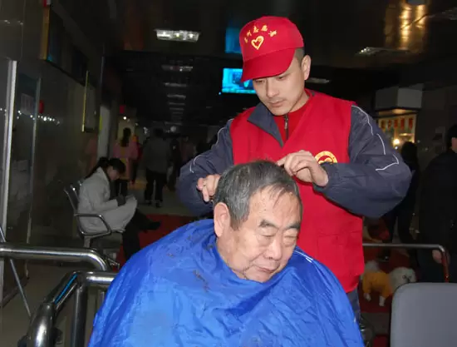
meaningful adj. 有意义的
Volunteers ususlly do meaningful things.

Slide 9
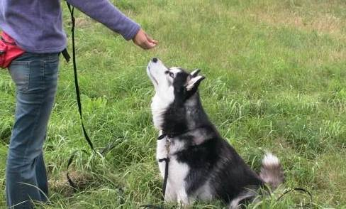
train n. 训练；培训
So we should train more volunteers to help more people.

Slide 10
Free talk
Have you ever been a volunteer?
Have you ever helped people who need help?

Slide 11
People who need help
The Class 1, Grade 8 students have found some pictures of people who need help. Write the correct words under them. Then put a tick in the boxes if you have ever helped these people.

Slide 12
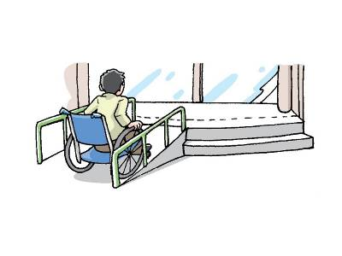
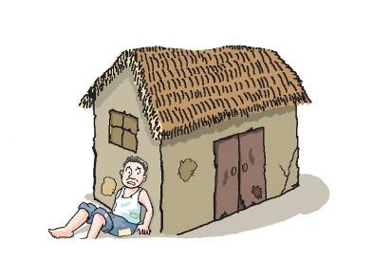
blind, deaf, disabled, elderly, homeless, poor
a _____ person
a ________ person
poor
disabled

Slide 13
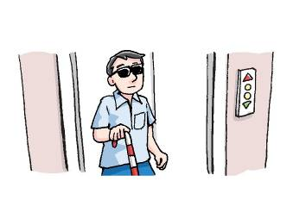
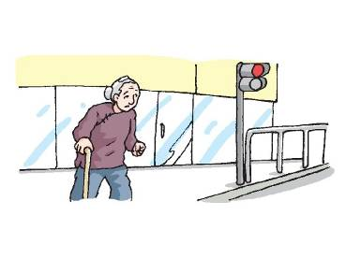
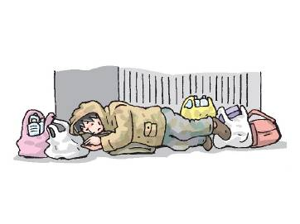
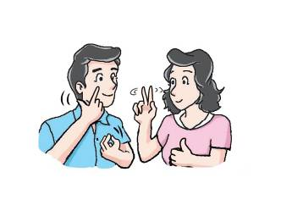
a _____ person
an ______ person
blind
elderly
_____ people
homeless
deaf
a ________ person

Slide 14
Amy and Daniel are talking about people who need help. Listen to the recording and answer the following question：
How can we help homeless people?
Give them food and clothes.
Write to the local government.

Slide 15
Work in pairs and discuss the people in Part A.
Use the conversation below as a model.

Slide 16
Amy: What are homeless people, Daniel?
Daniel: Homeless people don’t have their own places to live.
Amy: How can we help homeless people?
Daniel: We can give them food and clothes.
Amy: Are there any other ways to help them?
Daniel: Yes. We can write to the local government. They can provide special places for homeless people to stay.

Slide 17
Free talk
Would Eddie and Hobo like to
help people in need?

Slide 18
Listen and answer the questions.
What is Hobo doing?
Will Eddie support him?
How does Hobo want Eddie to help?
He is training to be a volunteer for the Olympic Games.
Yes, he will.
He needs some more food to eat at work.

Slide 19
Language points
1. I’m training to be a volunteer for the Olympic Games.
train v. 训练；培训
e.g. If you train hard, you'll make a
good footballer.
你要刻苦训练就能成为优秀的足球运动员。

Slide 20
2. It’s meaningful to do something for the Olympics.
It’s meaningful to do sth. for sb.
为某人做某事是有意义的
e.g. It’s meaningful to do something for
children in poor areas.
为贫困地区孩子做些事是很有意义
的。

Slide 21
3. I want you to help me.
want sb. to do sth.
想要某人做某事
e.g.
Parents want us to study hard
everyday.
父母想要我们每天努力学习。

Slide 22
4. I need some more food to eat at work.
(1) need sth to do sth 需要某物来做某事
e.g. I need some tools to finish the work.
我需要一些工具来完成这份工作。
(2) some more food 更多一些食物
数量意义词+more+名词: 表更多……
e.g. two more apples
再两个苹果

Slide 23
5. Homeless people don’t have their own places to live.
to live：动词不定式做定语修饰前面的名词。
e.g. have something to eat
有一些吃的东西

Slide 24
6. They can provide special places for
homeless people to stay.
provide sth for sb 为某人提供某物
=provide sb. with sth.
e.g. He was very poor because he’d
to provide food for seven children. 他很穷，因为他要给七个孩子提供
食物。

Slide 25
Exercises
I. Complete the sentences.
1. It’s __________ (mean) to help people in need.
2. My father needed a pair of scissors _____ (cut) out some pieces of cards.
3. I don’t have enough money ____ (go) travelling.
4. He is a _______ (able) person. He lost one of his legs in a car accident.
meaningful
to cut
to go
disabled

Slide 26
II. Translate the following sentences.
我们怎样帮助盲人呢？
工作时我需要更多一些食物吃。
我正在训练成为奥林匹克的一名志愿者。
How can we help blind people?
I need some more food to eat at work.
I am training to be a volunteer for the Olympic Games.

Slide 27
4. 为奥林匹克做些事情很有意义。
5. 有没有其他的办法帮助老人？
It’s meaningful to do something for the Olympics.
Are there any other ways to help the elderly?

