Slide 1
Unit 2 School life
GrammarⅠ
WWW.PPT818.COM

Slide 2
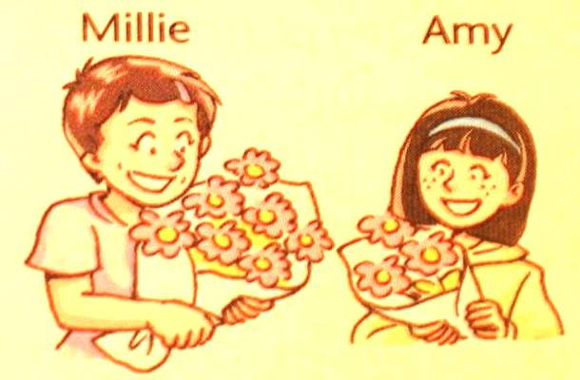
Amy has some flowers in her hands .
Millie has more flowers than Amy.
Amy has fewer flowers than Millie.

Slide 3
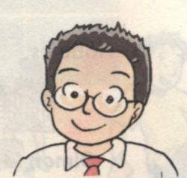
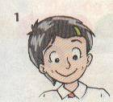
Millie
Daniel
Daniel has some apples .
Millie has more apples than Daniel .
Daniel has ______ apples than Millie .
fewer

Slide 4
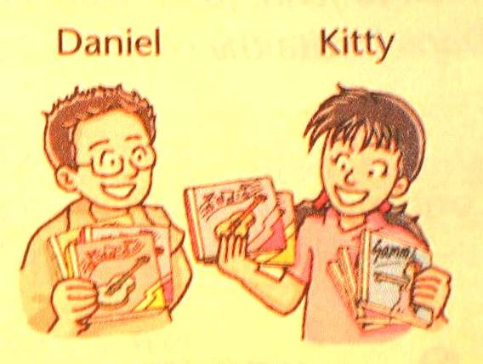
Daniel has many CDs .
Daniel
has fewer CDs than Kitty.
Kitty
has more CDs than Daniel.

Slide 5
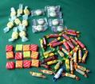
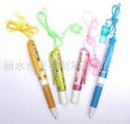
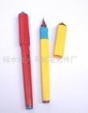
Make sentences with “more/fewer than…”
Betty Tom
stickers
sweets
pens

Slide 6
Millie has more flowers than Amy.
Daniel has fewer CDs than Kitty.
Consolidation :
more/fewer + nouns＋than
countable

Slide 7
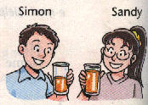
Simon has some orange juice in his glass .
Sandy has more orange juice than Simon .
Simon has less orange juice than Sandy.

Slide 8
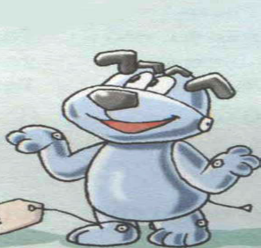
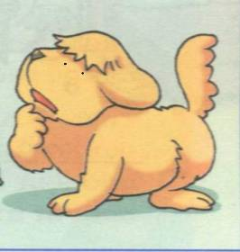
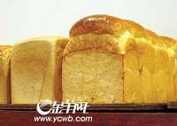
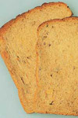
Eddie has two pieces of bread .
Hobo has
more bread than Eddie .
Eddie
has less bread than Hobo .

Slide 9
Consolidation :
+ nouns + than
more/ less
uncountable

Slide 10
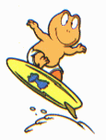
 | Nancy | John
Subjects
Clubs
Free time
6
8
3
2
4 hours
3 hours
John studies ______subjects than Nancy.
more
more
Nancy is in ______clubs than John.
John has ______free time than Nancy.
less

Slide 11
Talk about Peter and Tom with “more/less than…”
Peter Tom
coke
milk
bread

Slide 12
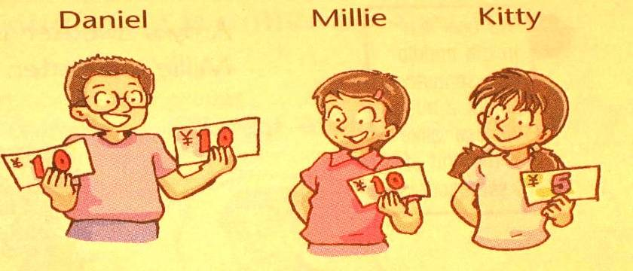
Kitty has five yuan .
more
Millie has ______ money than Kitty .
Daniel has ______ money than Millie .
more
Daniel has the most money.
Kitty has the least money.

Slide 13
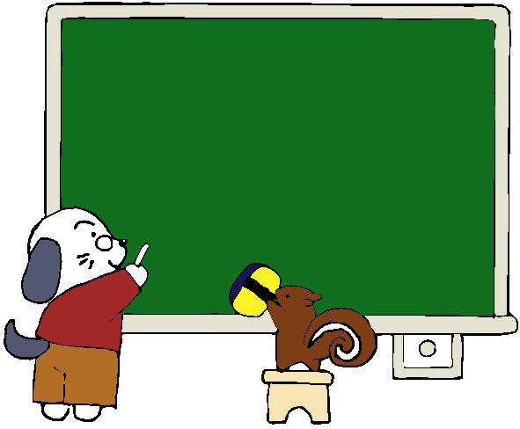
Amy
Sandy
Simon
72 words 68 words 65 words
72 points 68 points 65 points
the most
Amy wrote ___________ words.
She scored ___________ points.
the most
the fewest
2. Simon wrote __________ words.
He scored ___________ points.
the fewest

Slide 14
Consolidation :Comparing more than two things:
the most
the fewest
+ ( ) nouns.
countable
the most
the least
+ ( ) nouns.
uncountable

Slide 15
Comparing school lives
 | Nancy | John | Daniel
Subjects | 6 | 8 | 12
Clubs | 3 | 2 | 4
Free time | 4 hours | 3 hours | 1 hour
the most
Daniel studies _______ subjects among the three.
John is in _______ clubs among the three of us.
Among the three, Daniel has the _____free time
and Nancy has the _____ free time.
the fewest
least
most

Slide 16
Comparing more
What is your school life?
 | Nancy | John | Daniel | Me
Subjects | 6 | 8 | 12
Clubs | 3 | 2 | 4
Free time | 4 hours | 3 hours | 1 hour
Make sentences with “more, fewer, less, most, fewest, least…”

Slide 17
你能写出所给形容词的适当形式吗?
There are ________ apples on this tree than on that tree. (many)
Miss Xia is one of ___________________ (popular) teachers in our school.
The Yellow River is the second ___________ (long) river in China.
This coat is too ______ (small). Have you got a ________ (big) one?
It says that it is very ______ (cold) in Beijing in winter.
more
the most popular
longest
small
bigger
cold

Slide 18
你能帮助Jack完成下列句子的变换吗?
1.John studies more subjects than Millie.
Millie studies _____ subjects _____ John.
2.Amy 的尺子比Ann的长.
Amy has a _____ ______ than Ann.
3.Japanese is not as useful as English.
Japanese is ____ ______ ____ English.
4.Nancy has more free time than John.
John has _____ free time _____ Nancy.
5.Kitty has less money than others in her class.
Kitty has ____ _____ _______in her class.
fewer
than
longer
ruler
less useful than
less
than
the least money

Slide 19
改错：
1. Mr. Smith eats the fewest beef .
2 .Tom has least sheep of them .
3. Mary has the more bread than her classmate.
4. The students in China have little free time
than those in the UK .
5. Cindy has less friends in his new school than
in his old school.
least
the fewest
去掉
less
fewer

Slide 20
Exercise:
他讲的笑话比我少。
Tom有的空闲时间比Millie的多。
在所有的学生中，我有最多的光盘。
我有最少的钱，但是我有最多的朋友。
He tells fewer funny jokes than me.
Tom has more free time than Millie.
Of all the students, I have the most CDs.
I have the least money, but I have the most friends.

Slide 21
Homework
Finish the exercises in the workbook after class.

