Slide 1
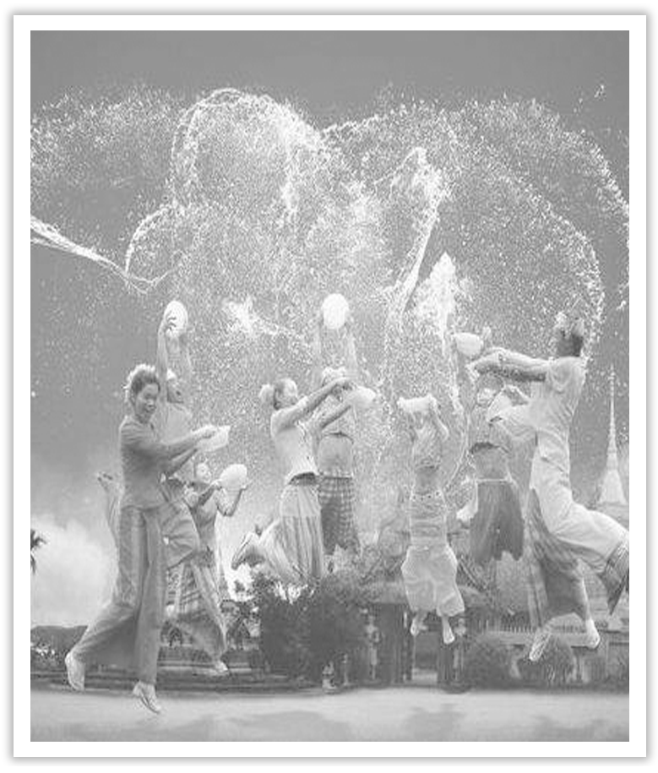
Unit 3 Diverse Cultures
Section Ⅱ Reading and Thinking(1)
WWW.PPT818.COM

Slide 2
1.Discussing—Look at the following pictures and answer the questions.
(1)What do you know about the city of Beijing?
The answer is open.
________________________________________________________________________

Slide 3
(2)What do you want to know about the city of San Francisco?
The answer is open.
________________________________________________________________________
2.Predicting—Look at the pictures on Page 28 and predict what the text is probably about?
The text is probably about the city of San Francisco.
________________________________________________________________________

Slide 4
1.First reading—Read the passage carefully and answer the following questions.
(1)Where are many beautiful old buildings in San Francisco?
____________________________________________________________________
(2)What started in the Mission District?
____________________________________________________________________
(3)Why did many people from all over the world come to San Francisco?
____________________________________________________________________
(4)What is so special about Chinatown?
____________________________________________________________________
On top of big hills.
An art movement called the“Mission School”．
To seek their fortune.
There were so many good cafès and restaurants.

Slide 5
2.Second reading—Fill in the blanks according to the passage.
Before coming to San Francisco | ①____________ in the Redwood Forest and visited ②_________________ of Napa Valley
In the morning | walked around ③____________ the ④____________ for a few hours and ⑤____________ some delicious Mexican-Chinese ⑥____________
camped
the wine country
looking at
street art
ate
noodles

Slide 6
In the afternoon | headed to a ⑦_________________ and learned much about the ⑧_________________ in California
In the evening | went to Chinatown and ate ⑨____________ in a Cantonese restaurant
tomorrow | go to ⑩____________ in the Richmond District
local museum
historical changes
great food
a jazz bar

Slide 7
3.Third reading
(1)Summarizing：Read the passage again and try to summarize the main idea in one sentence.
________________________________________________________________________
________________________________________________________________________
(2)Thinking and discussing：What are the benefits and challenges of cultural diversity?
________________________________________________________________________
________________________________________________________________________
________________________________________________________________________
The passage is a travel journal about the city of San Francisco and the writer’s travel experience in one day.
Benefits：increased adaptability，broader serve range，variety of viewpoints，more effective execution...
Challenges：communication barriers，resistance to change，socio-cultural factors...

Slide 8
Group work：Have you ever been to a place that has a diverse culture? What do you think brought about the cultural diversity? Please discuss these questions in groups.You may start like this.
A：Hello，glad to meet you here.Have you ever been to a place that has a diverse culture?
B：Yes.I went to San Francisco，a multi－cultural city，in the summer holidays.
A：...

Slide 9
阅读技巧点拨
如何分类和组织信息？
1.By deciding the kind of information，e.g.dates，numbers，opinions.
2.By putting things in order，e.g.according to how old，how much，what kind.
3.By drawing a diagram to organize the information.

Slide 10
语言现象感知
Ⅰ.单词理解
体会句中加黑单词的词性和含义
1.She admitted having done wrong.____________
2.I saw the child reading a science fiction comic.____________
3.The police are still seeking the men involved in last week’s robbery.____________
4.His claim to own the house is valid.______________
vt.承认
n.漫画杂志
vt.寻找
n.宣称；断言

Slide 11
Ⅱ.词块积累
写出下列词块的含义
1.sit on the top of big hills ______________
2.one of the oldest parts of the city __________________________
3.used to be a poor area ___________________
4.a centre for art ____________
5.a real mix of cultures ________________
位于大山顶上
这个城市最古老的地方之一
过去是一个贫困区
艺术中心
真正的文化融合

Slide 12
6.head to a local museum ________________
7.gold rush ____________
8.earn a living ____________
9.open up shops ____________
10.immigrants from different countries and cultures __________________________
去当地的博物馆
淘金热
谋生
开商店
来自不同国家和文化的移民

Slide 13
Ⅲ.句式欣赏
1.动词-ing形式作宾语
Today was my first day back in San Francisco after camping in the Redwood Forest and visiting the wine country of Napa Valley.
2.it作形式主语，不定式是真正的主语
I have to admit that it definitely feels good to be back in the city again.
3.how引导宾语从句
The museum did a really good job of showing how America was built by immigrants from different countries and cultures.

