Slide 1
Unit 11 I was born in January
WWW.PPT818.COM

Slide 2
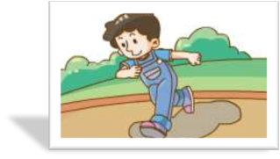
What is he doing?
He is going running.
Is he going running?
Yes, he is.

Slide 3
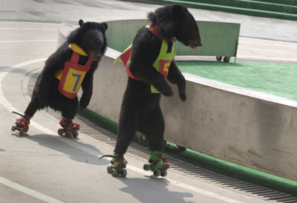
What are they doing?
They are skating.
Are they going running?
No, they are not.

Slide 4
Is he going running?
Yes, he is.
Are they going running?
No, they are not.

Slide 5
Be + 主语 + v-ing + 其他？
让一个同学上来，其他人问。他答yes,no

Slide 6
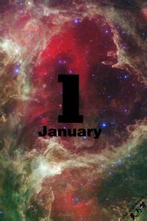

Slide 8
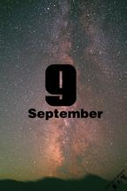

Slide 10
game time

Slide 11
庆祝
celebration

Slide 12
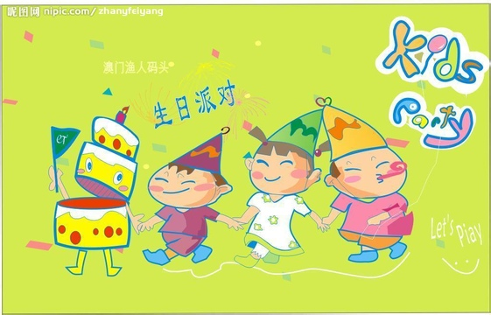
party

Slide 13
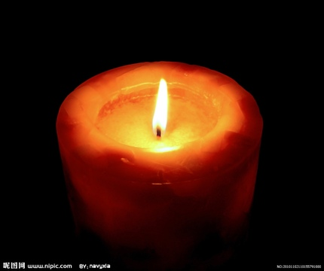
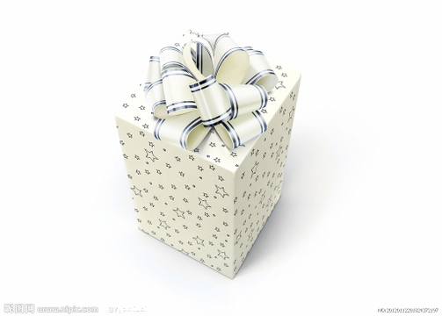
present
candle

Slide 14
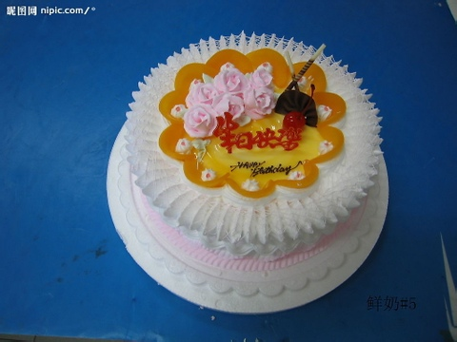
card
cake

Slide 15
大家一起来找茬
january
paty
kake
Merch
Novenber
Apil
cadle
January
party
cake
March
November
April
candle

Slide 16
celibration
Juna
Augast
plesent
Feburary
Septeber
celebration
June
August
present
February
September

Slide 17
_ _ _uary
p_ _ty
c__ __d
Mar__ __
N_v_ _ber
Apr__ __
c__ __dle
celebra_ _ _ _
J__ne
__ __gust
pre_ _ _t
Febr_ _ry
Septem_ _ _

Slide 18
When were you born?
I was born in ...
My birthday is in ...

Slide 19
听力训练
目标实施手册58页第3题

Slide 20
have a break.

Slide 25
When were you born?
I was born in ...
My birthday is ...

Slide 26
我用am，你用are，is连着他，她，它；
单数名词用is，复数名词全用are。
变疑问，往前提，句末问号莫丢弃。
变否定，更容易，be后not莫忘记。
疑问否定任你变，句首大写莫迟疑

Slide 27
1. I ___ a boy.
2. ___ you a boy? No, I __ not.
3. The girl___ Jack's sister.
4. The dog ___ tall and fat.
5. The man with big eyes ___ a teacher.
6. ____ your brother in the classroom?
7. How ____ your father?
8. Mike and Liu Tao ____ at school.

Slide 28
How old are you?
I am ten.
I am ten years old.
I am ten-year-old.

Slide 29
How old is he?
He is ten.
He is ten years old.
He is ten-year-old.

Slide 30
How old is Poppy?
____ ____ 25.
She is 25 years old.

Slide 31
What's going on?

Slide 32
阅读
实施手册53页7

Slide 33
homework:
1 写作文：This is me!
2 抄写讲义的单词
3 背书Unit11
4 下周6.1放假

