Slide 1
Unit 2 Housework
What are you doing?
WWW.PPT818.COM

Slide 2
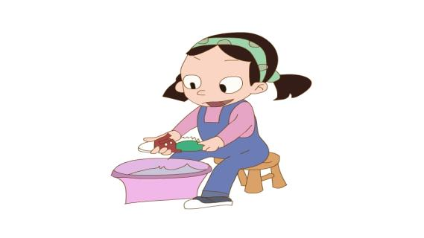
I can do and say（我会做也会说）
clean the shoes

Slide 3
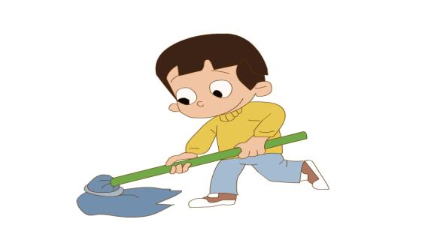
clean the floor

Slide 4
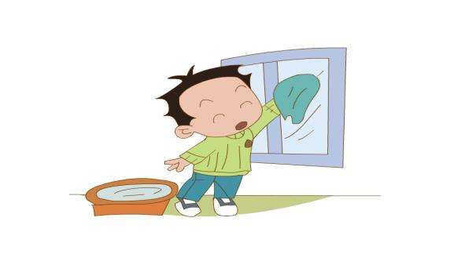
clean the windows

Slide 5
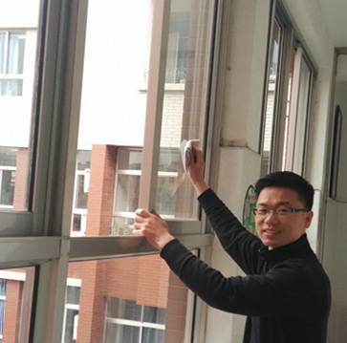
I’m cleaning the windows.

Slide 6
Let’s say and do. (一边说一边做)
I can clean…
I’m cleaning…

Slide 7
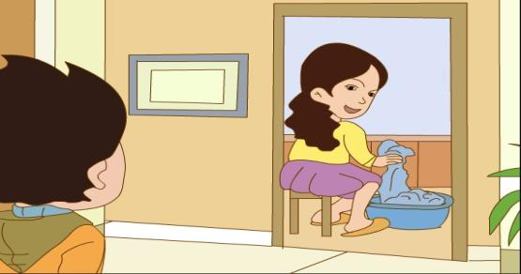
Task1 任务1
Watch and answer the question(看视频回答问题)
What are you doing, mum?

Slide 8
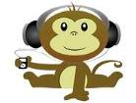
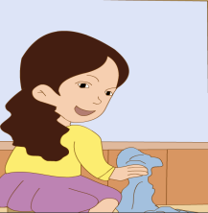
What are you doing, mum?
I’m
washing clothes.

Slide 9
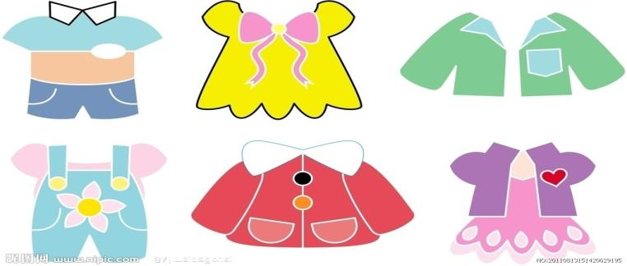
clothes

Slide 10
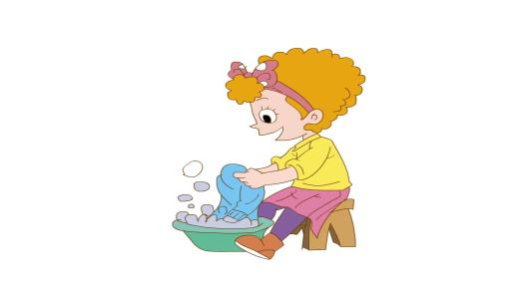
washing clothes

Slide 11
Task 2. 任务2.
Read the dialogue and answer the question
(读对话回答问题)
Is dad washing clothes, too?
No, he isn’t.

Slide 12
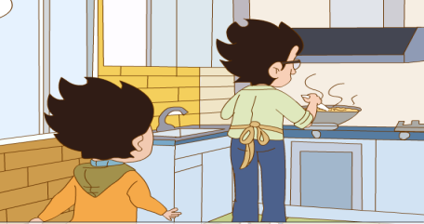
Are you cooking the meal, dad?
Yes, I’m cooking the chicken.

Slide 13
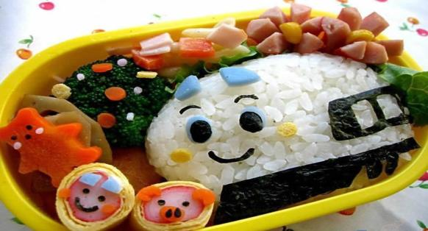
meal

Slide 14
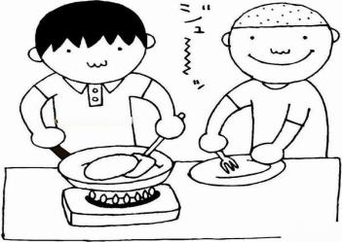
cooking the meal

Slide 15
Task 3. 任务3
Listen and answer the question:
听录音回答问题
What are you doing Danny?
I’m
watering the flowers.

Slide 16
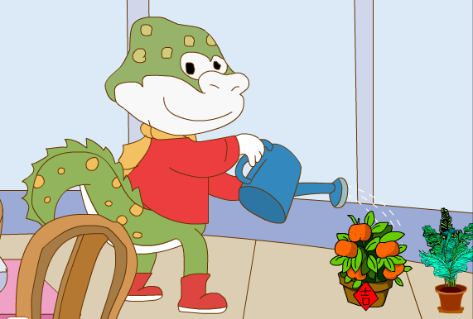
watering the flowers

Slide 17
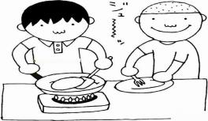
Let’s clap and chant
Water watering
I’m watering the flowers
Wash washing
I’m washing clothes
Cook cooking
I’m cooking the meal

Slide 18
Task 4. 任务4
Let’s listen to the tape again and imitate.(模仿跟读)

Slide 19
Task 5 任务5
Let’s talk(两人一组做对话)
A: What are you doing, Jenny?
B: I’m cleaning the floor.
You can use these words:
drawing pictures, playing the piano,
cooking the meals, washing clothes,
playing basketball, watering the flowers

Slide 20
Summary(总结)
1. words: clothes, water, meal, flower.
2. sentences: What are you doing?
I’m washing clothes.
I’m cooking the chicken.
I’m watering the flowers.
3. Help parents do housework.

Slide 21
do housework
自己能做的事情要自己做

Slide 22
Homework:
Imitation(模仿跟读)
Do group work according to what you’ve learnt in real situation.(小组合作，运用所学知识创设情景，进行口语交际训练)

