Slide 1
Unit 4 Amazing art
Part Ⅱ Using language——现在进行时的被动语态
WWW.PPT818.COM

Slide 2
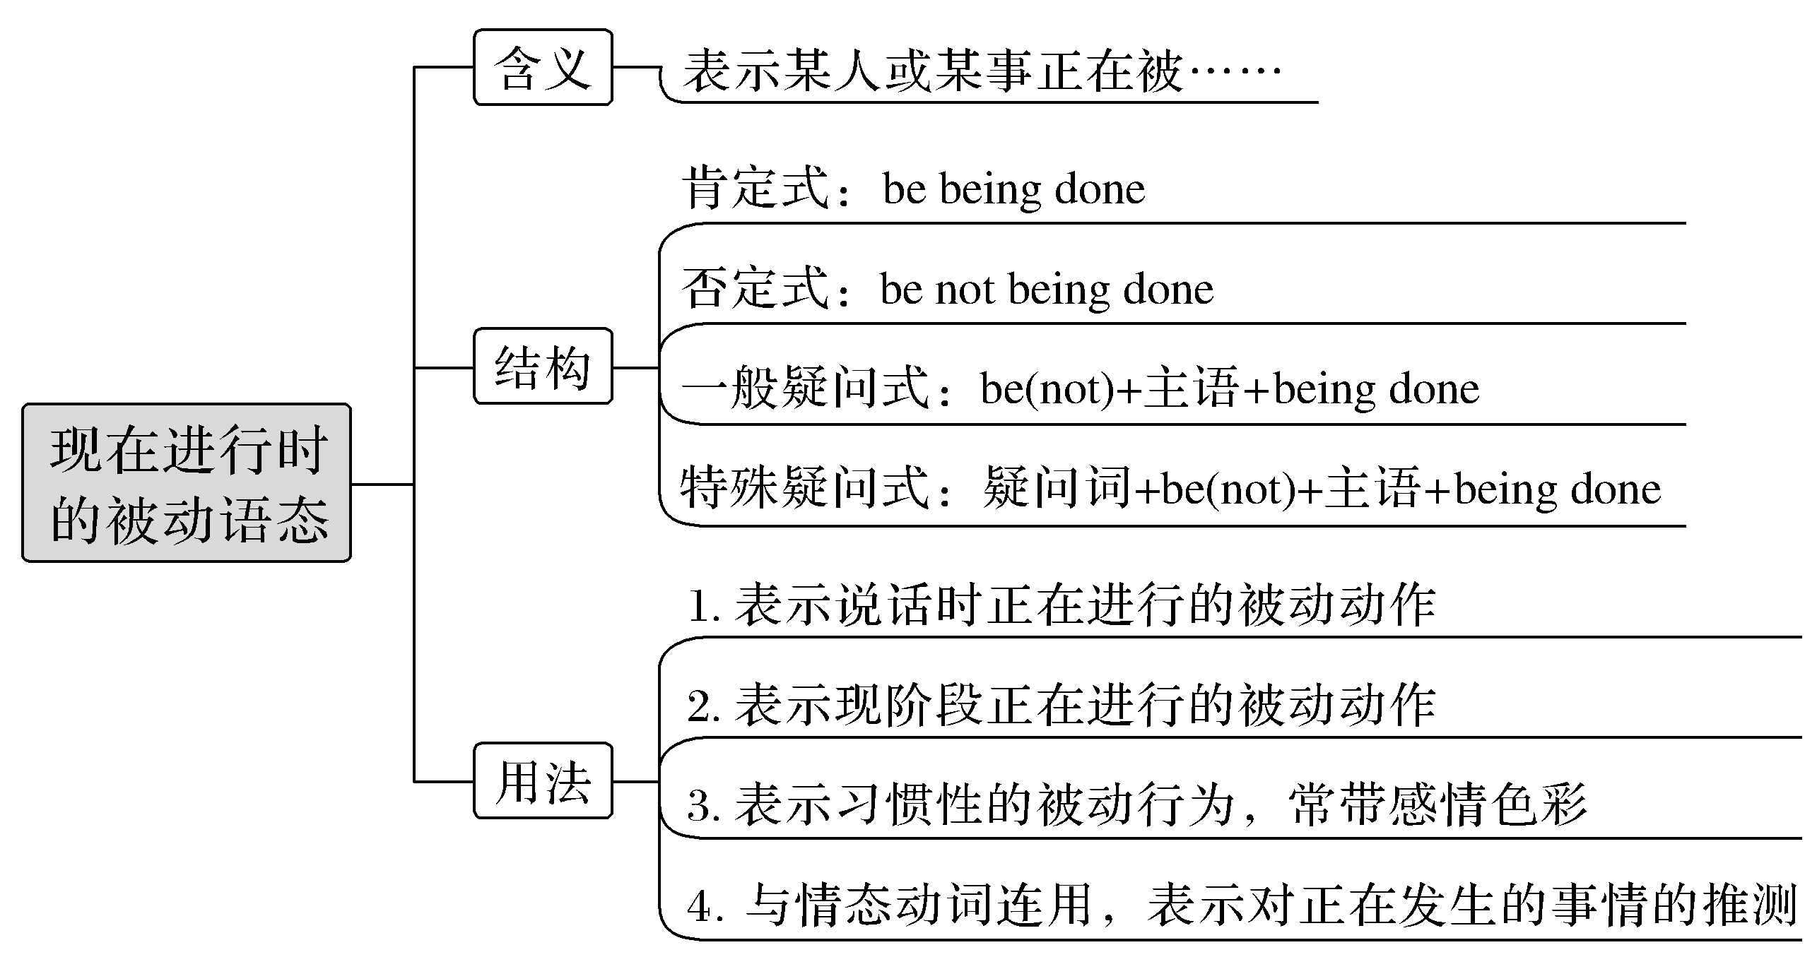
【思维导图】

Slide 3
什么时候使用被动语态？
1.当关注的是事情本身而不是动作的执行者，或者根本不知道动作的执行者。
2.强调的是动作的承受者。
3.修辞的需要，为了使句子更加简练、匀称。

Slide 4
一、基本特征感悟
【感悟用法】
①It is reported that many a new house is being built at present in the disaster area.
②The plan is not being discussed at the meeting now.
③Is the house you bought last month being decorated now?
④What is being done to the machine?

Slide 5
【自我总结】
1.以上例句中都用了________________________________，其谓语构成是：________________________________。
2.以上例句中第①句是现在进行时被动语态的____________句式；第②句是____________句式；第③句是____________句式；第④句是____________句式。
现在进行时的被动语态
be＋being＋done
肯定
否定
一般疑问
特殊疑问

Slide 6
二、主要用法精讲
1.含义
现在进行时的被动语态表示现在或现阶段正在进行或发生的被动动作，强调主语是动作的承受者。

Slide 7
2.结构
(1)肯定式：主语＋am/is/are＋being done
Some trees are being cut down in the park.公园里的一些树木正在被砍倒。
(2)否定式：主语＋am/is/are＋not being done
It is reported that the water in the lake is not being protected now.
据报道，这个湖里的水现在没有得到保护。
(3)一般疑问式：Am/Is/Are (not)＋主语＋being done
Are the babies being taken care of by this nurse? 这些婴儿正由这个护士照看吗？
(4)特殊疑问式：特殊疑问词＋am/is/are (not)＋主语＋being done
Who is being trained for the coming English speech contest?
为了即将举行的英语演讲比赛，谁正接受训练？

Slide 8
3.具体用法
(1)表示说话时正在进行的被动动作。句中常用now，at the moment等时间状语。
My younger sister is now being interviewed.我妹妹现在正在接受采访。
He is now being treated in China.现在，他正在中国接受治疗。
(2)表示现阶段正在进行的被动动作(说话时不一定在进行)。
These animals are being hunted at such a speed that they will disappear soon.
这些动物正以如此速度被捕杀，它们很快就会消失。
Preparations are being made for the 2022 Winter Olympic Games in Beijing.
北京正在为2022年冬季奥运会做准备。

Slide 9
(3)表示一种习惯的被动行为，常与always，constantly，often等词连用，表示有赞赏、羡慕、讨厌等感情色彩。
I feel very surprised that the window of our classroom is often being broken.
我感到非常吃惊的是我们教室的那扇窗户经常被打破。
Tom is always being praised by the teacher.汤姆总是被老师表扬。

Slide 10
(4)与某些情态动词连用，表示对正在发生的动作的推测。
Jim may be being interviewed by the reporters at the very moment.
吉姆此刻可能正在被记者们采访。
—Do you know what Smith is doing?
—He is ill.He may be being examined by the doctor.
——你知道史密斯正在做什么吗？
——他病了。他可能正在接受医生的检查。

Slide 11
即学即练1
同义句转换
They are building a modern school in his hometown.
①A modern school ________________________ in his hometown.(改为被动语态)
②A modern school ________________________ in his hometown.(把①句改为否定句)
③ ____________ a modern school ________________ in his hometown？(把①句改为一般疑问句)
④Where ____________ a modern school ________________？(对①句就in his hometown进行提问)
is being built
isn’t being built
Is
being built
is
being built

Slide 12
名师提醒
(1)stay，love，have，want，belong to等一般不用于现在进行时的被动语态。
(2)“be＋under/in等介词＋名词”结构可用来表示现在进行时的被动语态的含义。
The telephone is in use.
＝The telephone is being used.
电话正在使用中。

Slide 13
即学即练2
补全句子
①The little boy has made rapid progress recently and _____________________ by his teachers.
那个小男孩最近进步很快，总是被他的老师表扬。
②The plan to explore the South Pole ______________________ these days.
最近正在制订勘探南极的计划。
is always being praised
is being made

Slide 14
be being criticized
③Because of bad scores，Jimmy may ________________________ by his father at the very moment.
由于成绩不好，吉米此刻可能正在被父亲批评。
④The question about where is the factory going to be built ___________________ now.
关于在哪儿建厂的问题现在正在被讨论。
⑤A project about protecting the natural resources ____________________________.
正在设计一个保护自然资源的项目。
is being discussed
is being designed

