Slide 1
Unit 4 Neighbourhood
Is there a gym around?
WWW.PPT818.COM

Slide 2
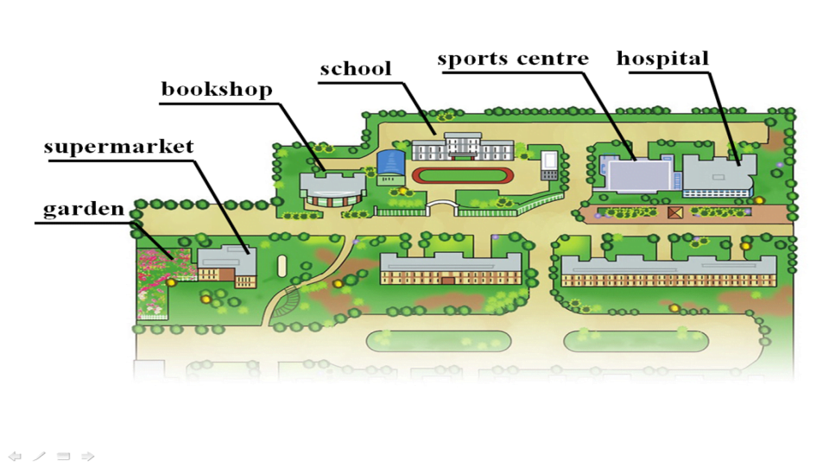
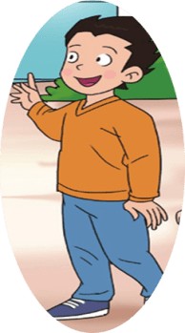
Neighbourhood

Slide 3
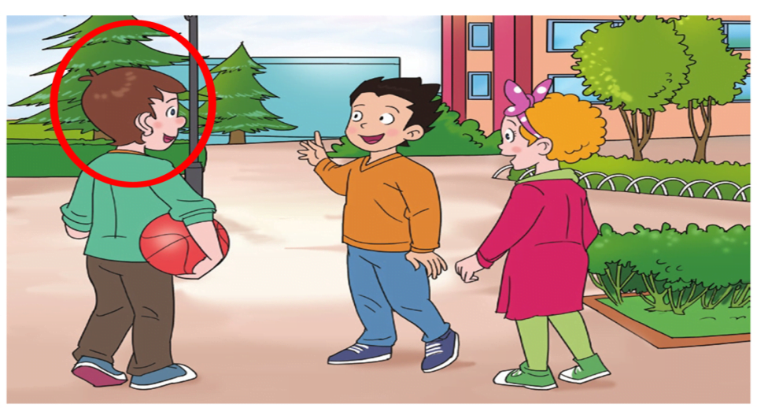
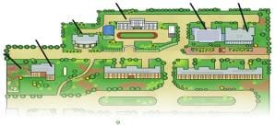
Andy
new neighbour

Slide 4
Step 1 answer.
Is there a gym around?
Yes, there is. No, there isn’t.
sports centre
But we have a _____________.

Slide 5
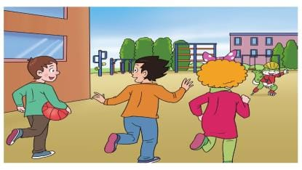
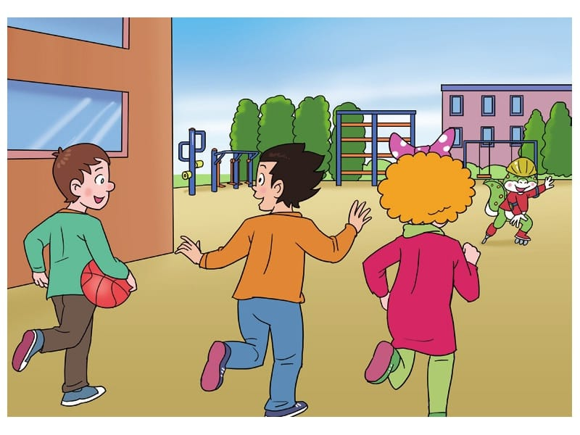
What is Danny doing?
Danny is skating there.
Danny is skating in ____________.

Slide 6
Neighbourhood

Slide 7
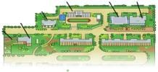
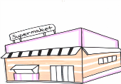
What’ s in Li Ming’ s neighbourhood?
Step 2 choose.
There is _____ .
a garden
a gym
a sports centre
a bookshop
a supermarket

Slide 8
Neighbourhood

Slide 9
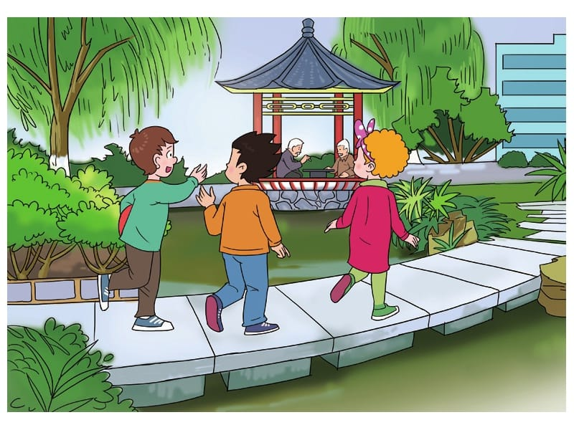
What are the men doing in the garden?

Slide 10
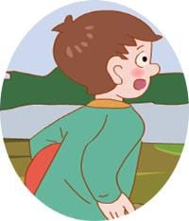
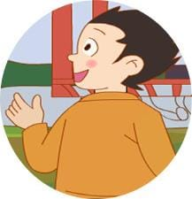
What are the men doing in the garden?
They’re playing Chinese chess.
bed
get
men

Slide 11
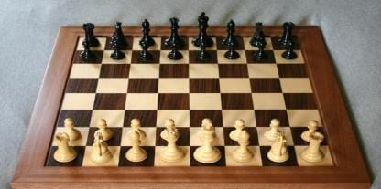
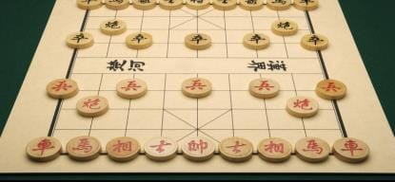
different
Chinese chess
chess

Slide 12
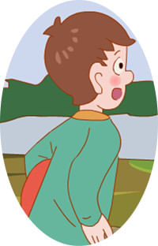
Chinese chess is different from our chess.
I think so .
我也这么想。

Slide 13
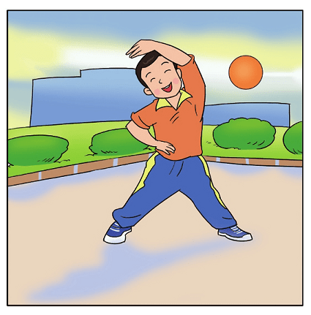
We should do sports everyday.
I think so.

Slide 14
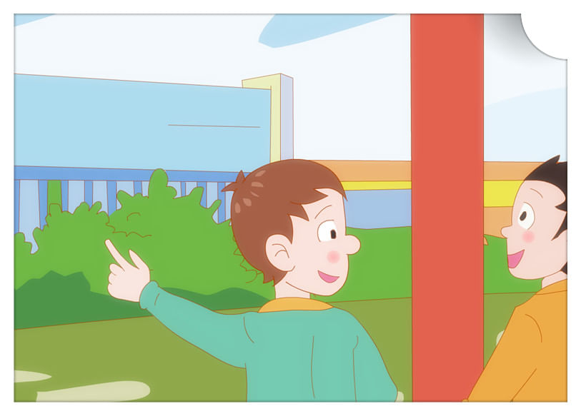
What ’s that blue building?

Slide 15
What’s that blue building?
And there is a
Supermarket beside it.
It’s a bookshop.

Slide 16
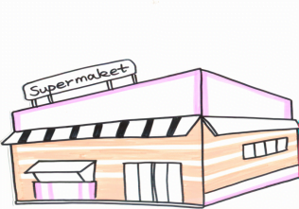
There is a supermarket________ the bookshop.

Slide 17
There is a shop________ the hospital.
在……旁边

Slide 18
Step 3 Read and fill.
（自己读课文，填空。）
1.Two men are playing Chinese chess
in the _____________.
garden
different
2.Chinese chess is __________from our chess.
3.There is a supermarket_______the bookshop.
beside
4.Is there a gym around? No, but we have
a____________
sports centre.

Slide 19
Neighbourhood
Is there a …… in the neighbourhood?

Slide 20
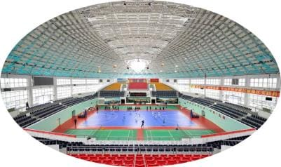
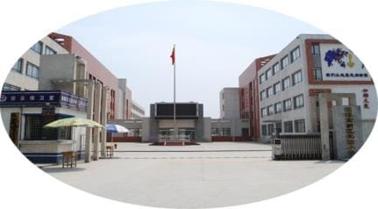
gym
Is there a _______ in the neighbourhood?
Yes, it’s ________the school.

Slide 21
supermarket
Is there a ___________ in the neighbourhood?
beside the bookshop
Yes, it’s ____________________.

Slide 22
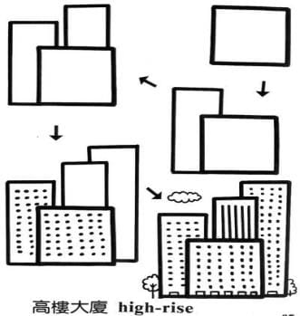
Draw your neighbourhood and introduce in groups. (小组内介绍自己的小区。)
Let’s do.
This is my neighbourhood . There’s a _________. There is a ______beside _______. There is a ______behind _______. There is a ______near _______. I like my neighbourhood.

Slide 23
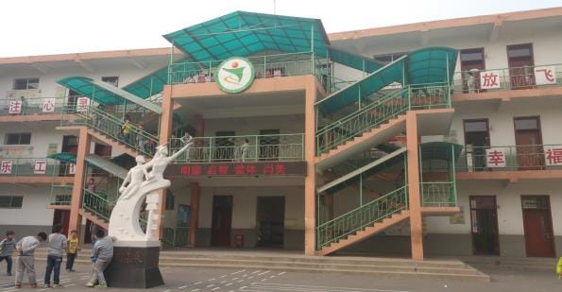
Let’s talk.
playground
music room
art room
dining room
classroom
……
Is there a…… in your school?
Yes
No
It’s beside/ near/ behind……

Slide 24
Homework
1. Read the text for _____ times. 读课文_____遍。
2. Introduce your neighbourhood for your friends. 向你的朋友介绍你的小区。

Slide 25
We love our neighbourhood.
We love our life.

Slide 26
Thank You

