Slide 1
Unit6 Is this your skirt?
人教精通版三年级下册
WWW.PPT818.COM

Slide 2
Review
Let’s sing

Slide 3
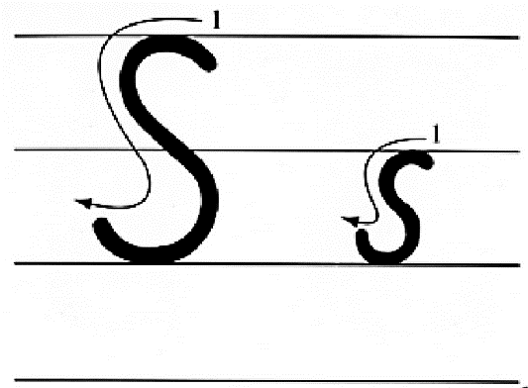
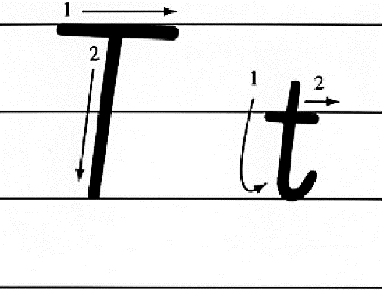
Presentation
Let’s learn

Slide 4
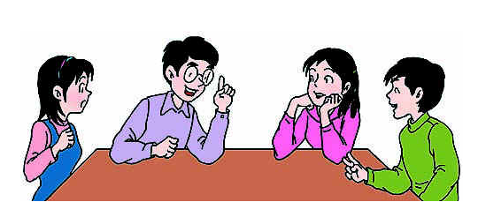
Presentation
Discussion
你都知道哪些含有字母s或t的单词呢？
school, seven, sister, son, six, three, ten, tiger, two…

Slide 5
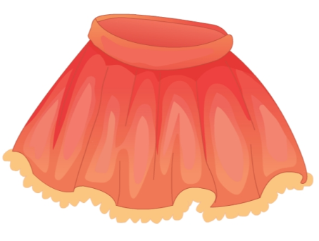
Presentation
Let’s learn
What’s this?
skirt

Slide 6
Presentation
Let’s learn
What’s this?
T-shirt

Slide 7
Practice
Let’s chant

Slide 8
Presentation
Let’s learn
Is this your skirt?
Yes. Thank you.

Slide 9
Presentation
Let’s learn
Is this your T-shirt?
Yes. Thank you.

Slide 10
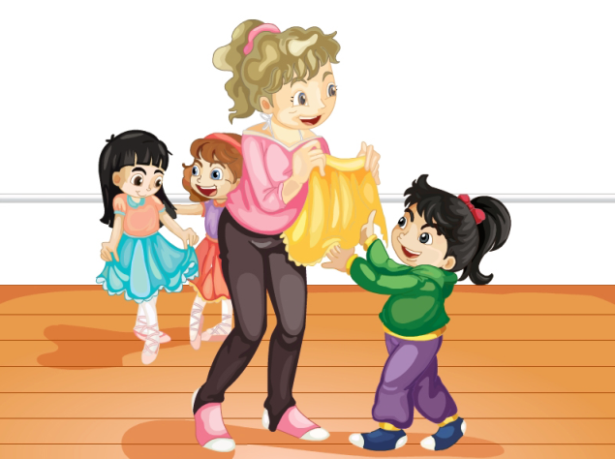
Presentation
Let’s learn
What are they talking about?

Slide 11
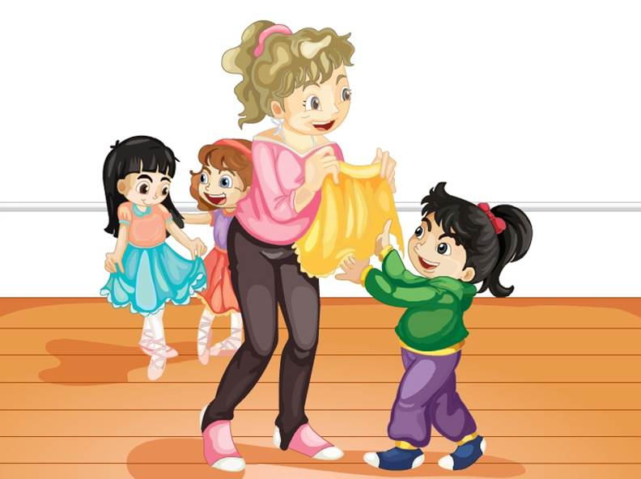
Presentation
Let’s learn
Hi, Li Yan. Is this your skirt?
Oh, yes. Thank you.

Slide 12
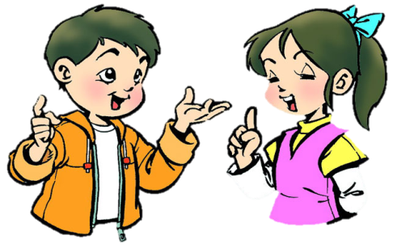
Practice
Role-play
分角色朗读对话，注意模仿语音语调。
两人一组，试着表演出来吧。

Slide 13
Practice
Let’s guess
Is this a dog?
Yes.

Slide 14
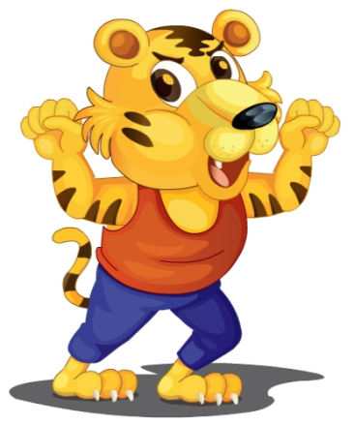
Practice
Let’s guess
Is this a tiger?
Yes.

Slide 15
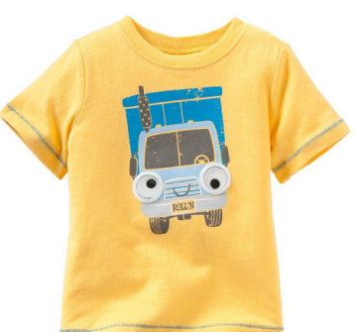
Practice
Let’s do
This is my ______.
T-shirt
A: _______________?
B: Oh, yes. Thank you.
Is this your T-shirt

Slide 16
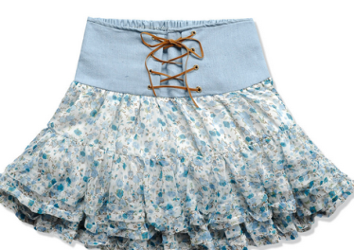
Practice
Let’s do
skirt
This is my ______.
A: ______________?
B: Oh, yes. Thank you.
Is this your skirt

Slide 17
Summary
本课学到的重点单词：
skirt T-shirt
本课学到的重点句型：
—Is this your … ?
—Oh, yes. Thank you.

Slide 18
Homework
1. 观看Just talk部分的课文动画，跟读对话并注意语音、语调。
2. 在四线三格中正确抄写本课新学的单词和字母，不少于5遍。
3. 预习Lesson 32。
Close

