Slide 1
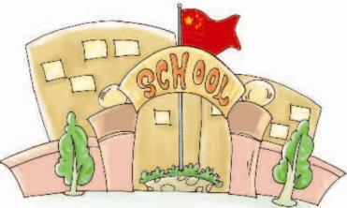
Unit3 How do you come to school?
陕旅版
三年级下册
第四课时
WWW.PPT818.COM

Slide 2
>>Review
Let’s do it
They
He
goes
A: How does Lily come to school?
B: ______ comes to school by car.
She
A: How does Tom go to school?
B: He ______ to school by car.
goes
A: How do they go to school?
B: They ______ to school by bike.
go

Slide 3
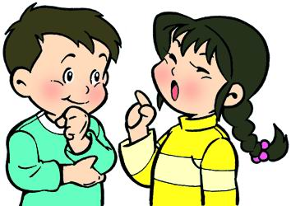
>>Review
Ask and answer
How do you go to …?
How do they/does he/she go to …?

Slide 4
>>Warm-up
Let’s sing
How Do You Come to School?
How do you come to school,
Come to school,
Come to school in the morning?
By bus, By bike, On foot,
I come to school in the morning.
How do you go home,
Go home, Go home in the afternoon?
By bus, By bike, On foot,
I go home in the afternoon.

Slide 5
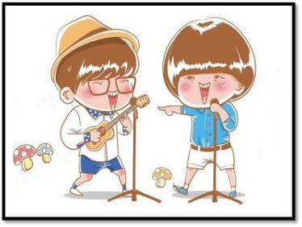
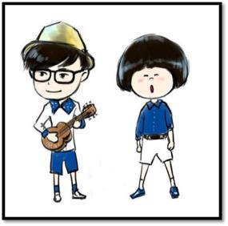
>>Lead-in
活动1
我是小小演唱家
超级学生
How Do You Come to School?

Slide 6
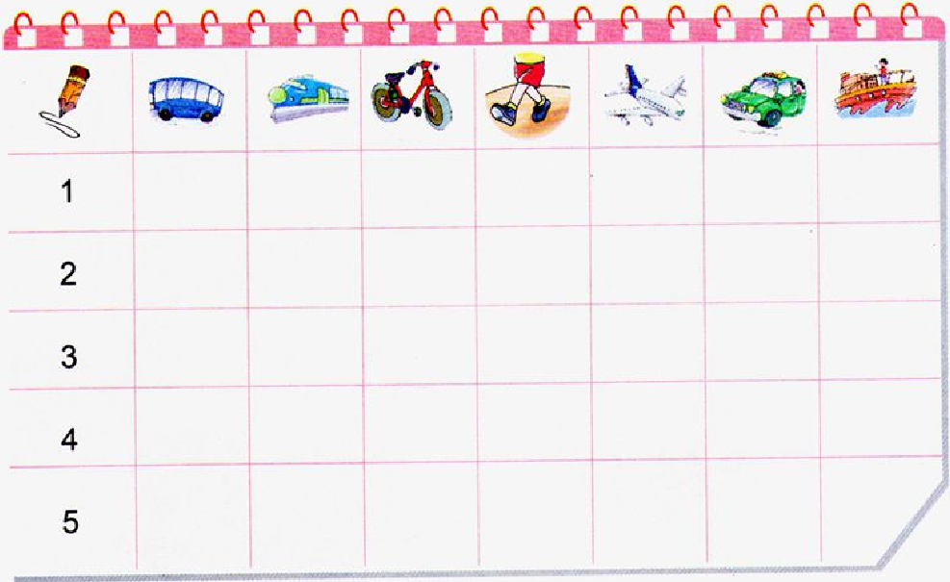
>>Presentation
Listen and tick
√
√
√
√
√

Slide 7
>>Practice
Ask and answer
1: How do you go to school?
I go to school by bus.
2: Do you go to the zoo by train?
No, I don’t. I go to school by taxi.
3: How do you go to Beijing?
I go to Beijing by train.
4: Do you go to Dalian by ship?
Yes, I do.
5: How do you go to London?
They go to London by plane.

Slide 8
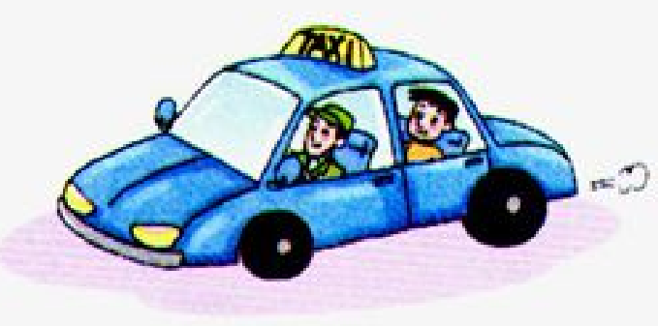
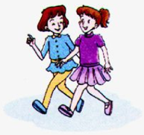
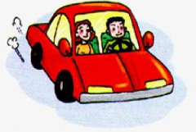
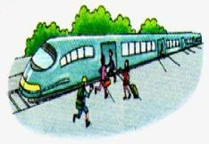
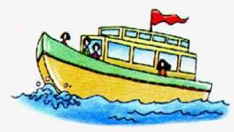
>>Presentation
Look and say
A: Taxi.
B: By taxi.
C: I go to school by taxi.
1
2
3
4

Slide 9
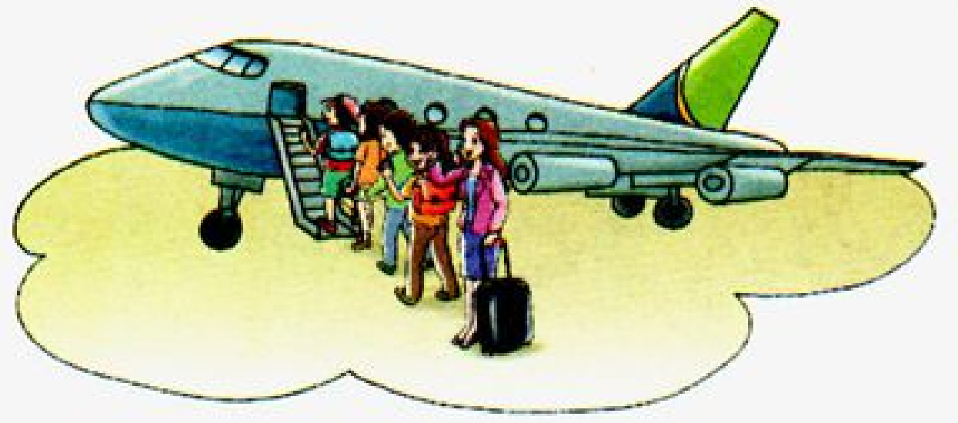
>>Presentation
Ask and answer
How many people are there in the picture?
There are five people in the picture.

Slide 10
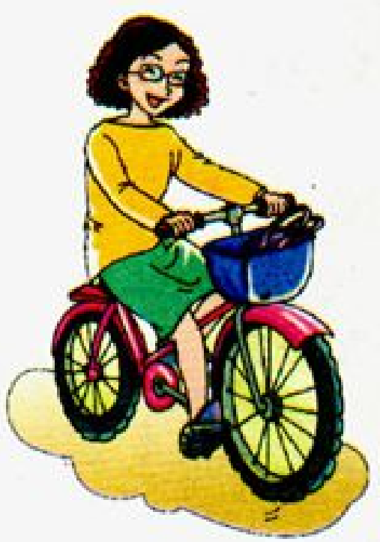
>>Presentation
Ask and answer
How does she go to school?
She goes to school by bike.

Slide 11
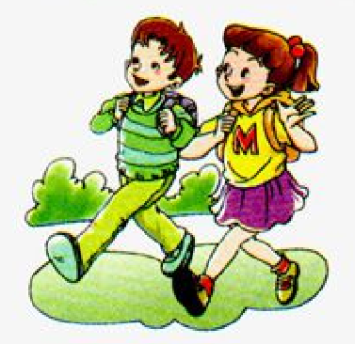
>>Presentation
Ask and answer
How do they go to school?
They go to school on foot.

Slide 12
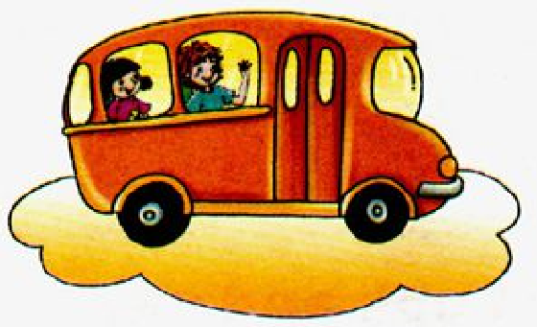
>>Presentation
Ask and answer
How do they go to school?
They go to school by bus.

Slide 13
>>Presentation
Read and match
A: Colin and Wu Chen go to the zoo by bus.
B: The girl and the boy go to school on foot.
C: Mom goes home by bike.
D: Miss White goes to Beijing by plane.
D
C
B
A

Slide 14
>>Practice
Read and say
Miss White goes to Beijing
by plane.
Mom goes home by bike.
The girl and the boy go
to school on foot.
Colin and Wu Chen go
to the zoo by bus.

Slide 15
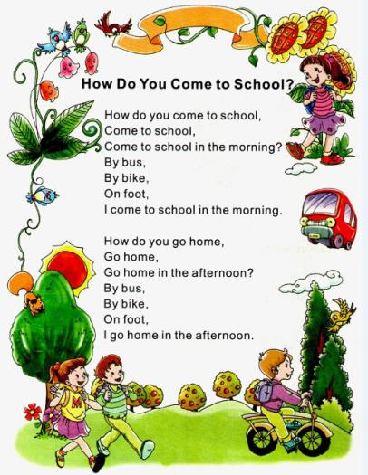
>>Summary

Slide 16
>>Summary
本课的重点句型有哪些？
—How do they/does he go to …?
—They go/He goes to… by …
例如
—How do they go to school?
—They go to school by car.

Slide 17
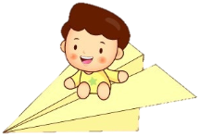
>>Homework
1.听课文录音并跟读，按照正确的语音、语调朗读并表演课文对话。 2.学唱歌曲Let’s sing并给家长或朋友演唱。
3.预习Unit4 A Let’s learn。
close

