Slide 1
Module 2
Unit 2 It will snow in Harbin.
WWW.PPT818.COM

Slide 2
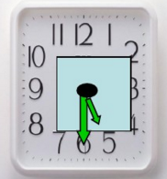
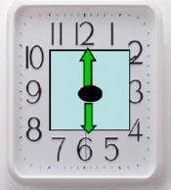
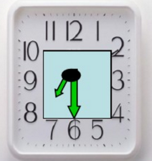
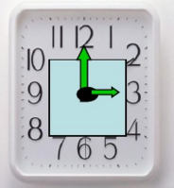
Let’s review
What time is it ?
half past five
six o’clock
half past seven
three o’clock

Slide 3
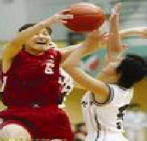
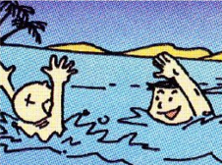
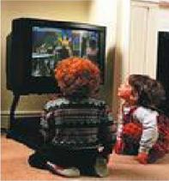
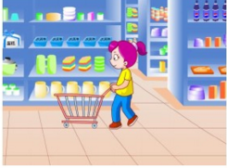
Say the activities
_____be going to_______

Slide 4
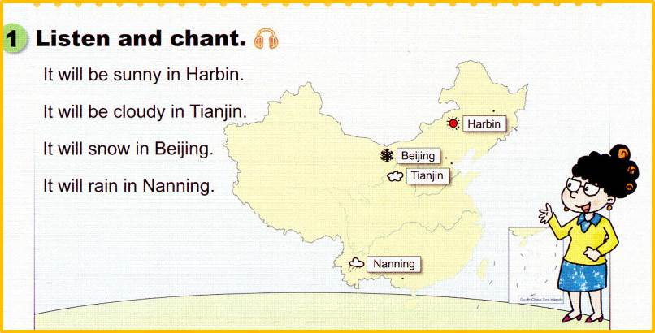
Let’s chant

Slide 5
What's the weather like today?
It’s sunny（晴朗的） .

Slide 6
What’s the weather going to be like tomorrow ? Guess ！
sunny
晴朗的，阳光充足的
warm
温暖的
It will be sunny and warm tomorrow.
明天将是晴朗温暖的。

Slide 7
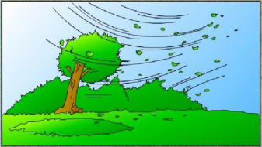
What’s the weather going to be like tomorrow ? Guess ！
wind---windy
多风的，有风的
cloud---cloudy
多云的
It will be windy tomorrow .
明天将是多风的。

Slide 8
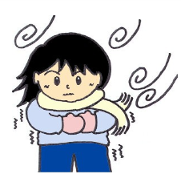
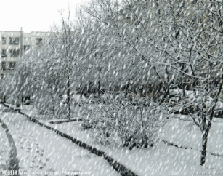
What’s the weather going to be like tomorrow ? Guess ！
snow---snowy
下雪---下雪的，多雪的
cold
寒冷的
It will snow tomorrow .
明天将会下雪。

Slide 9
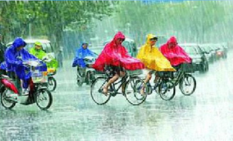
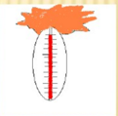
What’s the weather going to be like tomorrow ? Guess ！
rain---rainy
下雨---下雨的，多雨的
hot
炎热的
It will rain tomorrow .
明天将会下雨。

Slide 10
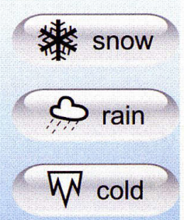
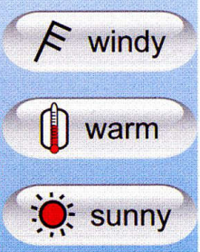
What’s the weather going to be like tomorrow ? Guess ！
cloudy
hot
It’s will (be) ________ .

Slide 11
你知道吗？
It will ( be )... .
可以表示未来的天气情况。
Will 后接 动词原形 。
主语 +Will + 动词原形 。
What will the weather be like in Harbin ?
It will be snowy in Harbin .
It will snow in Harbin .
明天将会下雪。

Slide 12
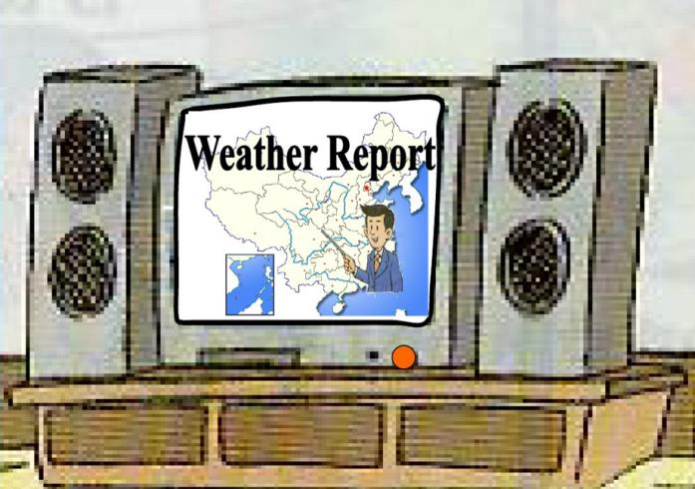
Do you want to be a weather reporter?

Slide 13
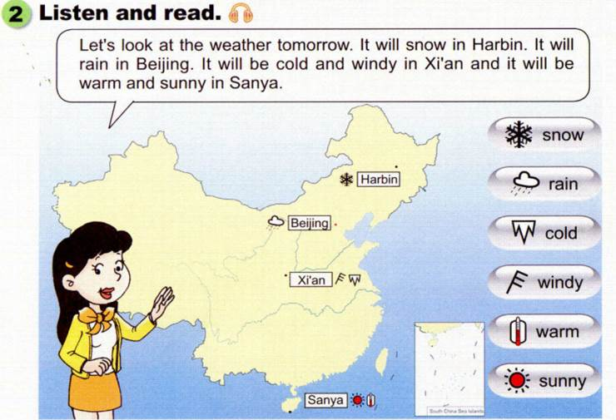
Watch and say

Slide 14
Watch and answer
What will the weather be like in Harbin ?
lt will snow in Harbin .
What will the weather be like in Beijing ?
lt will rain in Beijing .
What will the weather be like in Xi’an ?
lt will be cold and windy in Xi'an .
What will the weather be like in Sanya ?
It will be warm and sunny in Sanya.

Slide 15
重点讲解
a. It will ( be )... in___.可以表示未来的天气情况。
b. It will + 表示天气的动词。
It will be + 表示天气的形容词 。
c. 肯定形式：It will ( be )... .
否定形式：It will not (won’t ) be … .
Eg : lt will snow in Harbin. 哈尔滨将会下雪。
lt won’t be snowy in Harbin.哈尔滨将不会下雪。

Slide 16
Read and repeat.
Let's look at the weather tomorrow.lt will snow in Harbin . lt
will rain in Beijing . lt will be cold and windy in Xi'an and it
will be warm and sunny in Sanya.
Listen the tape again, please follow the tape .

Slide 17
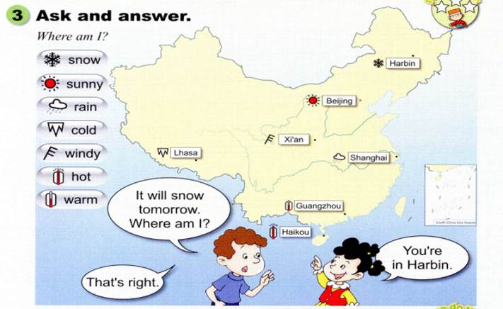
Ask and answer
It will snow
tomorrow.
Where am I?
You're
in Harbin.
That's right.

Slide 18
Ask and answer
同桌互相提问，说天气猜地方。
It will _____
tomorrow.
Where am I?
You're
in ______.
That's right.

Slide 19
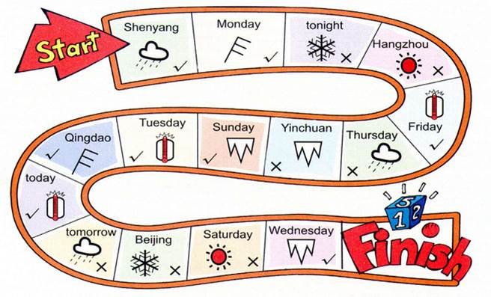
Watch and say

Slide 20
Let’s try
S1：lt will be hot on Friday.
S2：It won't be sunny in Hangzhou.
S3：lt will be rainy on Monday .
S4：It won't be windy in Shenyang.
...

Slide 21
Read and chant
What are you going to do today?
今天你打算做什么？
l'm going to the park to play.
我打算去公园玩。
And what are you going to do after dinner?
晚餐后你打算做什么？
l'm going to play chess and I'll be the winner!
我打算下棋并且我将会是赢家！
And what are you going to do tonight?
今晚你打算做什么？
Go to bed and have a good night．
上床睡觉，过一个美好的夜晚。

Slide 22
Listen and say.Then chant.

Slide 23
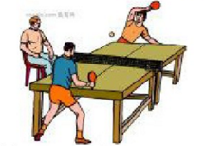
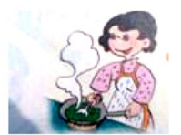
歌曲改编
What are you going to do today?
l'm going to ____________ .
And what are you going to do after dinner?
l'm going to _______and I'll be _______!
And what are you going to do tonight?
Go to bed and have a good night．

Slide 24
Challenge your memory!
Are you ready?
go...

Slide 25
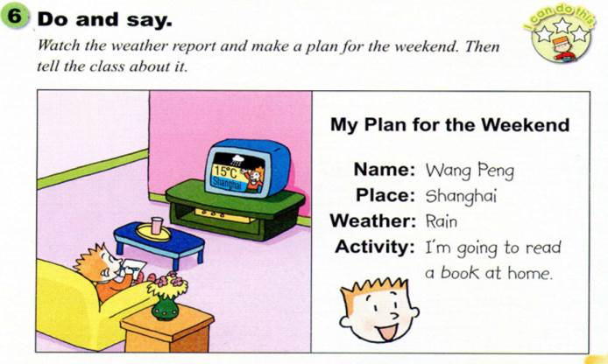
Do and say
Q：What will you do on the weekend?

Slide 26
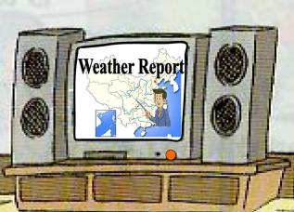
Make a plan for the weekend
看天气预报并且为周末制定一个计划。
My Plan for the Weekend
Name:___________
Place:__________
Activity: l'm going to … .

Slide 27
Make a plan for the weekend
Activity: l'm going to … .

Slide 28
It will ( be )... 可以表示未来的天气情况。
It will + 表示天气的动词。
It will be + 表示天气的形容词 。
主语 + Will + 动词原形 。
肯定形式：It will ( be )...
否定形式：It will not (won’t ) be …

Slide 29
Homework
能独立完整地朗读第11页活动2的内容。
完成配套教辅相应的练习。

