Slide 1
Unit 7
International charities
Reading（I）
WWW.PPT818.COM

Slide 2
Review
Translate phrases and sentences.
1. 剩下一些零花钱
2. 太虚弱以至于不能走的更远
3. 吃一顿丰盛的午餐
4. 国际慈善机构
have some pocket money left
too weak to walk any further
have a big lunch
international charities

Slide 3
Charities around the world
ORBIS
World Wide Fund for Nature
Oxfam
UNICEF

Slide 4
Which charity can help them?
A. ORBIS B. Oxfam
C. Spring Bud Project
Spring Bud Project
Problem 1: ___________________
Nancy is a 12-year-old girl. She lives in a poor family in a far-away village. She has two younger sisters and a little brother. Her family is so poor that she has to work on the farm all day.

Slide 5
Oxfam
Problem 2: _______
The factory he has worked bankrupted (破产) last month. He and his workmates lost their jobs and they have less money to support their families.
ORBIS
Problem 3: _______
Mrs. Black has been blind since she was sixty years old. Now ten years has passed, she still can’t see anything because she is very poor and has no enough money to go to hospital.

Slide 6
Lead-in
Why is the plane special?
a flying eye hospital
(空中眼科医院)

Slide 7
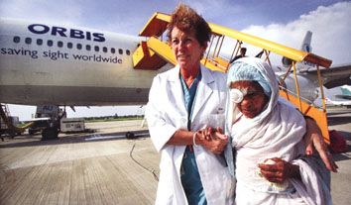
It works to help the blind people in poor areas by plane.

Slide 8
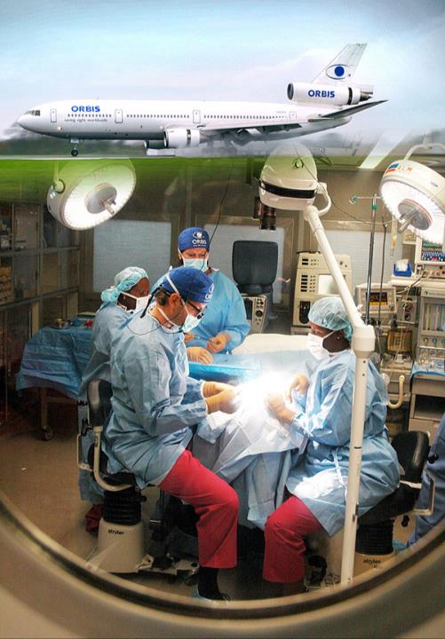
What do ORBIS doctors do on the plane?
operate on patients
= do an operation on patients

Slide 9
ORBIS
treat (治疗), cure (治愈) or prevent (预防) blindness

Slide 10
Information about ORBIS
ORBIS is a charity that helps blind people. Most eye problems can be cured or prevented. However, many people can’t afford to go to hospital. The doctors on the ORBIS plane fly to poor areas to treat people with eye problems and teach local doctors and nurses new skills. After learning from the ORBIS doctors, they can help more people.
What does ORBIS do in the world?

Slide 11
New words
interviewer n.
blindness n.
mostly adv.
case n.
cure vt.
medical adj.
treatment n.
patient n.
afford vt.
采访者
失明
主要的，大部分的
案例，病例
治愈
医学的，医疗的
治疗
病人
买得起，能做

Slide 12
go to hospital
go aboard
operate vi.
proud adj.
reader n.
medicine n.
develop v.
treat vt.
carry on
去看病
在飞机(船，火车)上
做手术
自豪的，骄傲的
读者
医学，药
发展，加强
治疗，处理
继续开展，继续下去

Slide 13
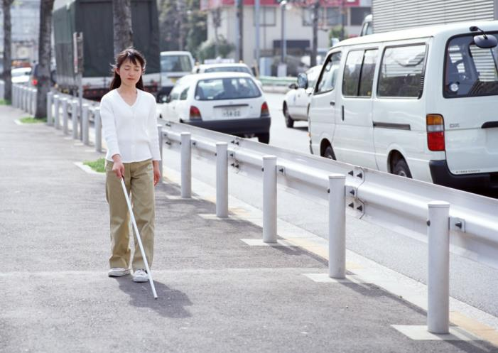
Further word study:
blindness

Slide 14
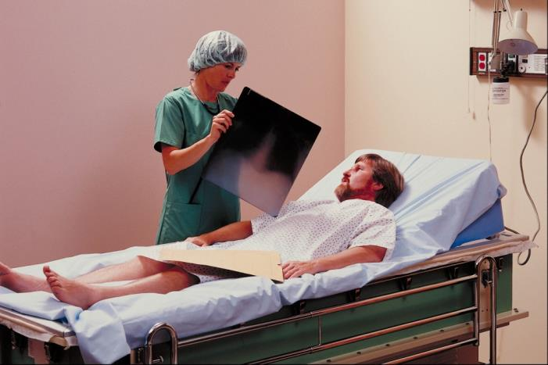
patient n.
She is very patient to look after those patients.

Slide 15
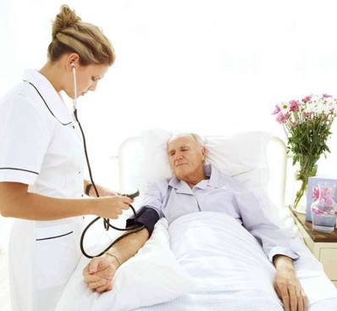
cure or treat?

Slide 16
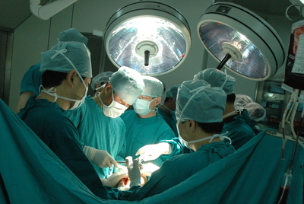
operate V.
do an operation on sb.

Slide 17
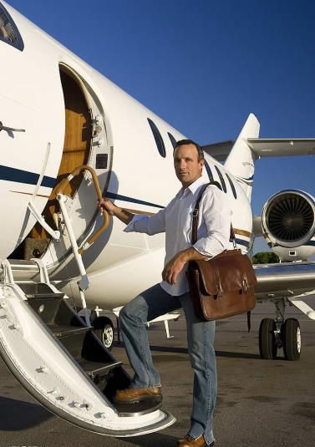
on board
=on a plane

Slide 18
cut a person’s body open to take out or repair a part
in or on a plane, ship, train, etc.
make an illness go away
have enough money to pay for something
a person who is ill, especially in hospital
the condition of being unable to see
1. blindness
2. cure
3. patient
4. afford
5. on board
6. operate
f
c
e
d
b
a

Slide 19
Scanning:
How many people did he operate on during his last visit?
He operated on 150 patients during his last visit.

Slide 20
Skim and write T or F:
All the eye problems can be cured or prevented.
Many people can’t afford to go to hospital.
The plane is used as a hospital and teaching centre.
ORBIS is a business that helps blind people.
Local doctors and nurses can help people in poor areas after learning from ORBIS doctors.
F
T
T
F
T

Slide 21
Read and Answer
Lines 1-6
1. How many people does blindness affect around the world? Where are they mostly from?
2. How many sick people can be cured or prevented?
Blindness affects about 285 million people, mostly in poor countries.
About 80 per cent of the cases.

Slide 22
3. Why don’t some people receive
medical treatment?
Because they do not have the money for medical treatment.
Lines 10-20
Why don’t ORBIS doctors work
in a hospital?
Because many patients cannot afford to travel to hospital, ORBIS doctors have to go to them.

Slide 23
2. Is the plane only a place to perform
operations?
3. How does Dr Ma feel about his job?
No. Local doctors and nurses can come to the plane to learn about eye operations.
He is proud to help people see again and improve their lives.

Slide 24
Read Lines 21-26after the tape, then try to answer:
What is needed to help blind people?
What does Dr Ma hope?
More money is needed to help blind people.
He hopes more people will support ORBIS.

Slide 25
Try to write down the main ideas of the following.
1. (Line 1-6)
something about blindness
2. (Line 7-15)
the work of ORBIS
3. (Line 16-20)
Dr Ma’s work and his feeling
4. (Line 21-26)
Dr Ma’s hope

Slide 26
Part B2 on P96.
Amy wants to show how ORBIS helps people. She is making a chart. Help her fill in the blanks with the words in the box.
doctors and nurses eye operations
eye problems Flying Eye Hospital
new skills see again

Slide 27
More details about how ORBIS help people
ORBIS, a charity
Flying Eye Hospital
uses its _________________ to visit poor areas
treats people with ______________
eye problems
does _____________
on the plane
doctors and nurses
eye operations
invites local __________
________ on board
helps people _______
teaches them _________
see again
new skills

Slide 28
Amy made some more notes of the interview. Help her put the sentences together.

Slide 29
Many more people in poor areas
Dr Ma thinks that most eye problems and diseases
Many blind people do not get any treatment
4. The ORBIS plane is used as
5. One hundred and fifty patients
6. More money is needed
were operated on during Dr Ma’s last visit.
b. a hospital and a treating centre.
c. because they have no money to go to hospital.
d. to carry on with
the work.
e. have eye problems.
f. can be prevented or cured.
e
f
c
b
a
d

Slide 30
Amy is writing an article about ORBIS for the school newsletter. Help her complete it with the correct forms of the words in the box.
afford board cure medicine patient proud support train

Slide 31
The ORBIS plane travels all around the world and helps people with eye problems in poor areas. Most of the people there cannot (1)_______ to go to hospital, so ORBIS doctors go to them. Operations are done to help people with eye problems see again. The (2)_________ do not have to pay because ORBIS is a charity.
afford
patients

Slide 32
Local doctors and nurses are also invited on (3)_______ to learn new skills. By (4)________ them, ORBIS doctors hope to help more people.
Dr Ma is a doctor on the ORBIS plane. He feels (5)_______ to help people see again. Dr Ma thinks that modern (6)_________ is developing quickly and now most eye problems can be treated and (7)_______, but more money is needed to (8)_________ their work.
board
training
proud
medicine
cured
support

Slide 33
Discussion:
Dr Ma tells us that more money is needed to carry on with their work. As a student, what can you do to help them?
Donate our pocket money to ORBIS.
Introduce ORBIS to more people.
Tell people that it is important to take good care of eyes.
…

Slide 34
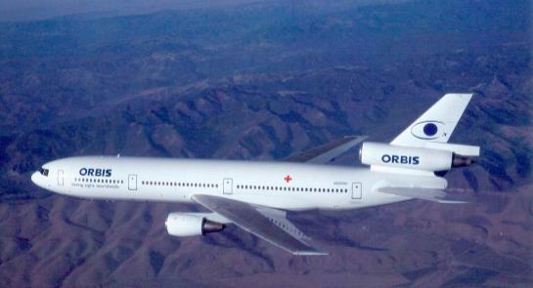
Homework
1. 《课课练》练习
2. 《大课堂》练习

