Slide 1
Unit 7
We will go by train
WWW.PPT818.COM

Slide 2
Rain,rain,go away

Slide 3
What’s the date today?
What day is it today?
It's Thursday.
It's March 26th.
What’s the weather like today?

Slide 4
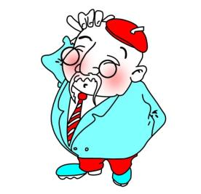
Thank you! Bye!
1.复习上一节课重要短语、句型。
2.T: People are going to do different things on different dates. Let’s meet more dates.呈现下一张PPT。

Slide 5
What are you going to do this Saturday?

Slide 6
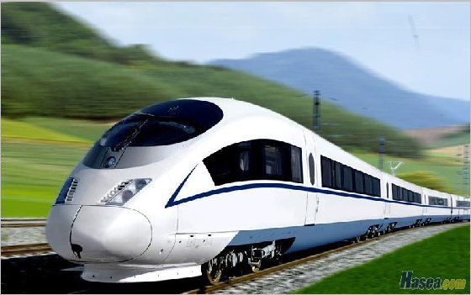
We will go
by train.
by 乘；由
train 火车

Slide 7
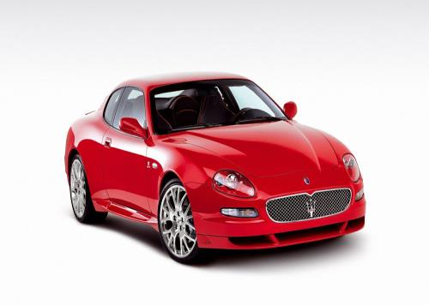
by car

Slide 8
by bike

Slide 9
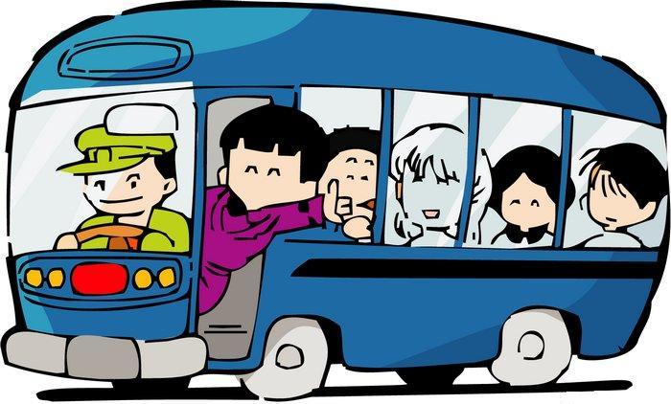
by bus

Slide 10
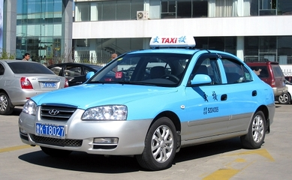
by taxi

Slide 11
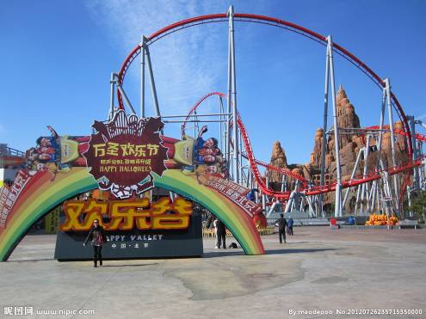
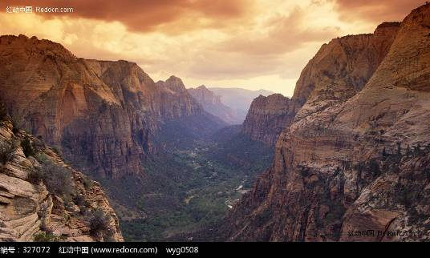
I’ll go to Happy Valley,too.
valley
山谷

Slide 12
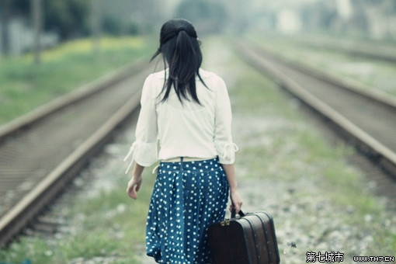
We will leave Shenzhen on Sunday.
leave
离开

Slide 13
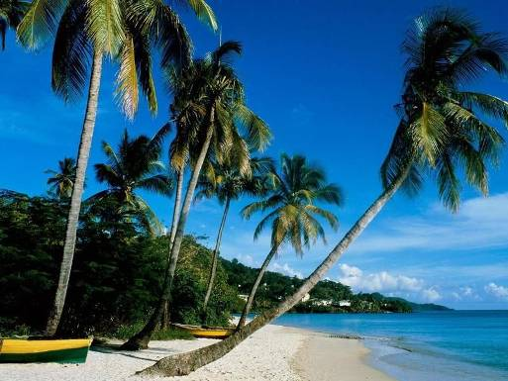
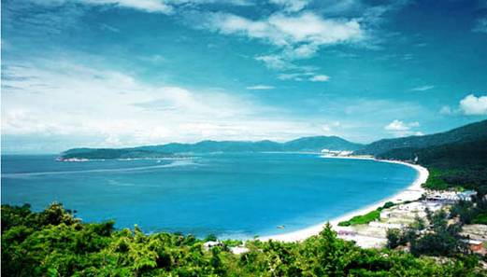
I’m going to Hainan Island this summer holiday.
island

Slide 14
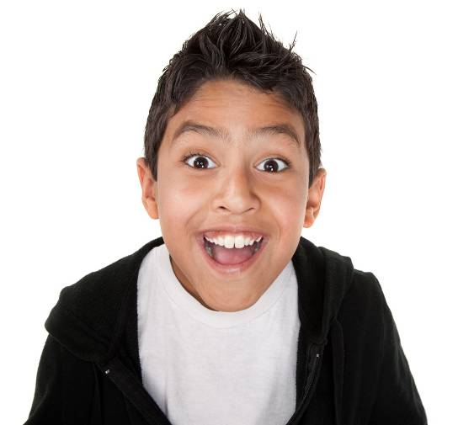
It’s very exciting.
exciting

Slide 15
Let's play a game.

Slide 16
k tchen
i
Sharp Eyes
Go to the kitchen. Have a snack.

Slide 17
by bike

Slide 18
by taxi

Slide 19
by train

Slide 20
by car

Slide 21
by bus

Slide 22
Talking
Aki is asking his friends about their plans.

Slide 23
Where will you go this Sunday?
I will go to Panyu.

Slide 24
Let’s tell a story
How will you go there?
I will go by car.

Slide 25
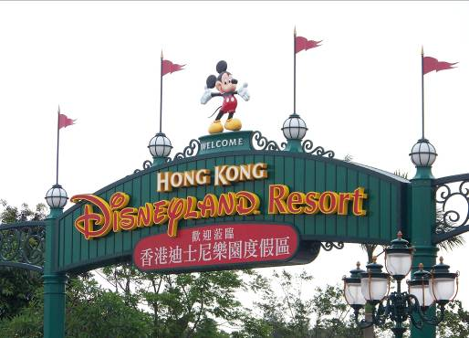
Where will you go this summer holiday?
I will go to ____.
Hongkong

Slide 26
How will you go there?
by train
I will go _______,

Slide 27
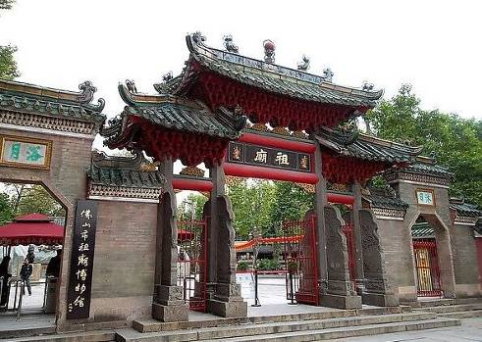
Where will you go this Saturday?
Foshan
I will go to _____.
佛山祖庙

Slide 28
How will you go there
by bus
I will go_____,

Slide 29
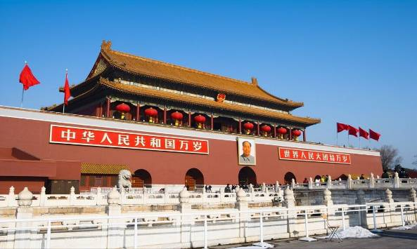
Where will you go this summer holiday?
I will go to ____.
Beijing

Slide 30
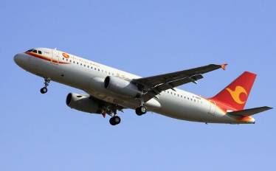
How will you go there
by plane
I will go____,

Slide 31
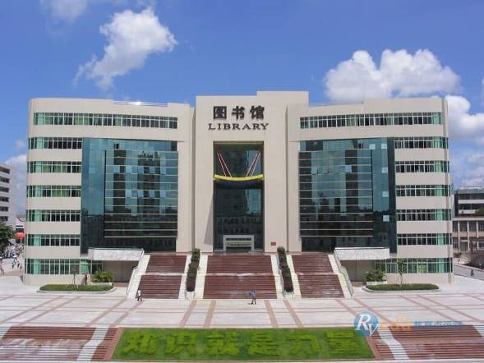
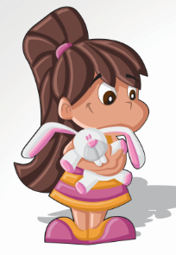
Let’s tell a story
Where will you go this Sunday?
I will go to ____.
the library

Slide 32
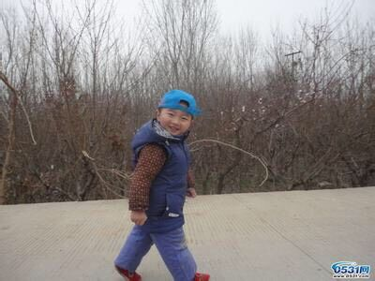
How will you go there
on foot
I will go _____.

Slide 33
Survey
Name | Place | Transport
Lily | Xiamen | By bus

Slide 34
Summary

Slide 35
1. Make a mini dialogue about plan.
2. Read the new words for 3 times.

