Slide 1
Unit2 Travelling
Integrated Skills
WWW.PPT818.COM

Slide 2
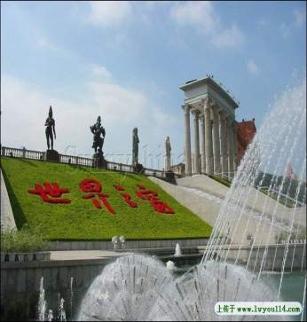
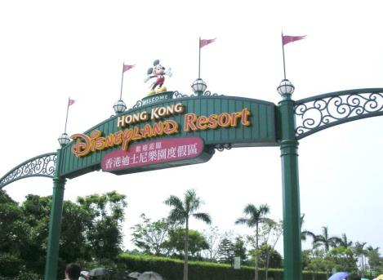
Places for travelling
theme parks
The Window of the World in Shenzhen
Hong Kong Disneyland

Slide 3
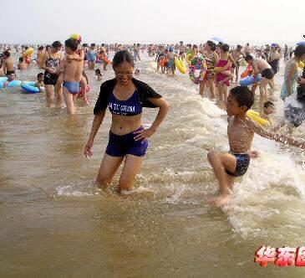
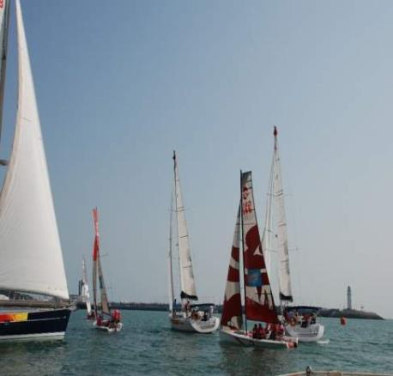
Seaside cities: Qingdao / Dalian
Water sports: go swimming / sailing

Slide 4
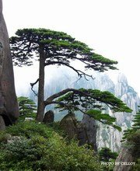
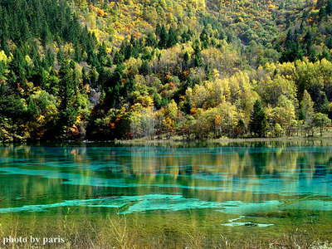
Places of natural beauty: Mount Huang or Jiuzhaigou
climb the mountain /
enjoy the beautiful view

Slide 5
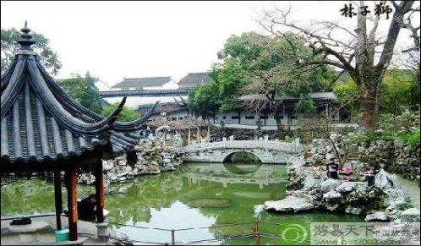
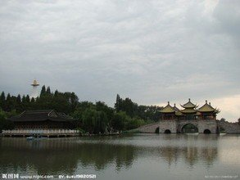
Lion grove
Suzhou (or Yangzhou)
visit Chinese gardens/in spring

Slide 6
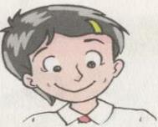
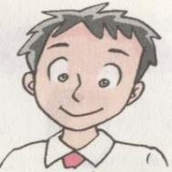
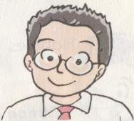
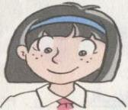
Pre-listening: Read and Guess Travelling in China

Slide 7
While-listening: Travel to China
 | Spring | Summer | Autumn | Winter
Chinese Gardens
Museums
Seaside cities
Places of natural beauty
theme parks

Slide 8
Let’s help Amy complete her notes.(Finish A3)

Slide 9
Speak up: Holiday plan--Travelling
2. Listen and try to answer:
1).What does Amy want to do for May Day holiday?
2).Who does she want to go with?
3).How does she want to go there?
She’s planning to visit Chengdu.
She wants to go there with her mum .
She will take a direct flight to Chengdu.

Slide 10
Holiday plan--Travelling
No. 1
Where…?
Travelling plan.
No. 2
How long
/When…?
No. 5 What…do?
No. 3
Who…
go with?
No. 4 How…?

Slide 11
Make a new dialogue in pairs:
A: Do you have any for______?
B: Yes. I’m going to visit ______.
A: That’s great.
My dad has been to ______on business twice.
How will you get there?
B:We’re going to take a _______ to _____.
A: How long are you staying there?
B: About three days. By the way, how long
does it take to fly to ________?
A: About ___hour(s), I think. but I can check it for
you with my dad.
B: Thanks very much.

Slide 12
Writing time
Write a report about the trip.

Slide 13
A Trip to Beijing
北京是我国最美丽的城市之一，有许多名胜。
每年世界各地的游客来到北京观光旅游。
五一假期间我和米奇坐飞机去了北京。
我们游览了一个又一个的公园，我们还登上了长城，心里感到很自豪。
我们难忘在北京那些愉快的日子。

Slide 14
Travelling is a good way to relax!
Enjoy travelling!
Enjoy life!

Slide 15
Homework
Design your own holiday plan and write a report.

