Slide 1
陕旅版四年级上册 Unit4 When Do You Have Classes? 第3课时
WWW.PPT818.COM

Slide 2
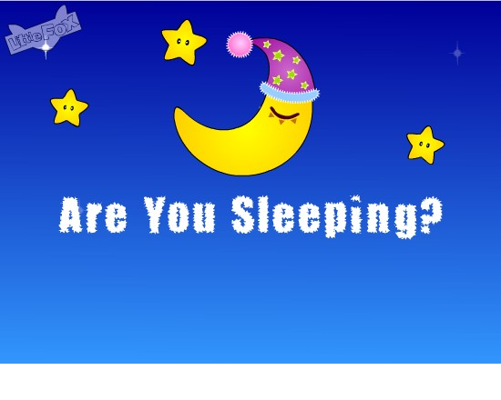
Let’s sing---Are you sleeping

Slide 3
教学目标：
（一）能听、 说 、读、 写单词early, late。
（二）学习When does he…？句型及其回答He…。

Slide 4
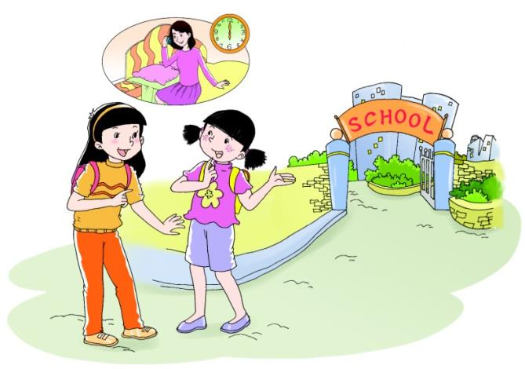
Let’s learn more
听录音，回答问题：
Who get up early in the morning?

Slide 5
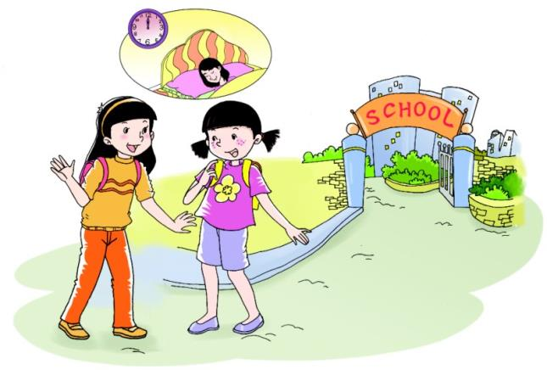
Let’s learn more
听录音，回答问题：
When does Shanshan’s mother go to bed?

Slide 6
No. But my mother gets up very early.
Do you get up early in the morning?
She gets up at six.
When does she get up?

Slide 7
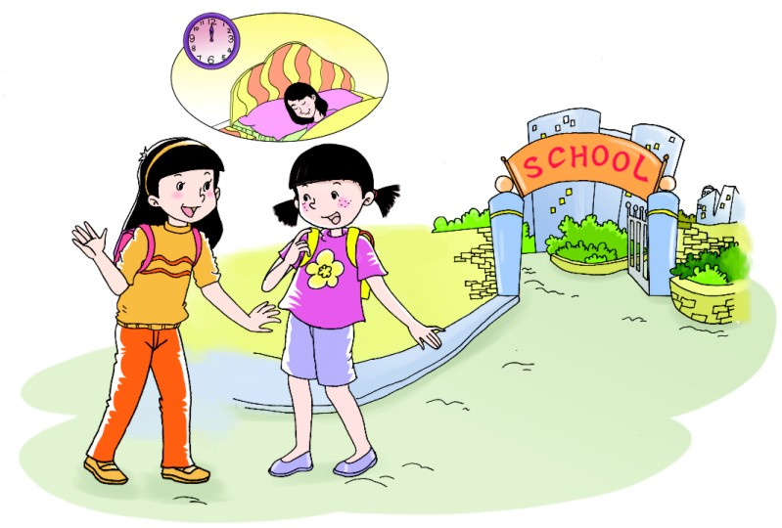
She goes to bed at twelve.
When does she go to bed?
Oh! She goes to bed late.

Slide 8
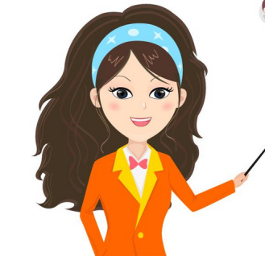
谁能听到我说的？
Boys and girls, please look at my mouth, who can hear me?

Slide 9
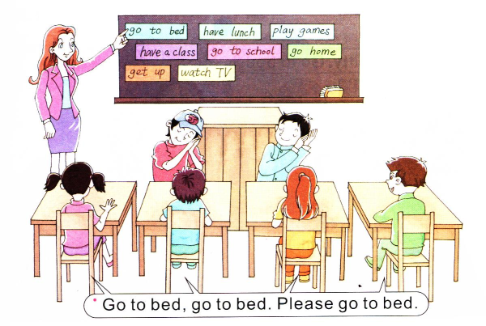
Let’s play
六人一组，仿照例子，四位同学说句子，另两位同学模仿动作，看哪组同学表现得好！

Slide 10
Summary
日常生活中问别人什么时候干什么事用到的句型：
(1)—When do you + 动词短语？
—I…
(2)—Do you + 动词短语？
—Yes, we do./ No, we don’t.
(3)—When does your father/mother + 动词短语？
—He/ She does…

Slide 11
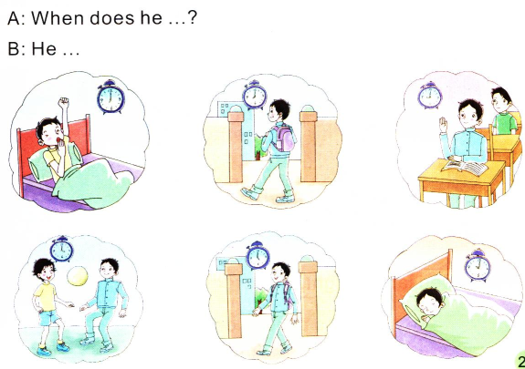
Look and talk
说说练练

Slide 12
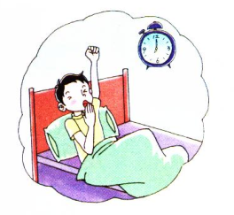
When does he get up?
He gets up at seven in the morning.

Slide 13
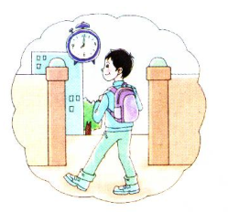
When does he go to school?
He goes to school at eight in the morning.

Slide 14
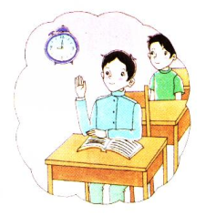
When does he have classes?
He has classes at nine in the morning.

Slide 15
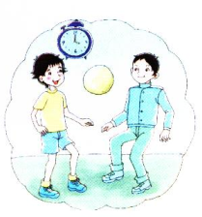
When does he play games?
He plays games at four in the afternoon.

Slide 16
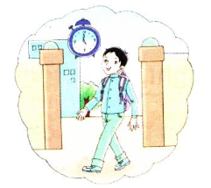
When does he go
home?
He goes home at five in the afternoon.

Slide 17
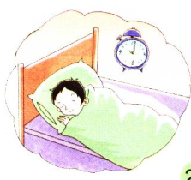
When does he go to bed?
He goes to bed at ten at night.

