Slide 1
Module 10 Unit 2
My mother’s cleaning our house and sweeping away bad luck.
WWW.PPT818.COM

Slide 2
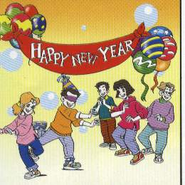
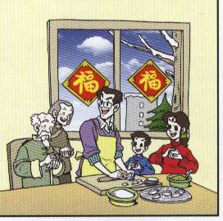
New Year
Spring Festival

Slide 3
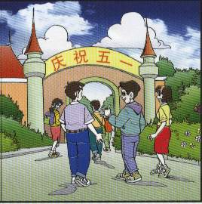
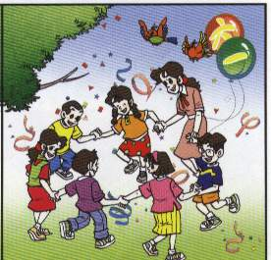
May Day
Children’s Day

Slide 4
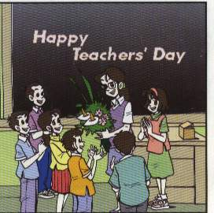
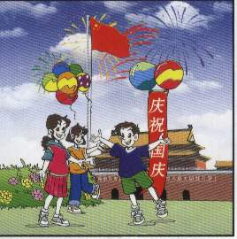
Teachers’ Day
National Day

Slide 5
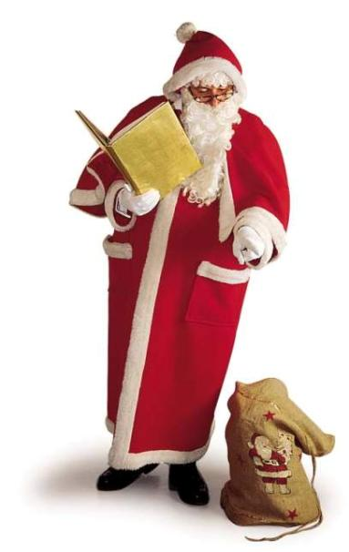
Christmas Day

Slide 6
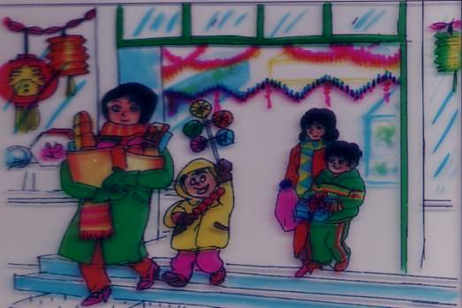
Warming up
Discuss: what do you do during Spring Festival?

Slide 7
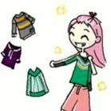
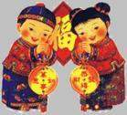
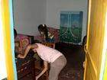
get a hongbao
called lucky money
buy new clothes
watch a dragon dance
visit family and friends
clean the house
have a haircut

Slide 8
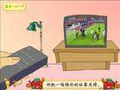
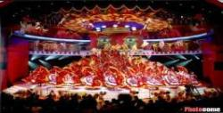
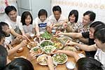
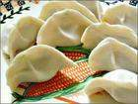
set off the fireworks
firecrackers
watch a special programme on TV
｛
have a big dinner together
eat jiaozi

Slide 9
1.Before the Spring Festival, what do people
do first? Why?
2. What do people do on the evening before
Spring Festival?
3.What presents do we get?
4. When does the Spring Festival begin?

Slide 10
Before the Spring Festival, what do
people do first?
clean houses and sweep away bad luck
buy a lot of things
have a haircut

Slide 11
On the evening before Spring Festival , what do people often do ?
put on new clothes
get lucky money
have a traditional family dinner together
eat jiaozi / dumplings
watch TV
set off fireworks

Slide 12
What do people do during Spring Festival?
visit family and friends
get lucky money
wear new clothes

Slide 13
Spring Festival
Spring Festival is our traditional（传统的） festival. It often begins in January or February. Before the Spring Festival, we…. On the Eve of the Spring Festival, we….

Slide 14
Spring Festival
Spring Festival is the most important
festival in China . On the evening before
Spring Festival ,families get together and
have a big meal .In many places people
like eating jiaozi and setting off firecrackers .
Dumplings are the most traditional food .
Children like it very much because they can have delicious food and wear new clothes .They can also get some money from their parents. The money means good luck . People visit families and friends .People enjoy Spring Festival because they can have a good rest .

Slide 15
现在进行时与一般现在时的用法区别
一．基本用法不同
１．一般现在时用来表示习惯性的动作或状态．
如：She goes to school by bike every day.
2. 现在进行时用来表示现在（说话的瞬间）正在发生或进行的动作或
用来表示现阶段正在进行或发的动作．
如：Look! She is reading under the tree.
二．谓语动词的形式不同
1. 一般现在时的动词（１）be动词用is/am /are三种形式．
（２）实义动词用动词原形或单三s/es形式．
2. 现在进行时的动词 be + v-ing
三．时间状不同
1. 一般现在时常与often, sometimes, always, usually等频度副词连用
还与every morning/day/week…on Wednesday, in the morning
/afternoon/evening等时间状语连用．
2. 与now, at the moment, these days, these weeks等时间状语连用，句首有Look!/Listen!等提示语时，后面句子中的动词一般用现在进行时．

Slide 16
填空：
1. My father always __________(come) back from work very late.
2. The teacher is busy. He __________ (sleep) six hours a day.
3. Listen! Joan __________(sing) in the classroom. She often __________ (sing) there.
4. __________ your brother __________(know) Japanese?
5. Where __________ you __________ (have) lunch every day?
6. The girl __________(like) wearing a skirt. Look! She __________(wear) a red skirt today.

Slide 17
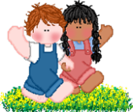
1. She ____ meals for us everyday.
A. cook B. cooks C. cooking
2. She often ____ her sister with English.
A. help B. helps C. helping
3. Tom is getting ready ____ the party.
A. for B. at C. of
4. A fire _____ in that village.
A. happen B. is happening C. happening
5. ___ he sweeping the floor?
A. Is B. Does C. Can
6. - ____they do their homework ?
- Yes, they do.
A. Do B. Are C. Can

