Slide 1
Unit 3
This is my father
WWW.PPT818.COM

Slide 2
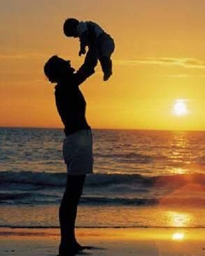
Let’s learn
father
父亲

Slide 3
mother
母亲

Slide 4
father=dad
mother=mum
father, mother用在比较正式的场合。
dad, mum就显得比较随意点，在家可以这么叫。

Slide 5
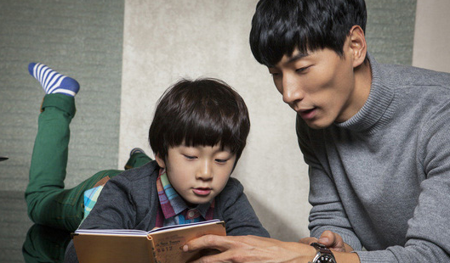
This is my father.
这是我爸爸。

Slide 6
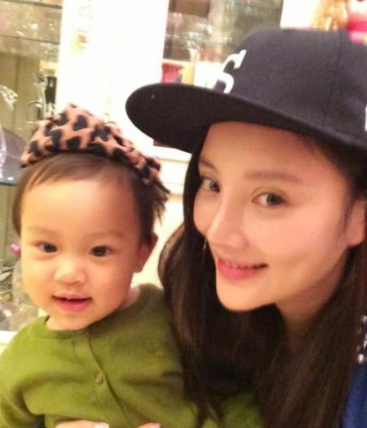
This is my mother.
这是我妈妈。

Slide 7
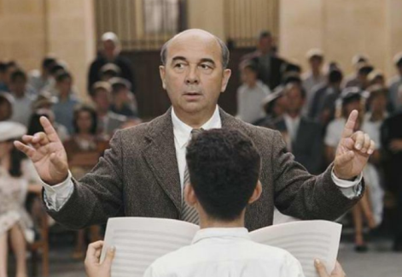
This is my teacher.
这是我老师。

Slide 8
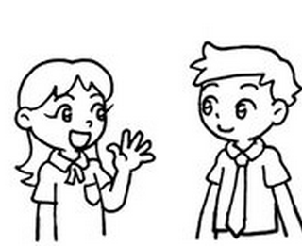
A: Good morning, Miss Wang, this is my father, this is my mother.
B: Pleased to meet you.
A: This is Miss Wang.
C: Pleased to meet you, too.

Slide 9
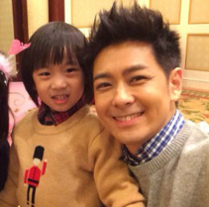
Look and say
This is my ___________.
father

Slide 10
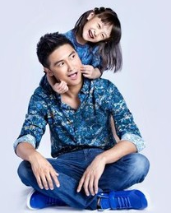
This is my ___________.
father

Slide 11
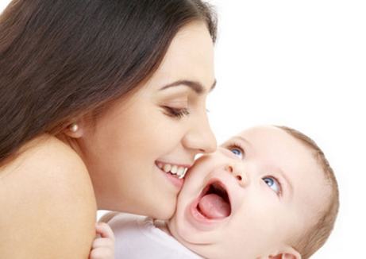
This is my ___________.
mother

Slide 12
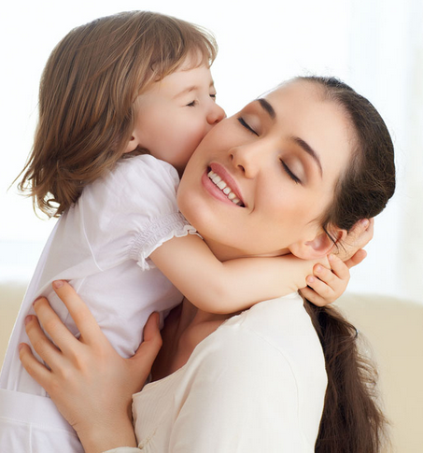
This is my ___________.
mother

Slide 13
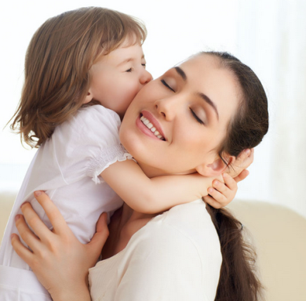
Let’s do
I love my ___________.
mother

Slide 14
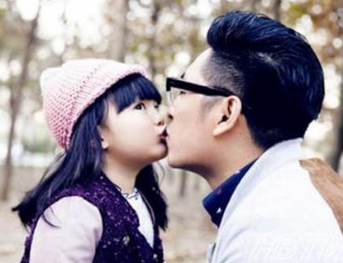
I love my ___________.
father

Slide 15
Let’s talk
This is ……

Slide 16
Homework:
1.熟读本课对话;
2.抄写本课重点单词3遍。

Slide 17
Thank you

