Slide 1
Unit 8 Save Our World!
Protect Our Environment
WWW.PPT818.COM

Slide 2
objectives
To understand the text
To use the words correctly:
again and again
make a difference
make a change
take short showers

Slide 3
Review
Vocabulary

Slide 4
leak
tap
beer
truck
recycling
factory
unlike
again and again
v.&n. 漏；渗漏
n. 龙头；阀门
n. 啤酒
n. 货车；手推车
n. 回收利用
n. 工厂
prep. 不像；与……不同
再三地；反复地

Slide 5
Think about it!
Is your hometown clean enough?
Do you have any ideas for reducing waste?

Slide 6
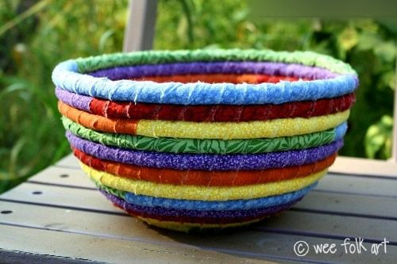
The recycling symbol
The recycling of the old cloth

Slide 7
Christmas Trees Made With Recycled Bottles

Slide 9
Listen and answer.
Where does Katie live?
She lives in Edmonton. It is a city in Canada.
2. What does Katie do to save water?
She takes short showers. She often checks to make sure there aren’t any leaks, and she never forgets to turn off the tap.

Slide 10
3. What pollute the environment most
in her opinion?
She thinks cars and factories
make the most pollution.
4. What does she think of the cars?
Cars pollute the air. She thinks there
are too many cars in Edmonton.
5. How does she go to school?
By bike.

Slide 11
1. Edmonton is a clean city.
2. Katie thinks cars and
factories make the most pollution.
3. Buses make more pollution than
cars.

Slide 12
Reading

Slide 13
Read and tick the points mentioned in the lesson.
√
sort garbage at home
reuse plastic bags
bring your own bag when you go shopping
ride bikes or take buses
pick up rubbish off the street
turn off the lights when you leave a room.
turn off the television and shut down the computer when you are not using them
take short showers
√
√
√

Slide 14
What can we do to help the environment? Read and match.
open a window instead of turning on the air conditioning.
use both sides of the paper.
throw garbage on the ground.
sort the waste before throwing it away.
cut down trees in forests.
turn off the tap when we are brushing our teeth.
We should
We shouldn’t

Slide 15
Language Points

Slide 16
1. I take short showers.
take a bath, have a bath, take a shower
洗澡
bathroom: 洗澡间；浴室
bathtub: 浴缸
起床后，我就到浴室冲了个澡。
After getting up, I go into the bathroom and take a shower.

Slide 17
2. In fact, if each of us makes a small change in our life, we can make a big difference to our environment.
make a change 意思是“做改动，改变”
Can I make a change in my reservation?
我能改变预定吗？
I think we need to make a change.
我觉得我们得做些改变。

Slide 18
make a difference意为“有影响；起(重要)作用”。如：
错走一步对我的前程会产生很大影响。
A false step will make a great difference to my future.
身为教师，你们必须坚信你们能够影响学生的一生。
As teachers, you must believe that you can make a difference to the lives of your students.

Slide 19
Fill in the blanks
make a difference
What you do now can ______________ (起重要作用) to your future.
My grandmother tells me the story __ ______________ (再三地).
She knew in that moment that she needed to _____________ (做出改变).
Whether he ____ __ _____(骑车) or takes a bus, he always attends class on time.
again and again
make a change
rides
a
bike

Slide 20
Time for Reflection
take a shower
make a change
make a difference
again and again

Slide 21
Homework
Review Lesson 46.
2. Finish off the activities on page 121.

Slide 22
Preview
1. Learn the words in Lesson 47 by heart.
2. Read the text in Lesson 47 and underline the useful phrases.

