Slide 1
Unit 6 Be a Champion!
2800 Years of Sports
WWW.PPT818.COM

Slide 2
Learning Targets
Key words & phrases:
BC, athlete, compete, Olympia, married, host, Olympic, amazed, spirit, represent, compete against, take part in, take place, every four years, be amazed at
Key sentences:
1. Have you ever watched the Olympics on TV?

Slide 3
2. The ancient Greeks wanted to have the best athletes compete against each other.
3. Women couldn’t take part in the games.
4. I also found out that the modern Olympics began in 1896 and took place every four years.

Slide 4

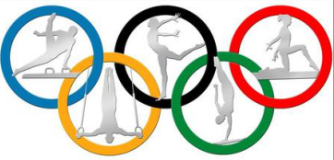
Lead in
What do you know about the history of Olympics ?

Slide 5
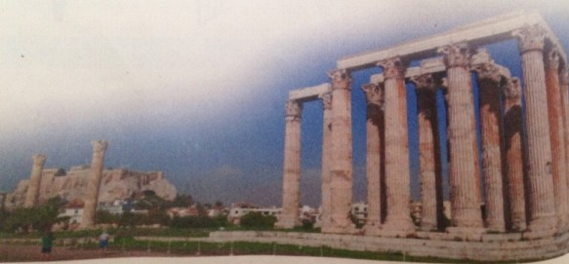
奥林匹克运动会（简称奥运会）是国际奥林匹克委员会主办的包含多种体育运动项目的国际性运动会，每四年举行一次。奥林匹克运动会最早起源于古希腊，因举办地在奥林匹亚而得名。奥林匹克运动会现在已经成为了和平与友谊的象征。

Slide 6
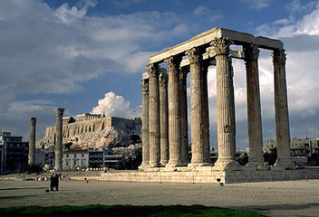
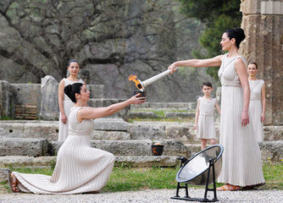
When we look at the pictures, we will think of …
Olympia
Olympic Games

Slide 7
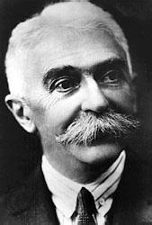
Pierre de Coubertin
the father of modern Olympics

Slide 8
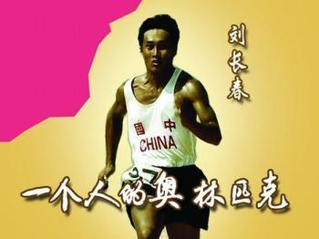
What else do you know about the
history of the Olympics?
1932年，刘长春作为中国体育代表团的唯一成员，首次参加第10届洛杉矶奥运会。

Slide 9
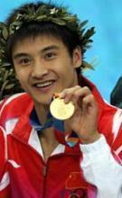
Do you know who he is ?
Tian Liang is an athlete. He won the gold
medal at the 27th Olympics. In 2000,
Australia hosted the 27th Olympic Games. He is married and has a lovely daughter.

Slide 10
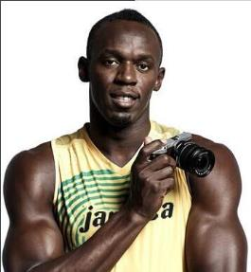
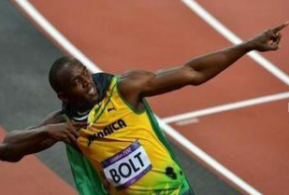
Bolt is a famous athlete. He broke several
world records. He competed against five top
runners at the 30th Olympics and won the
champion. He is the fastest runner. He
represents Jamaica. Many people are amazed
at his success.

Slide 11
Words and expression
BC
athlete
compete
Olympia
married
host
公元前
n. 运动员
v. 竞争；比赛
奥林匹亚（地名）
adj. 结婚的；已婚的
v. 主办；主持（活动）
n. 主人

Slide 12
Olympic
amazed
spirit
represent
compete against
take part in
take place
every four years
be amazed at
adj. 奥林匹克运动会的
adj. 惊奇的；惊讶的
n. 精神；精灵
v. 代表；象征
与……竞争；对抗
参加……
发生；举行
每四年
惊讶于……

Slide 13

Think about it
Have you ever watched the Olympics on TV? What did you watch?
Do you think the Olympics are important? Why or why not?

Slide 14
Presentation
Ⅰ. Read the lesson and match the questions with the answers.
In 1896.
In 2008.
Yes, it was.
In 776 BC.
In Greece.
When did the Olympics begin?
Where did the ancient Olympics start?
When did the first
modern Olympics begin?
4.When were the Beijing Olympics?
5.Was this the first time for China to hold the Olympic Games?

Slide 15

Ⅱ . Listen to the passage and fill in the blanks.
The Olympic Games are ______and ____. The ancient Olympics started in _____BC and lasted for more than a thousand years. They took place every four years. _________could not compete in the ancient Olympics. In 1896, a ___________ started the modern Olympic Games. He believed the games would help bring __________and fair play to people all over the world. Now there are ________and _________Olympics every four years.
new
old
776
Women
Frenchman
friendship
Summer
Winter

Slide 16
Ⅲ. Fill in the blanks with the correct forms of the words. The first letter is given.
Although Guo Wenjun was m________ and had a baby, she still practiced hard for the Olympics and finally won a gold medal.
Xu Haifeng won the first Olympic gold medal at the Los Angeles Olympics in 1984. Since then, Chinese a________ have achieved excellent performances throughout the world.
arried
thletes

Slide 17

3. London is an old but m________ city. It was the h_____ of the 30th Olympic Games. Over two hundred countries and districts c__________ in the games.
odern
ost
ompeted

Slide 18
Ⅳ. Let’s do a quick quiz!
1. Who is the father of modern Olympics?
2. How many sports did the first ancient Olympics have?
3. How many countries took part in the first modern Olympics?
4. When were women allowed to compete in the Olympics?
5. Who was the first Chinese athlete to take part in the Olympics?
Now try to find more facts about the Olympics.

Slide 19
Language points
1.Have you ever watched the Olympics on TV？
(1)此句是现在完成时的一般疑问句，其结构为：Have/Has＋主语＋动词的过去分词＋其他？当主语是第三人称单数时要用has。
例：Has she finished her homework？她完成家庭作业了吗？
(2)ever adv.曾经；在任何时候。它多用于一般疑问句、否定句和条件状语从句中，常与现在完成时态连用。

Slide 20
例：Have you ever been to Beijing？你曾去过北京吗？Haven't you ever been there alone？你从未单独去过那里吗？
If you ever come to Beijing，please let me know.如果你来北京的话，请告诉我。
2.Did anyone find out when the Olympics began？
find out找出，查清楚。它多指通过调查、询问、研究之后搞清楚、弄明白，通常含有经过困难、曲折的经历最终弄清楚较难找到的、抽象的东西。

Slide 21
例：Can you find out when the flight will take off？
你能查出这次航班何时起飞吗？
3．The ancient Greeks wanted to have the best athletes compete against each other.
(1)athlete n．运动员。它为可数名词，其复数形式为athletes。
例：Which athlete is the champion？
哪位运动员是冠军？

Slide 22
(2)compete against 与……竞争；对抗。其后接对手，相当于compete with。
例：Our school football team competed against the team from Yuhua Middle School.
我们校足球队和来自育华中学的足球队进行了比赛。
4.Women couldn't take part in the games.
【辨析】take part in、join in与join
三者都有 “参加，加入” 之意，但有区别。

Slide 23
①take part in指参加某项活动、集会等并在其中发挥作用。
例：Last week I took part in the school sports meet.
上周我参加了学校运动会。
②join in表示参加某项运动、比赛等，多指正在进行的活动。
例：May I join in the game？我可以参加这个游戏吗？
③join指加入到某一组织、团体中并成为其中的一员。
例：When did you join the Party？你什么时候入的党？

Slide 24
5.Married women couldn't even watch the games！
married adj.已婚的。常用短语：be married结婚(表状态)。
例：He has been married for two years.他已结婚两年了。
6．I also found out that the modern Olympics began in 1896 and took place every four years.
(1)【辨析】take place与happen
take place举办，发生。常指(某事)按计划进行或发生。
happen：
①发生。指某事偶然发生或未能预见的事情发生。

Slide 25
②碰巧，恰好。固定搭配：happen to do sth.碰巧做某事。
例：Our school sports meeting takes place every year.我们学校的运动会每年举办一次。
(2)every four years每四年(一次)。every意为“每一”， “every＋基数词＋单位名词” 表示 “每过……一次”，表示频率，因此用how often对其进行提问。其中数词通常是大于一的数，单位名词用复数。

Slide 26
例：Mr.Zhao goes to Shenzhen every three years.
赵先生每三年去深圳一次。
7. In 2008，China hosted the 29th Olympic Games. host v．主办；主持(活动)。
例：Which country is going to host the next World Cup？哪个国家将举办下一届世界杯？
8.One thing has not changed about the games—athletes compete in a spirit of fair play.

Slide 27
spirit n．精神。常用短语：in good/low spirits心情好/不好；in high spirits情绪高涨；keep one's spirits up使某人保持心情愉悦；raise/lift one's spirits鼓舞某人的情绪。
例：The long hot summer days lift our spirits.
悠长火热的夏日让我们精神振奋。
9.They also represent their countries at the highest level.

Slide 28
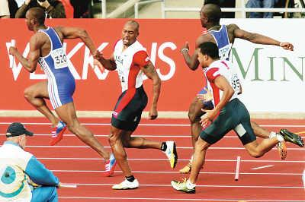
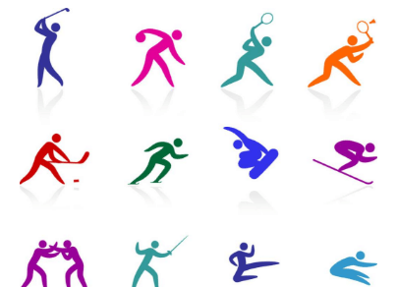
represent v．代表；象征。
例：They represented only a small section of public opinions.他们仅代表了一小部分民众的意见。

Slide 29
Exercises
Fill in the blanks with correct words.
Do some ________ (研究) on what is more or less healthy.
But the Olympics is the goal of every ________ (运动员).
Many businesses ________ ________ (与……竞争) each other for profits.
Tonight she ______ (举办) a ball for 300 guests.
research
athlete
compete against
hosts

Slide 30
5. When you _____ _____ ____ (参加) any performance, you get out as much as you put in.
6. The meeting will______ _____(举行) later this afternoon.
7. When you respect yourself, you‘ll be ________ (感到惊奇的) at the opportunities the world presents you.
8. It can ___________ (代表) all the Chinese.
take part in
take place
amazed
represent

Slide 31

Summary
Learn some new words and expressions.
Learn about the history of the Olympics.

Slide 32
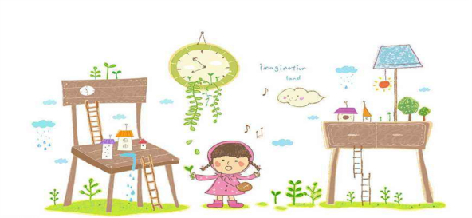
Homework
Find more facts about the Olympics and talk about them.

