Slide 1

Unit 4 My friends
第一课时
WWW.PPT818.COM

Slide 2
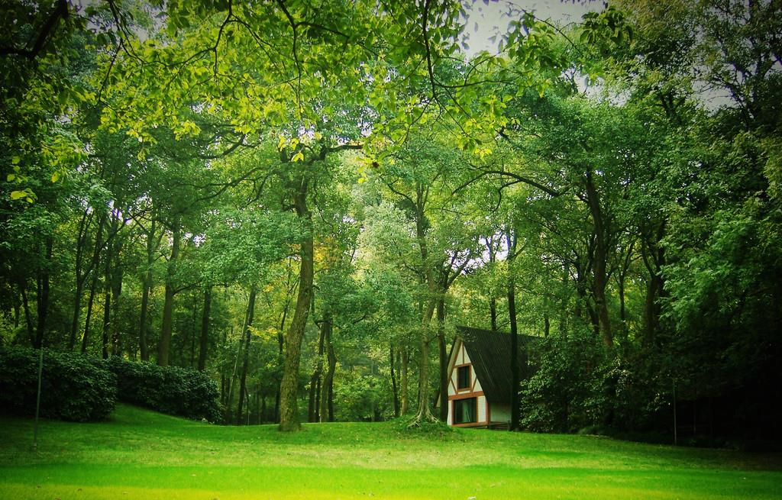

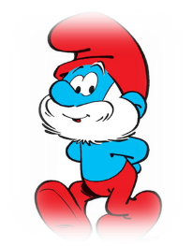
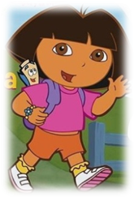
He is in the castle. You must make 5 breakthroughs to get there. Good luck!
Please tell me where is he!

Slide 3
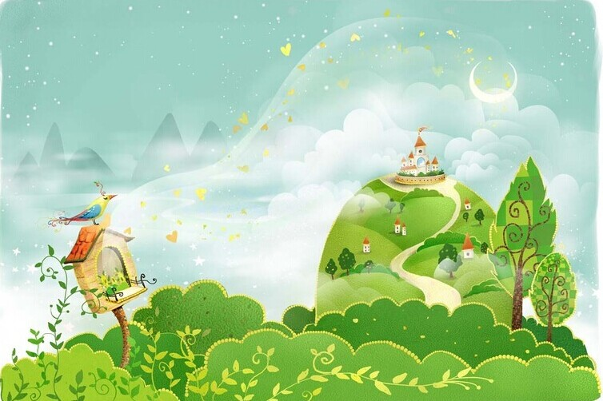
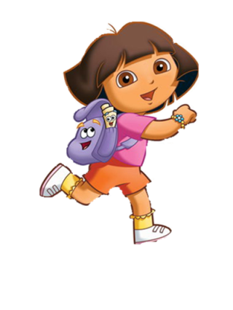
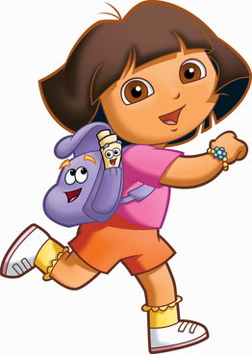
Let's find Boots.

Slide 4
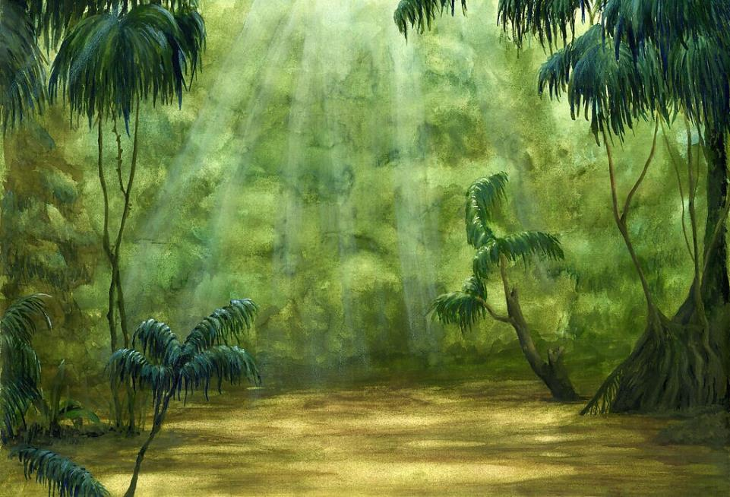
Dora's friend is in the castle.
Let's find him!
。

Slide 5
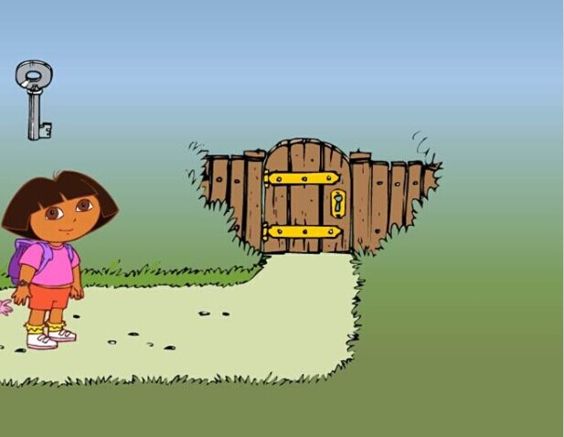

Round1：Make the door opened

Slide 6

a
f ___ t
Fat, fat, he’s fat.

Slide 7

t ___ i ___
h
n
Thin, thin, she’s thin.

Slide 8

___ ___l l
t
a
Tall, tall, it’s tall.

Slide 9
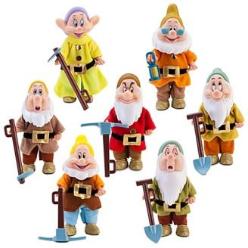
sh___ ___ t
o
r
Short, short, they’re short.

Slide 10

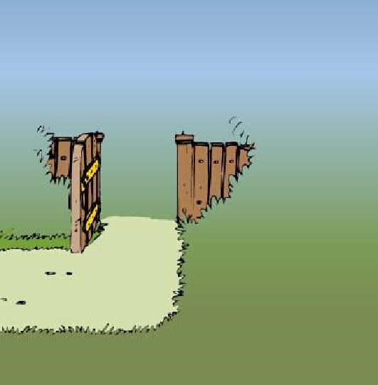
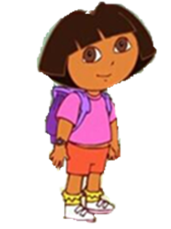
Wonderful!
The door is opened.
Let’s move on!

Slide 11
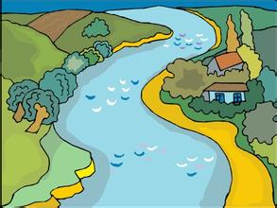
Round2：Go through the river

Slide 12




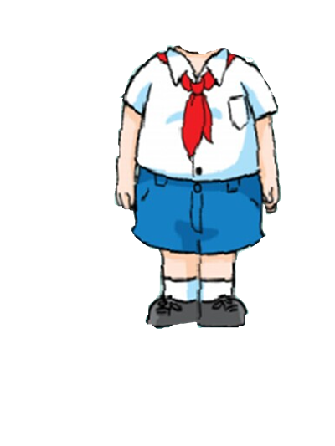

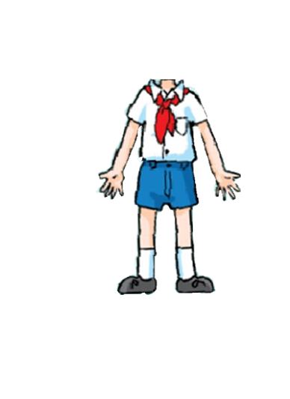
Notes:
12

Slide 13

比一比：看谁拼得又快又准确！
2
1

Slide 14
比一比：看谁拼得又快又准确！
4
3

Slide 15


Wonderful!
Here is a bridge.
Let’s move on!

Slide 16

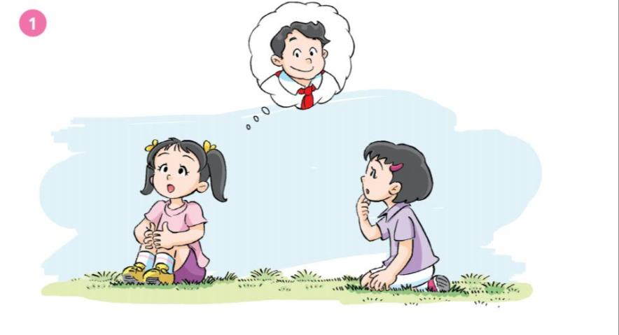
He’s my friend.
He’s tall.
Is he Joe?
Yes, he is.

Slide 17
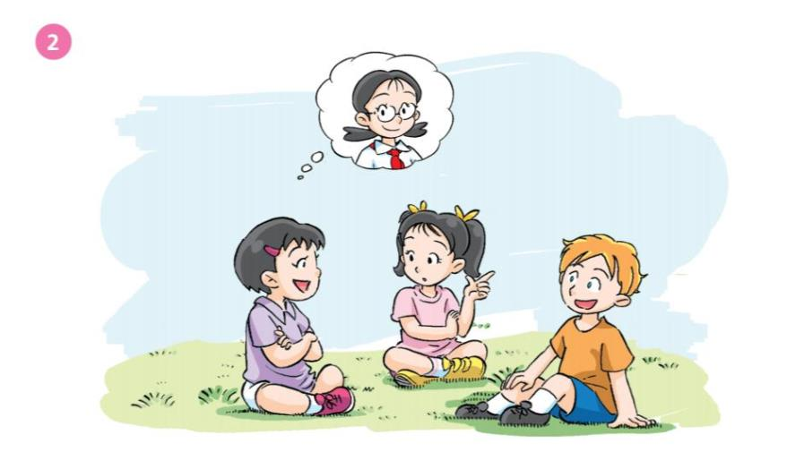
She’s my friend. She’s thin.
Is she Mary?
No, she isn’t.
Is she Kitty?
Yes, she is.

Slide 18
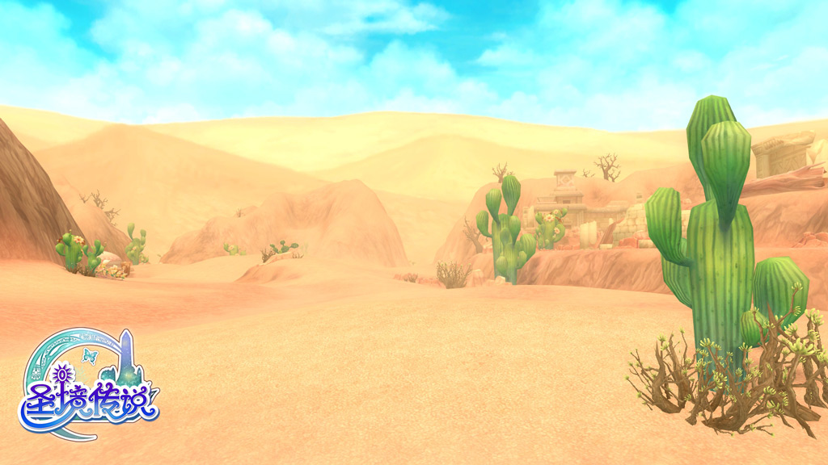




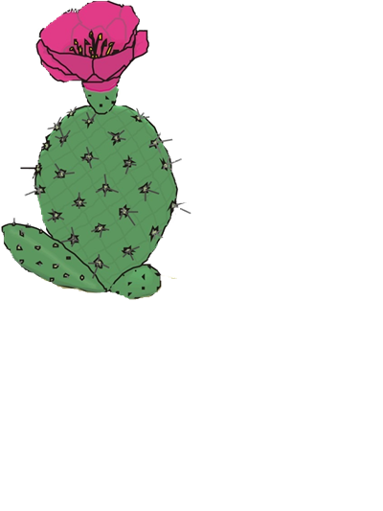
Round3：Across the desert

Slide 19

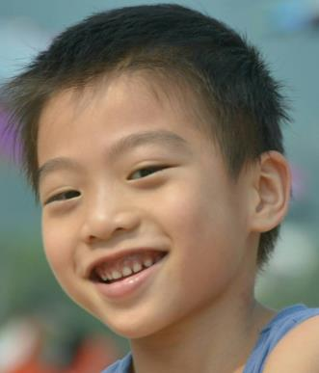
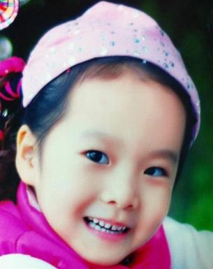

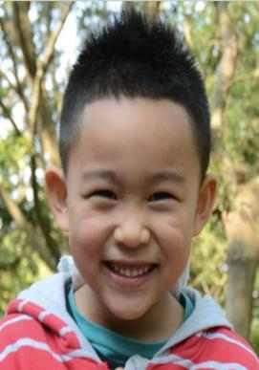








Guess, who is he/she?
Is he/she......?
Yes,he/she is.
No, he/she isn't.

Slide 20
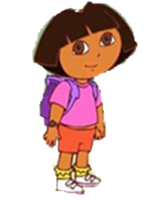

Wonderful！Along the path，
let’s move on!

Slide 21



Round4：Climb over the wall
。

Slide 22
pair work
A：He's/ She's my .......
He's/She's .......
He/She can......
B：Is he/she......?
A：Yes, he/she is.
No, he/she isn't.

Slide 23

Wonderful！
We're safe.
Let’s move on!

Slide 24

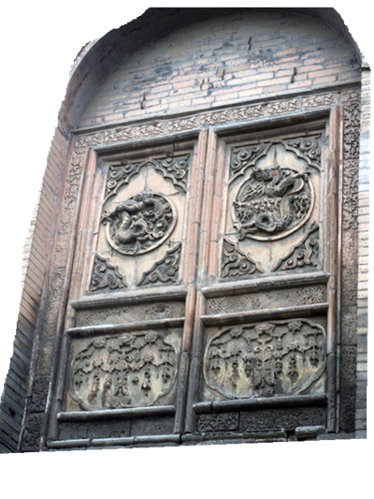

Round5：Say the password

Slide 25
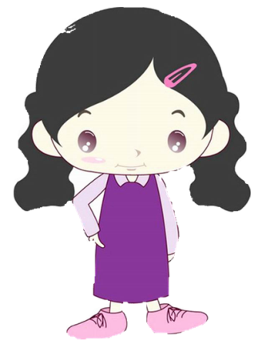
What’s missing?
g
___i r l
g
G
Big G, little g,
/g/ /g/ /g/.
/g/ /g/ girl.

Slide 26


G
g
Notes:
26

Slide 27
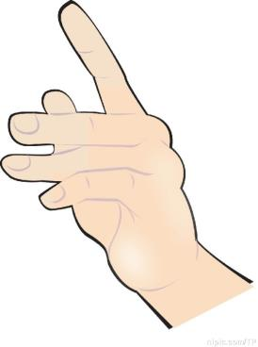
What’s missing?
__a n d
h
h
H
Big H, little h,
/h/ /h/ /h/.
/h/ /h/ hand.

Slide 28
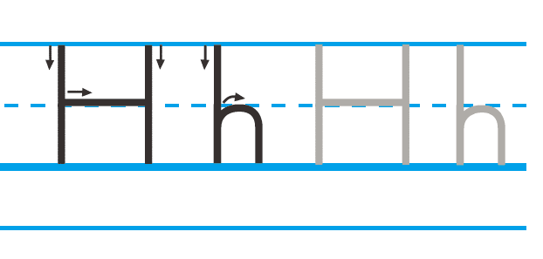
H
h
Notes:
28

Slide 29
Let’s make a new chant!
G for goat.
H for high.
I’m a goat.
I can't jump high.

Slide 30
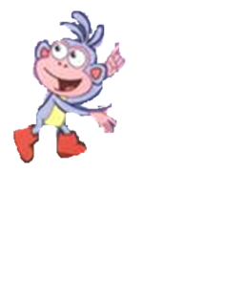
Oh! Boots!
Come to me!

Slide 31

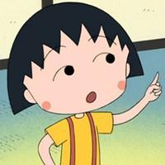

Draw and say
This is ...
He’s/ She’s my friend.
He / She has…
He’s /She’s…
He / She can…

Slide 32


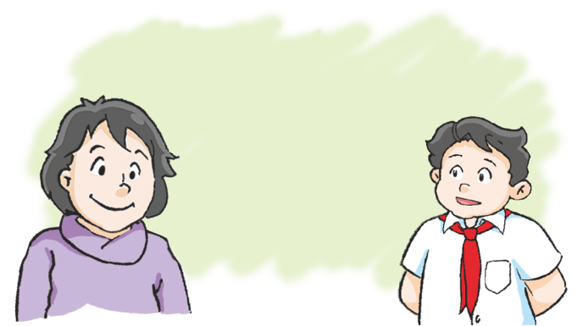
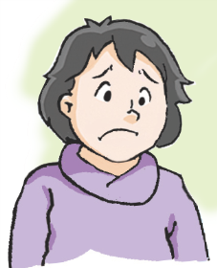
You’re fat, Mrs. Wang.
Why is Mrs Wang unhappy?
Notes:
32

Slide 33


strong
fat
big
chubby
plump

Slide 34


1.Iintroduce your friend to your parents by using the sentences：This is… He’s/ She’s my friend.
He’s/ She’s…. She has… She can…
2.Trace and write letters Gg and Hh
3.Make a new chant by using letters Gg andHh

