Slide 1
陕旅版四年级上册
Unit 2 What Do They Have on the Farm? 第4课时
WWW.PPT818.COM

Slide 2
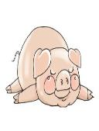
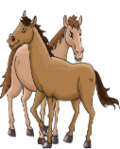
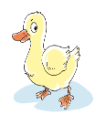
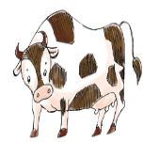
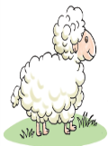
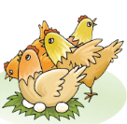
听音猜动物

Slide 3
教学目标： 通过Part B部分的活动和Part C部分的练习，对本单元所学的有关动物的单词和功能句型进行复习和检查。

Slide 4
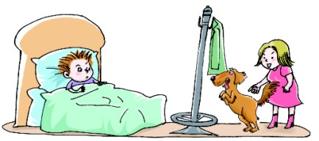
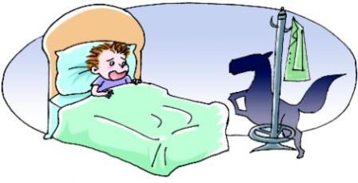
Read a story
No. It’s a dog.
Mommy! There’s a horse in my bedroom.

Slide 5
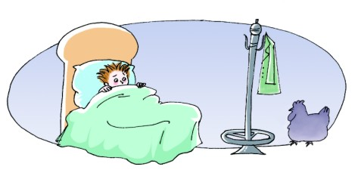
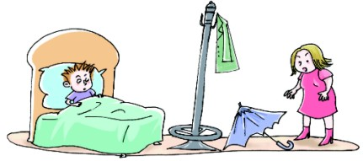
No. It’s an umbrella.
Mommy! There’s a hen in my bedroom.

Slide 6
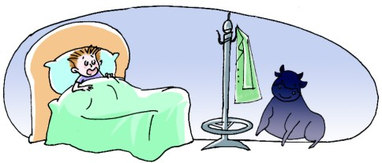
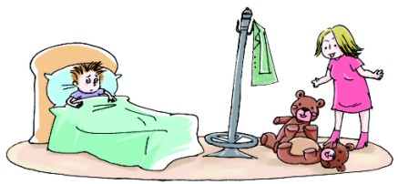
No. They are Teddy Bears.
Mommy! There’s a cow in my bedroom.

Slide 7
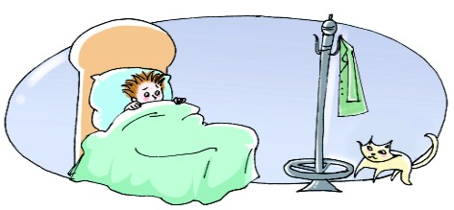
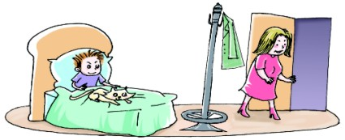
OK. Good night, dear!
Mommy! Look! It’s Mimi. I’m happy.

Slide 8
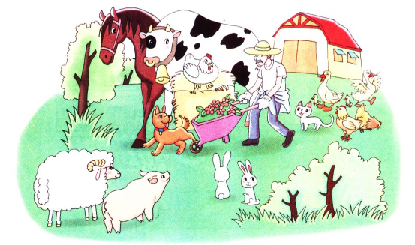
Look and say
Grandpa has…
There is / are … on the…

Slide 9
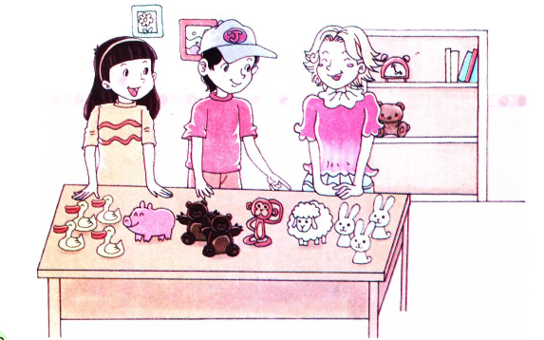
Talk in pairs
A: What does Li Shan have?
B: She has…

Slide 10
Talk in pairs-看图表演对话
一名学生扮演Li Shan,看图表达I have…
两人一组，一位学生扮演Liu Zhaoyang,另一位扮演他的朋友Alice, Liu Zhaoyang向Alice介绍Li Shan.
Liu Zhaoyang: This is my friend Li Shan.
Alice: What does Li Shan have?
Liu Zhaoyang: She has…

